Slide 1
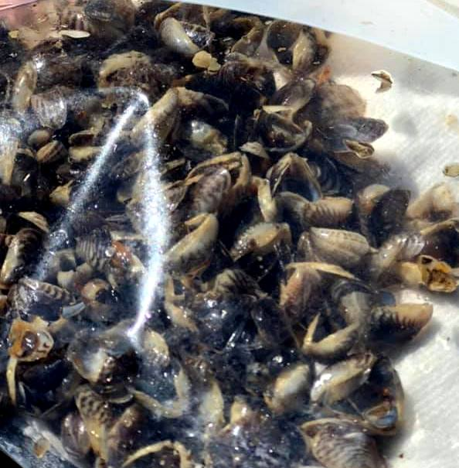
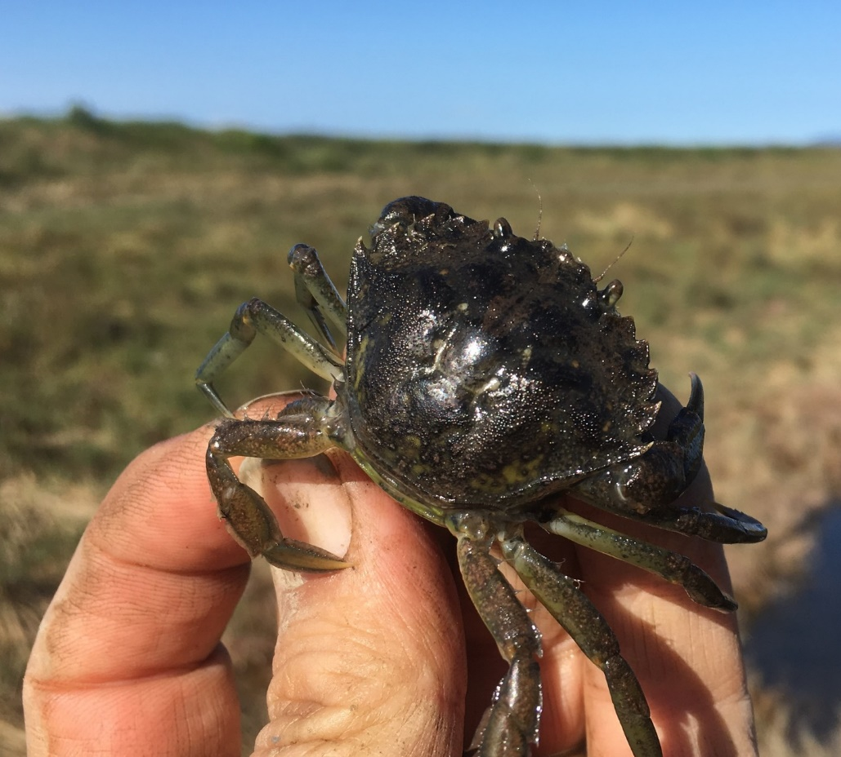
Aquatic Invasive Species
Notes:
Ask students for reasons they think wildlife should be managed. You can write their reasons on a board, or a whiteboard.

Slide 2
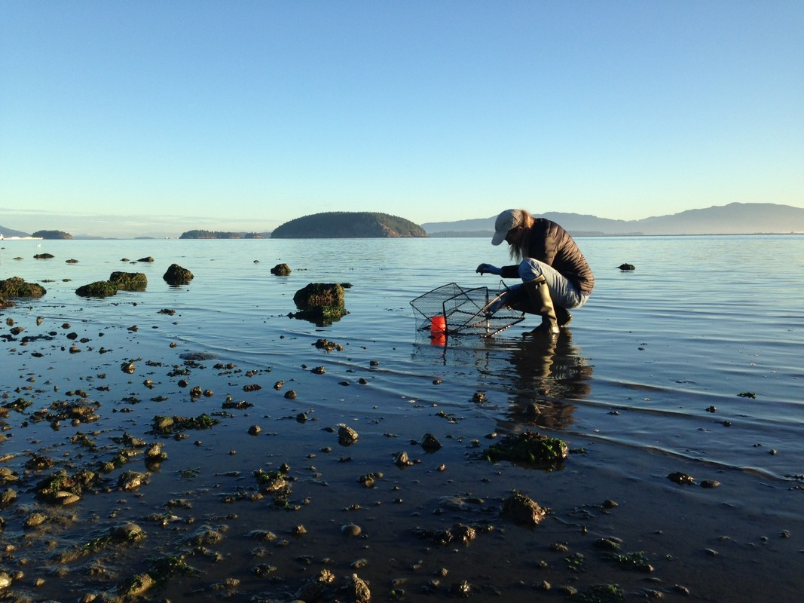
What are aquatic invasive species (AIS)?
Can you remember what invasive species are?
Aquatic invasive species are invasive species that live in water.
Notes:
Have students recall the introductory invasive species PowerPoint and have them think-pair share as a class about what it means for a species to be invasive.
Invasive species outcompete species who have evolved in their ecosystems for millennia. Often, they take over entire ecosystems reducing biodiversity and ecosystem services.

Slide 3
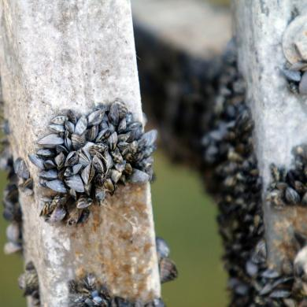
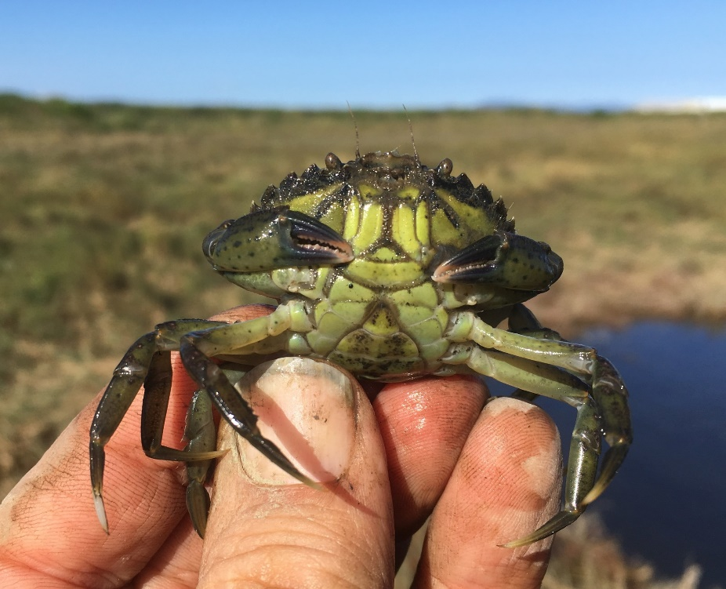
AIS of greatest concern for Washington
Zebra/Quagga mussels
European green crab
Notes:
The two largest aquatic invasive species of concern are zebra and quagga mussels and European green crab. European green crab has presence in Washington, where as the mussels do not.

Slide 4

European Green Crab (Carcinus maenas)
A globally damaging invasive species.
Ecological impacts to food webs, which could negatively impact ecological and cultural resources of the Salish Sea.
Let’s learn more
Notes:
First bullet: these crabs that pose a threat to Washington's economic, environmental, and cultural resources.
Second bullet: potential threats include: destruction of eelgrass beds and estuarine marsh habitats, threats to the harvest of wild shellfish and the shellfish aquaculture industry, the Dungeness crab fishery, salmon recovery.
The movie takes you to a four-minute video on European Green crab work in Washington.

Slide 5
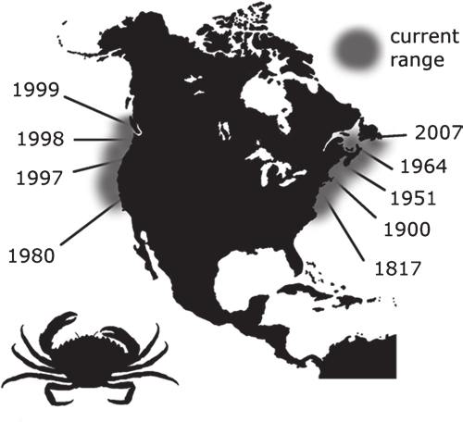
Where did they come from?
European green crab distribution extent (Jeff Adams WSG)
Native to NE Atlantic Ocean and Baltic Sea, ranging from Northern Africa to Norway and Iceland
19th century introduction to the eastern part of US, NY or NJ.
1989-90 California, colonized San Francisco Bay.
1997 Oregon, Coos Bay, Tillamook, Yaquina, Netarts…
1998 Washington, Grays Harbor and Willapa Bay, Makah and Dungeness Spit (2017)…
2013 Sooke Basin, BC.

Slide 6
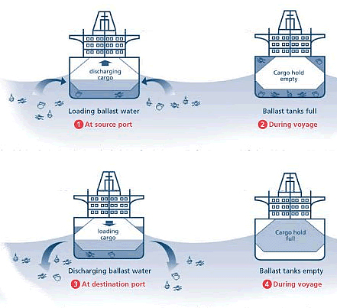
How did they get here?
Not 100% known.
  Most likely arrived via ballast water to the US.
Northward distribution from CA also unknown.
  Transport of larvae by ocean currents
  Ballast water exchange.
  Transfer of live shellfish, bait, or aquaculture equipment.
Uniform distribution likely suggest dispersal of larval stages.
Ballast water – hitch-hiking invasive species. Source: http://globallast.imo.org/

Slide 7
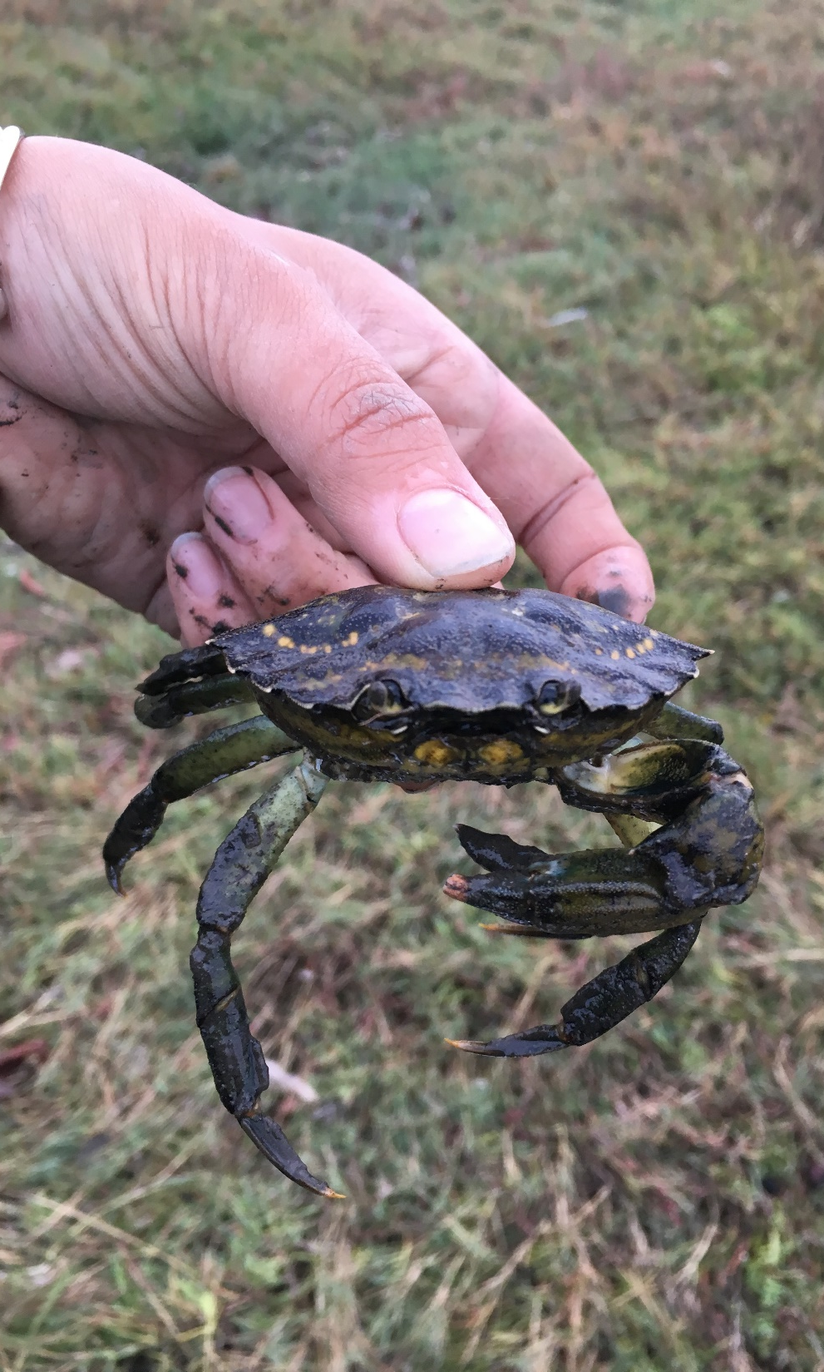
Why do we care?
Potential to alter any ecosystem where they become established.
Threat to our native Dungeness crab.
    UW study found that European green crab can out compete Dungeness for food and habitat.
    They can improve prey-handling skills while foraging.
Prey on bivalves and other crustaceans (clams, oysters, mussels, small crustaceans).
    Humbolt Bay, CA: manila clam harvest has dropped 40% since establishment.
Compete with native fish and shore birds for food.

Slide 8
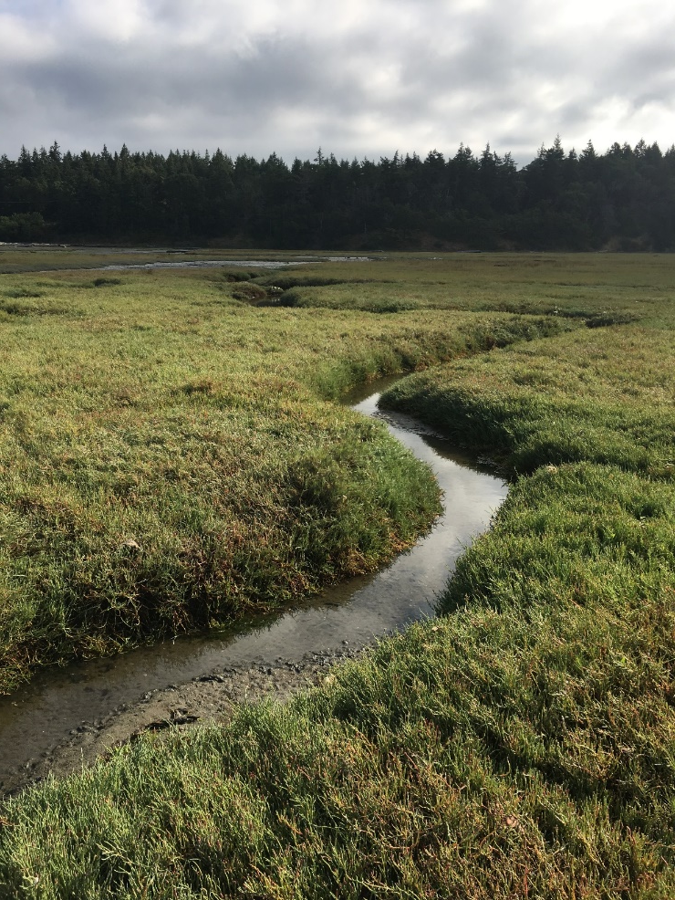
Where are they found?
Habitat
    Protected rocky shores
    Cobble beaches
    Sandflats
    Tidal marshes
    Pocket estuaries
Temperatures 0-33°C (32-92°F)
They have wide tolerances and can be found in areas you wouldn’t expect to see them.

Slide 9
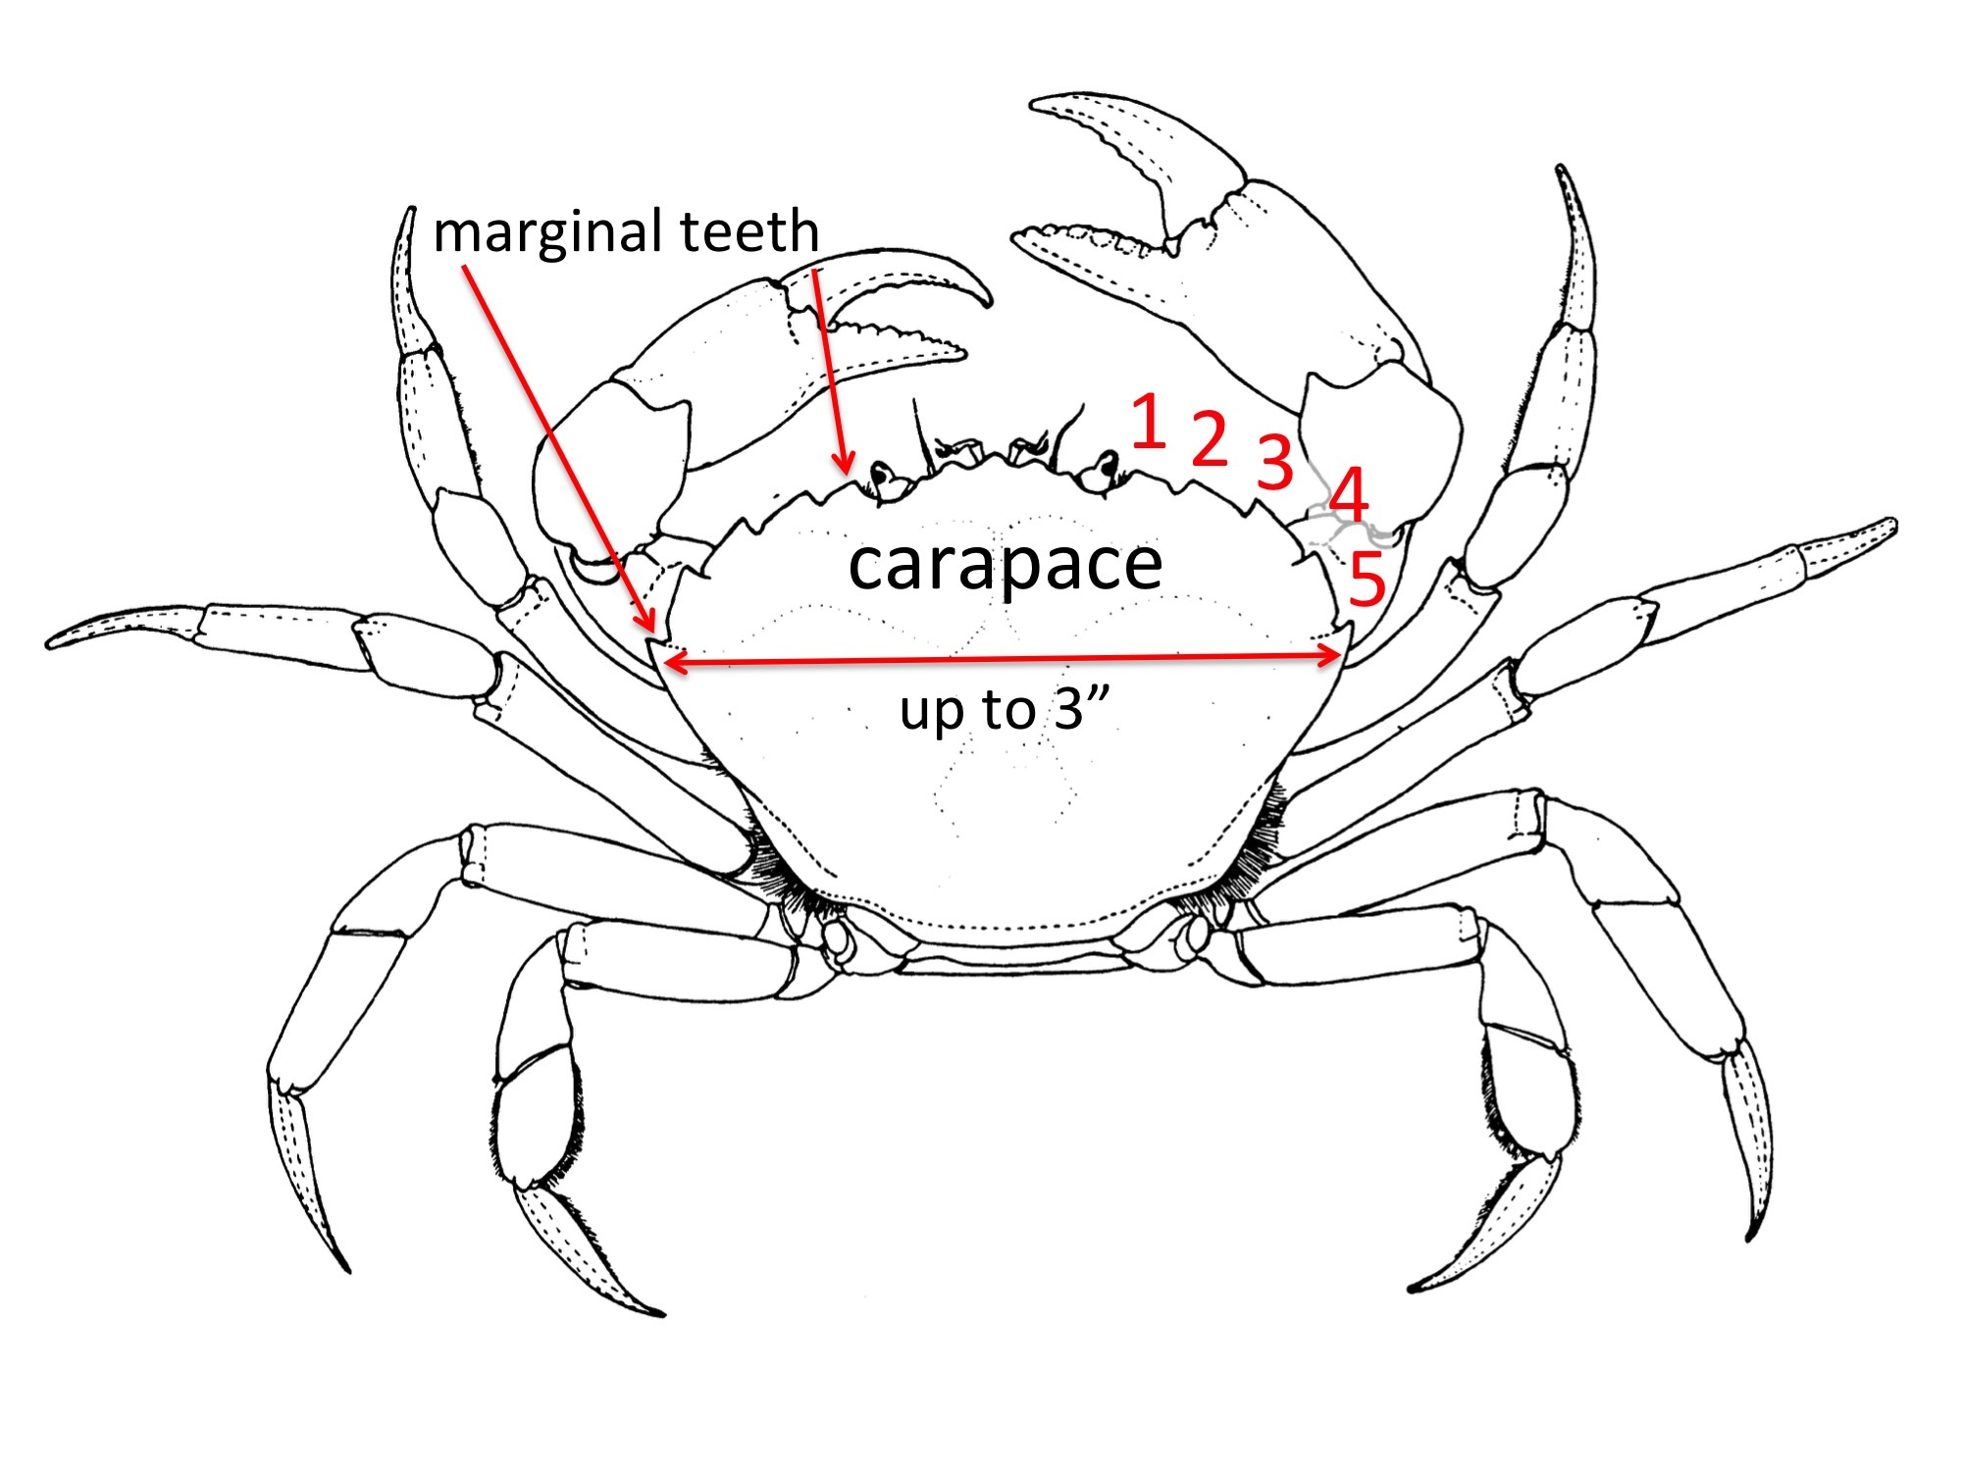
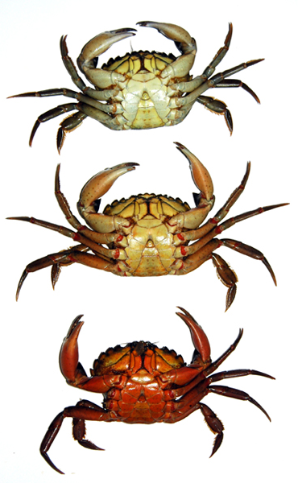
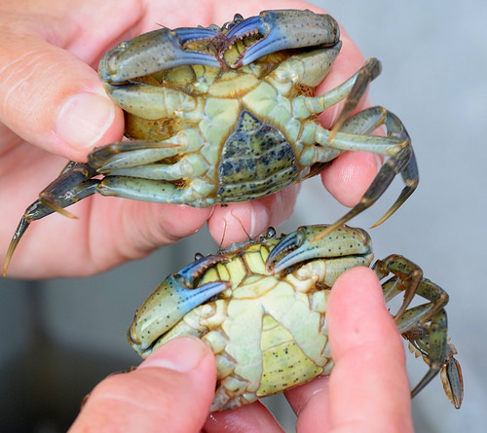
How do I know if I’ve seen one?
Five spines (marginal teeth)
Not always green
Can reach four inches (100mm+)
http://www.asnailsodyssey.com/LEARNABOUT/CRAB/crabComp2.php
https://pugetsoundblogs.com/waterways/files/2016/09/diagram.jpg
http://www.flickriver.com/photos/tags/europeangreencrab/
Jeff Adams (WSG) Presentation (Stevens et al 2014)

Slide 10
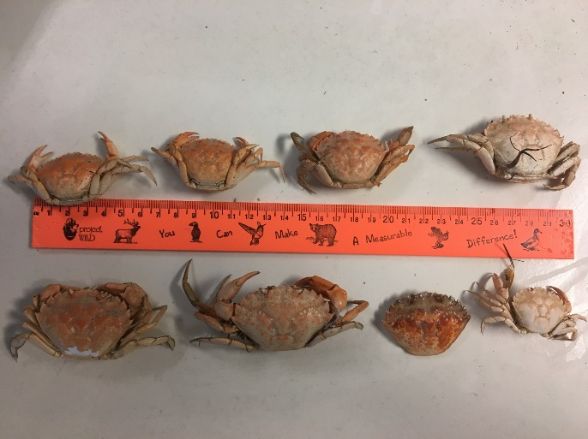
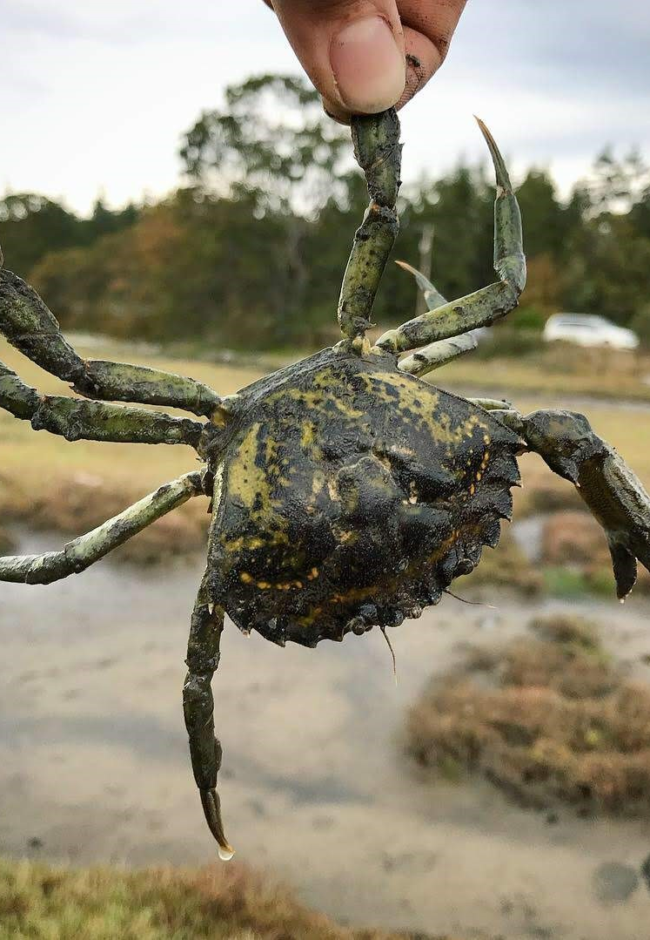
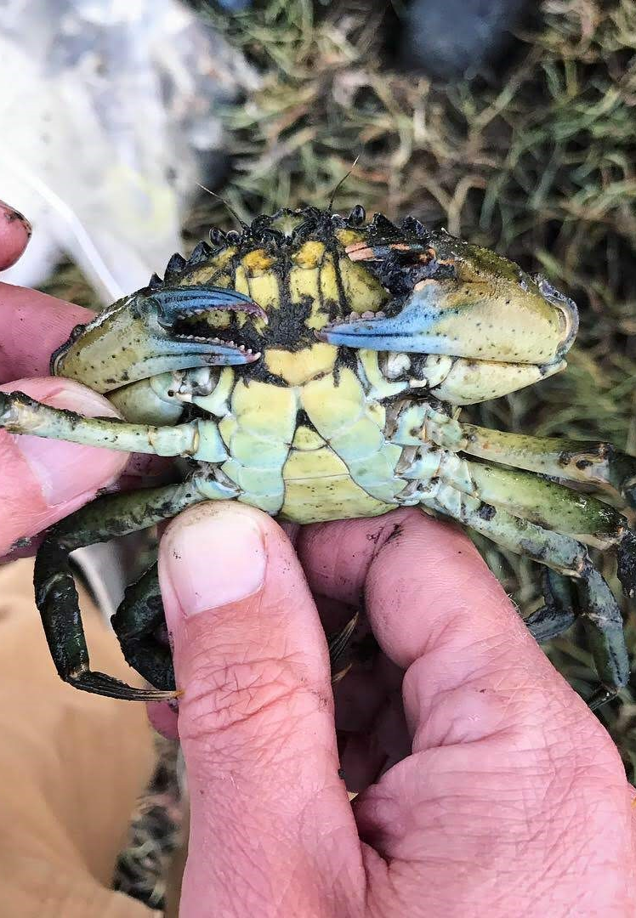
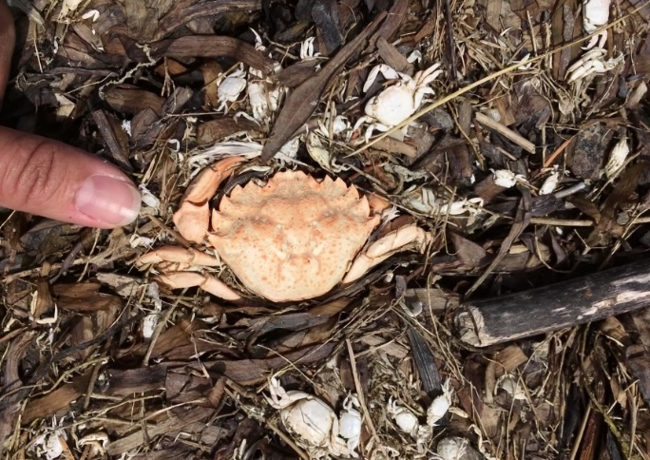
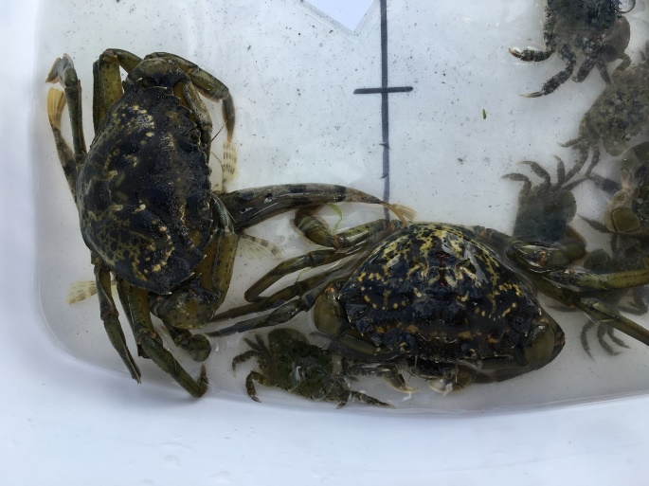
What do they look like?
Come in a variety of sizes and colors.

Slide 11
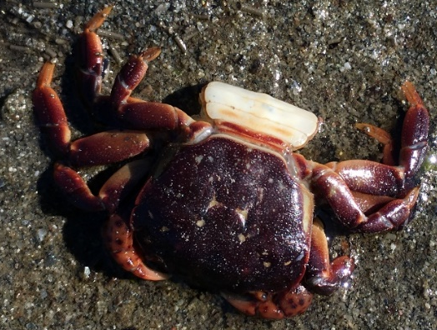
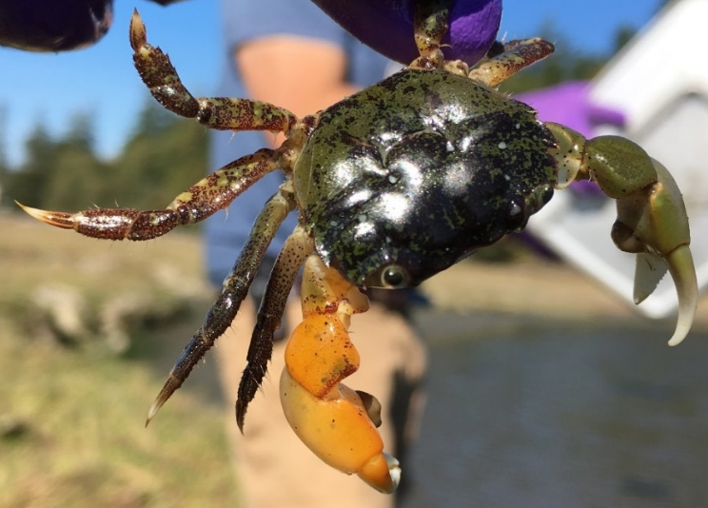
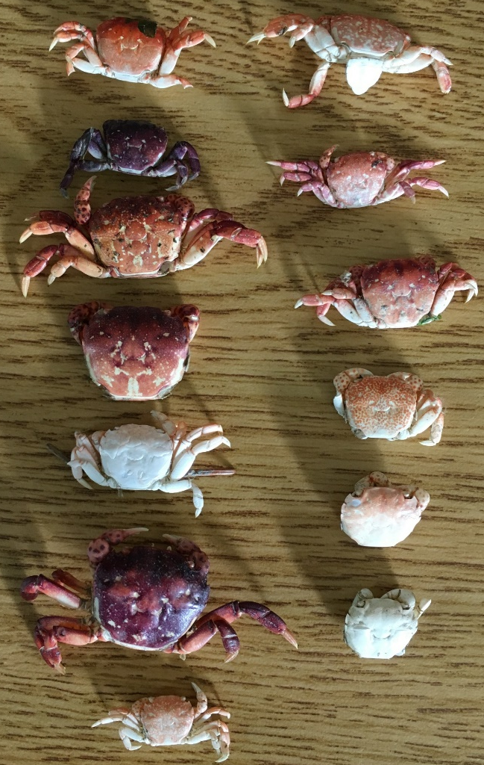
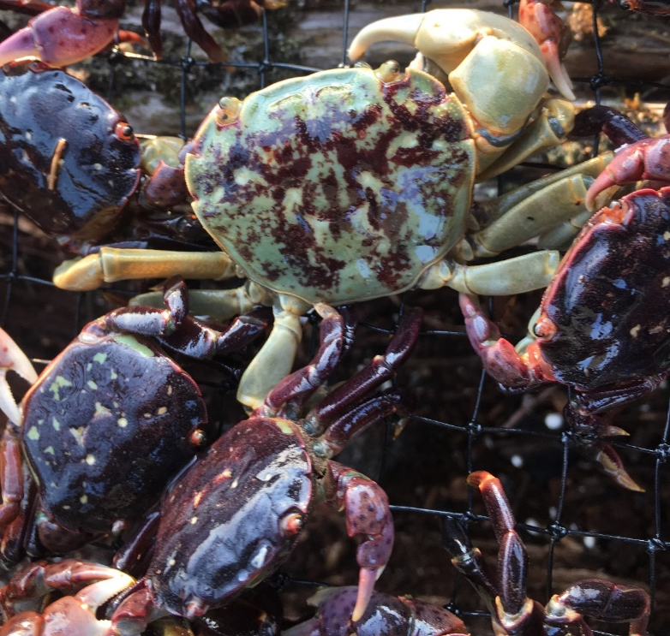
Look A-Likes
Native Shore Crabs
  Hairy shore crab
  Purple shore crab
Notes:
Some of our native crabs are green, leading people to mistakenly kill native crabs. WDFW asks that you do not kill any potential European green crabs that you find, but instead report them to WDFW or the Washington Invasive Species Council.

Slide 12
How to report a sighting
Take a photo and get a GPS and length if possible.
Washington Invasive Species Council
    Emergency Aquatic Invasive Species Hotline 1-888-WDFW-AIS
    Download the mobile app: WA Invasives for iOS and Android
    http://www.invasivespecies.wa.gov/report.shtml

Slide 13
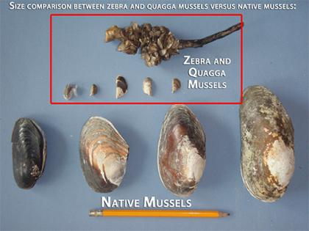
Zebra and Quagga Mussels
Zebra and Quagga mussels are freshwater mollusks that colonize lakes and rivers.

Slide 14
How did they get here?
Zebra and Quagga mussels are native to the Caspian Sea and Russia and were introduced into the Great Lakes in the mid 1980’s in ships ballast water.
Ballast water – hitch-hiking invasive species. Source: http://globallast.imo.org/

Slide 15
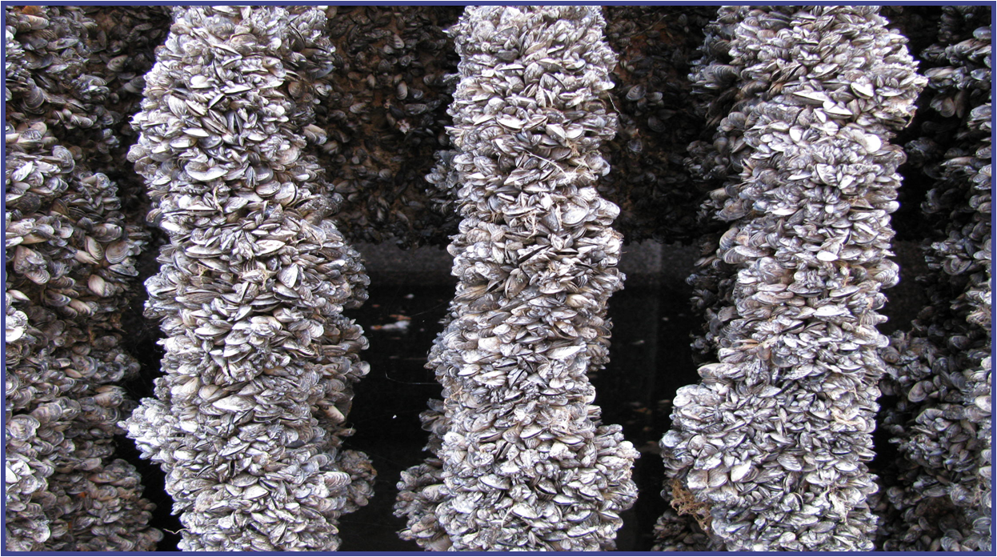
What do they do?
When these mussels establish populations, they spread quickly and are hard to eradicate.
Washington invasive Species Council

Slide 16
What do they do?
Their colonization can:
Close down access to state waters, recreation, and commercial opportunities,
Clog water intake piper, reducing abilities in power and water plants,
Change ecosystems and food sources for native animals, and
Cost taxpayers hundreds of millions of dollars annually.
Let’s see their impact in Lake Michigan
Notes:
Link takes you to a seven-minute video about the mussels’ impact on ecosystems and people in the Lake Michigan area.

Slide 17
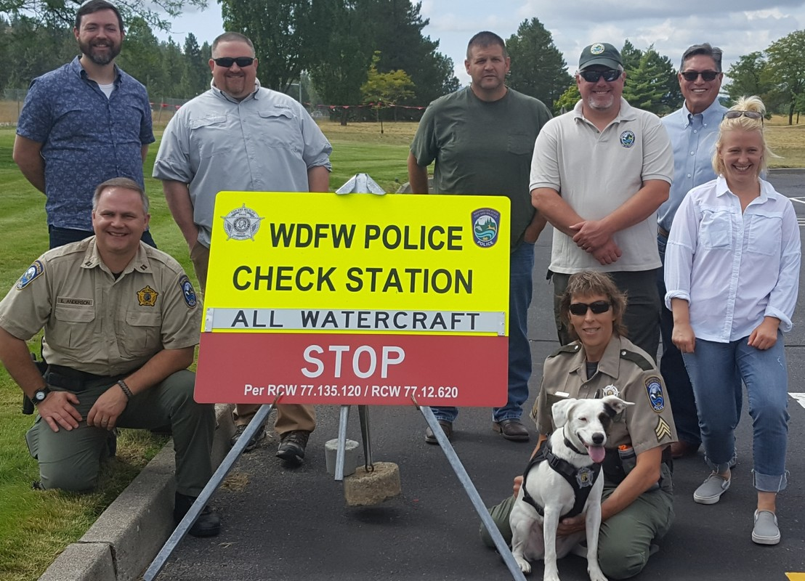
Preventing their entry
Due to careful monitoring and policies, these mussels have not made it into Washington.
In March 2021, an aquarium store in Seattle found mussels in moss balls for home-aquarium use. Let’s see why this is important and how home aquarium owners can help prevent the introduction of these invasive species to our state.
Notes:
Monitoring includes watercraft inspections by DFW enforcement officers and a mussel-detecting dog.

Slide 18
Reflection
Take two minutes to reflect on how these species may impact you.
  Consider:
    Do you use energy from hydroelectricity (dams)?
    Do you eat shellfish?
    Do you use water to recreate?
    Do you use waterpipes?
    How else may aquatic invasive species impact you and your family?
Notes:
Have students think-pair-share.

