Slide 1
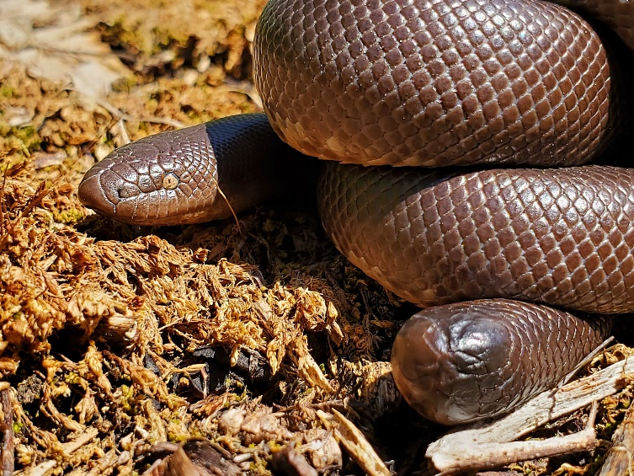
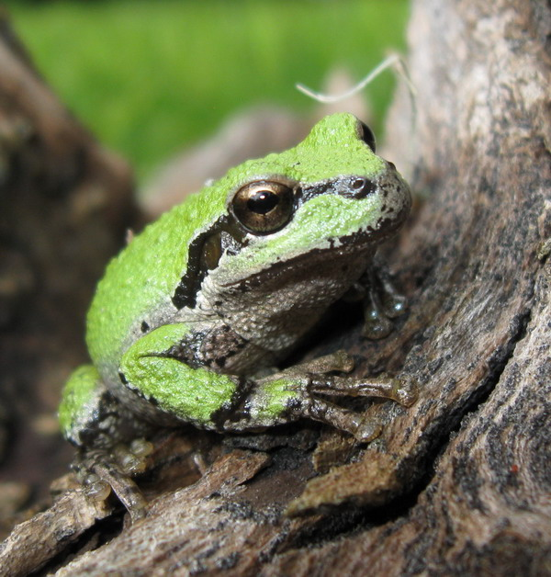
Herpetology: the study of reptiles and amphibians
Notes:
Pronounced herp-a-tall-o-gie

Slide 2

What’s a herp?
Herpetofauna (or herp for short) are reptiles and amphibians.
Tree frog
Rubber boa
amphibian
reptile
Notes:
Before clicking the answer, ask students if they can guess what a herp or herpetofauna is. (Based on the opening slide they should be able to guess).
After you introduce the definition, click and introduce the pictures. Have students guess which one is an amphibian and which is a reptile. After they guess reveal the answers. Ask students if they can think of other examples of reptiles or amphibians other than frogs and snakes. You can write answers in a new text box on this slide or on a white board or virtual whiteboard.

Slide 3
Reptiles
Vertebrates=have backbones.
Bodies are completely covered with scales.
They are cold-blooded.
Most produce leathery shelled eggs on land.
All species of reptiles have at least one lung.
    Let’s learn more!

Slide 4
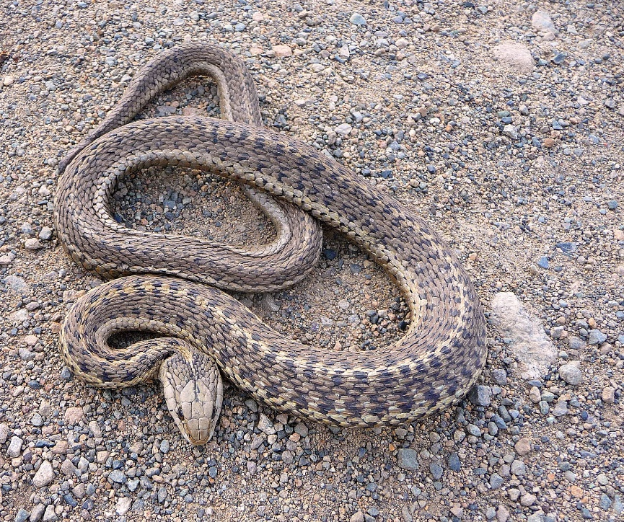
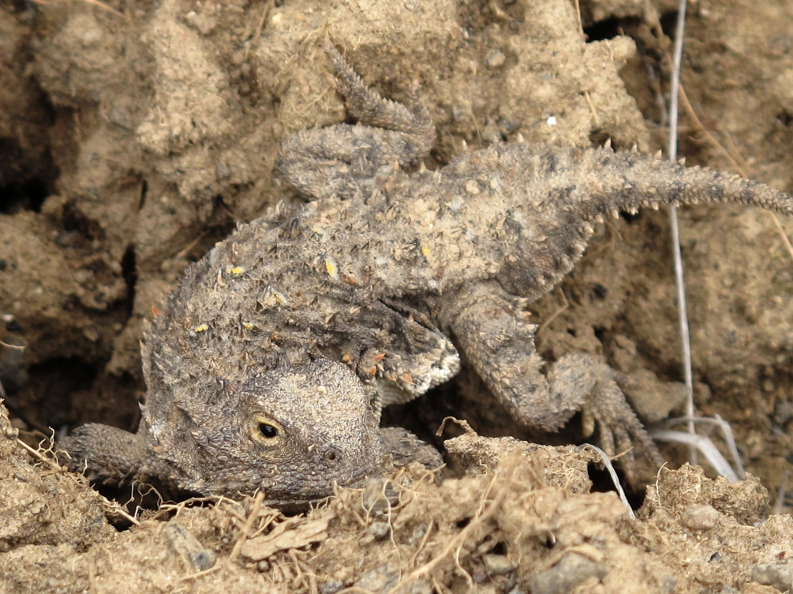
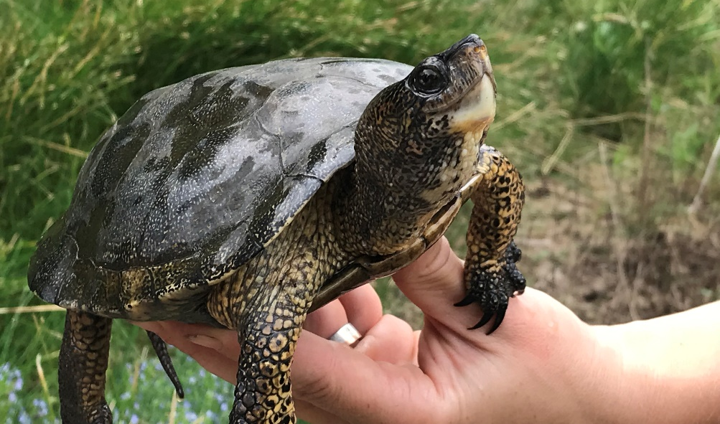
Reptiles
Snakes
Turtles
Lizards
Notes:
Before introducing the three types of reptiles found in Washington, ask students if they can guess them.

Slide 5
Amphibians
Vertebrates=have backbones.
Skin is smooth and slimy.
Most breathe through their thin, delicate skin.
Cold-blooded.
Eggs are laid in water; juveniles live in water before becoming adults.
Need water for their lifecycle.
Let’s learn more!

Slide 6
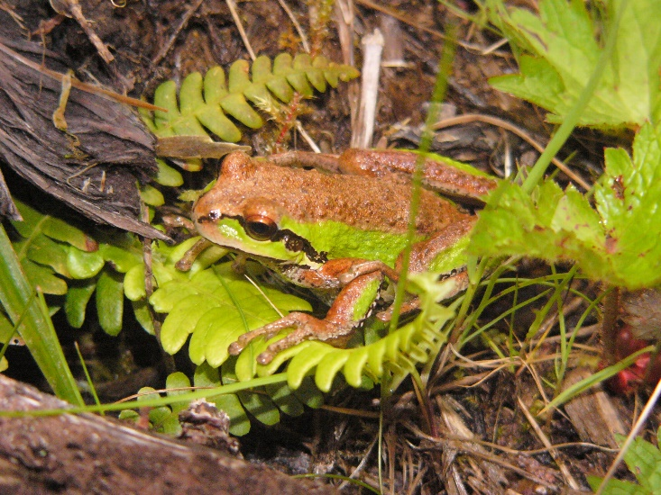
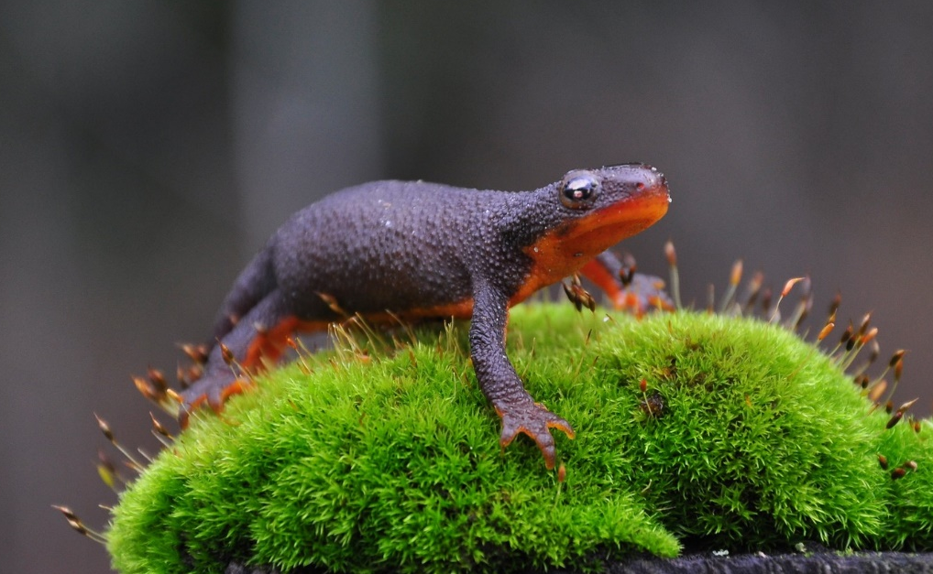
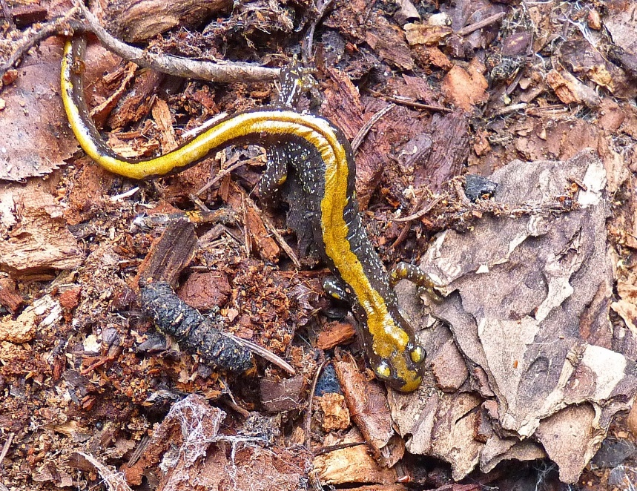
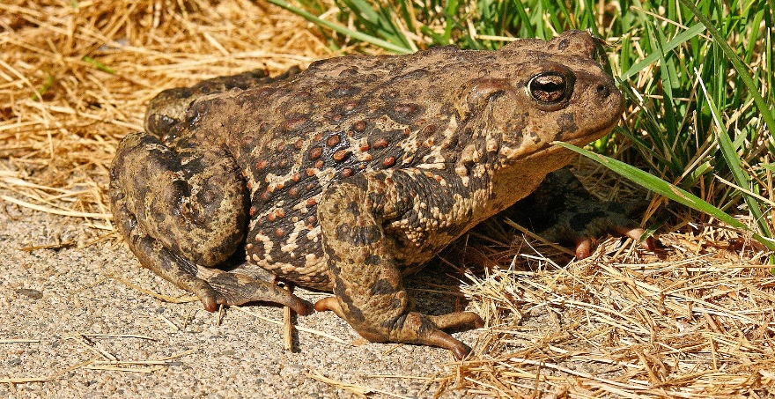
Amphibians
Frogs
Newts
Toads
Salamanders
Notes:
Before introducing the three types of reptiles found in Washington, ask students if they can guess them.

Slide 7
Why do scientists group reptiles and amphibians together?
Because they are both cold-blooded.
This means that their body temperature changes with their surroundings. Another word for cold-blooded is ectothermic.
Let’s learn more!
Notes:
Before clicking text, ask students to try and guess why scientists will group reptiles and amphibians together as, “herps”.
After introducing that both animals are cold-blooded, ask students what they think cold-blooded means.

Slide 8
Similarities and differences
Reptiles
Amphibians
Both
Skin is smooth and slimy.
Most breathe through their thin, delicate skin.
Eggs are laid in water; juveniles live in water before becoming adults.
Need water for their lifecycle.
Bodies are completely covered with scales.
Most produce leathery shelled eggs on land.
All species of reptiles have at least one lung.
They are cold-blooded.
Vertebrates=have backbones.
Notes:
Using the information students just learned, they will organize similarities and differences of reptiles and amphibians into a Venn diagram. You may choose to have students work with a partner (recommended for younger grades) or work by themselves (for older students).
Don’t reveal the information until next class when you review students’ Venn diagrams.

Slide 9
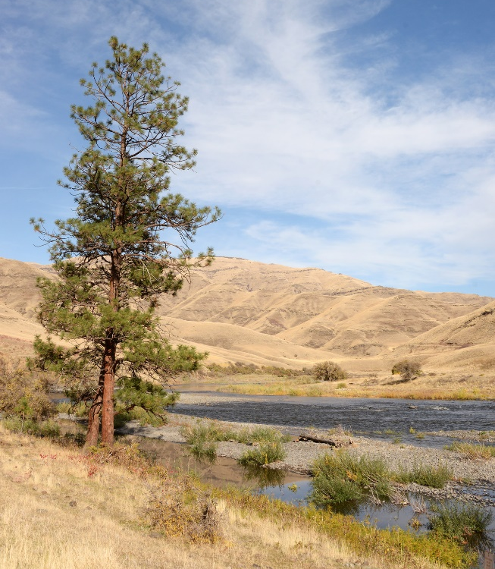
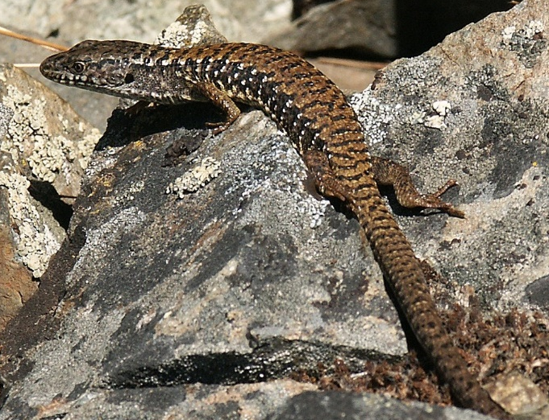
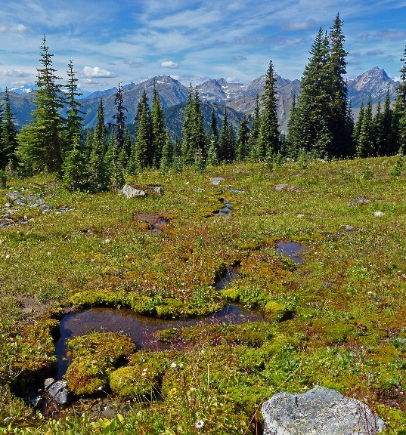
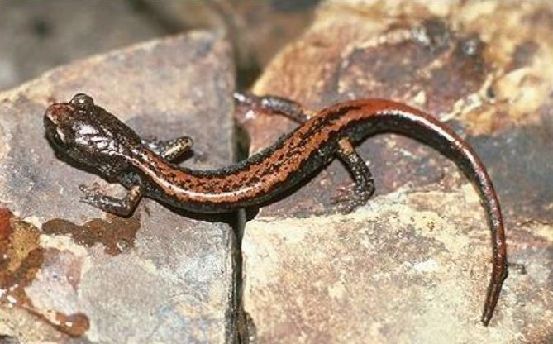
Herps in Washington
Washington is rich in herps.
Our state has 23 species of amphibians and 24 species of reptiles!
Notes:
Ask students why they think there are so many different types of reptiles and amphibians.– Washington has many different types of ecosystems and habitats that support a variety of species.
This variety of ecosystems, habitats and species is called biodiversity.

Slide 10

Camouflage
Camouflage is protective coloring or another physical feature that conceals an animal and enables it to blend into its surroundings.
Notes:
Ask students if they know what camouflage is before clicking.

Slide 11
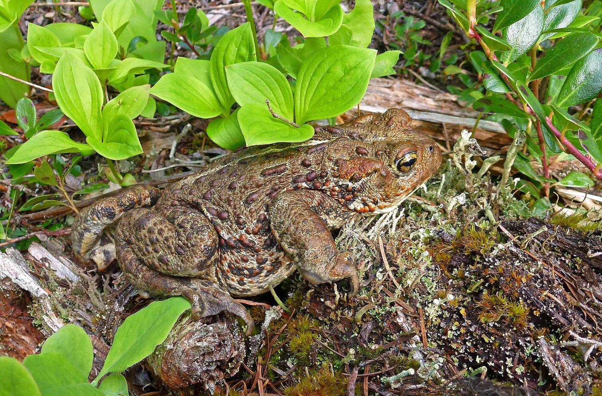
Camouflage
Why do you think it's important reptiles and amphibians have camouflage?
Notes:
Ask students if they know what camouflage is before clicking.

Slide 12

Camouflage
Because reptiles and amphibians can be both predators and prey, camouflage helps them blend in with their environment.
Notes:
This means they hide from their prey, or hide from their predators.

Slide 13
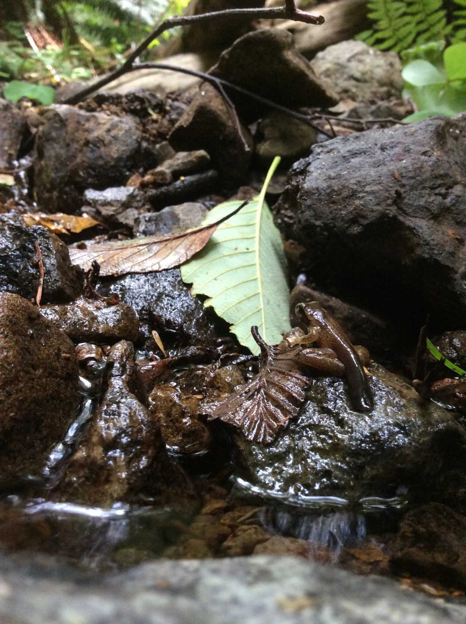
Can you spot the herp in this picture?
Notes:
Ask students if they know what camouflage is before clicking.

Slide 14
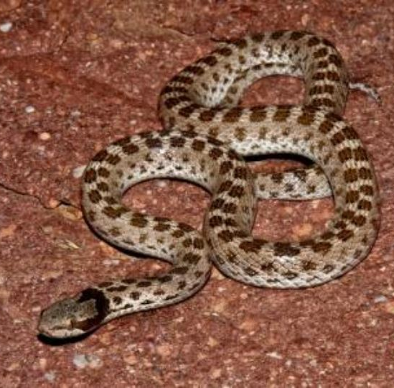
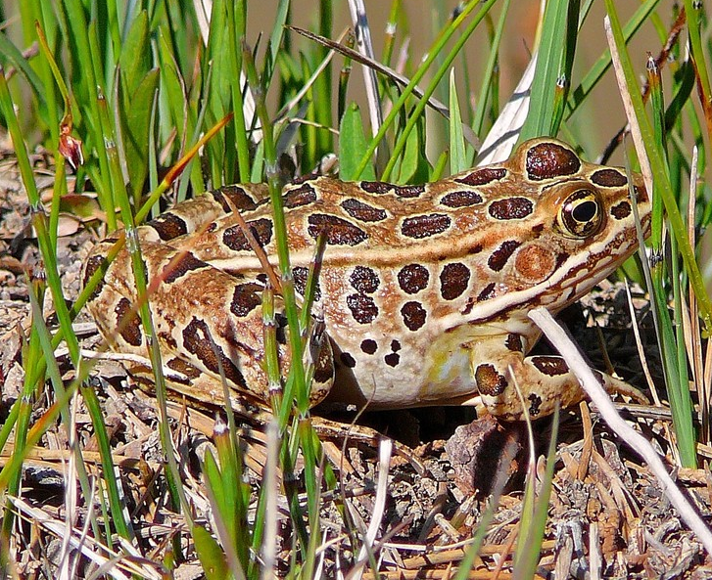
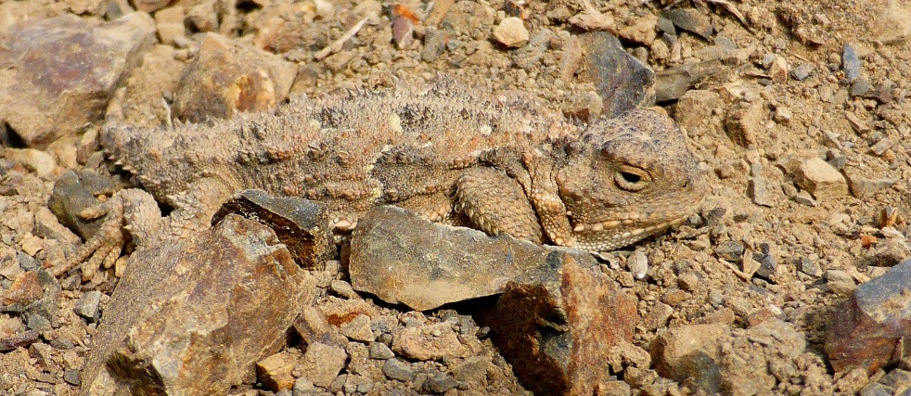
Why herps?
Herps aren’t just cool looking, they play an important role in our environments.

Slide 15
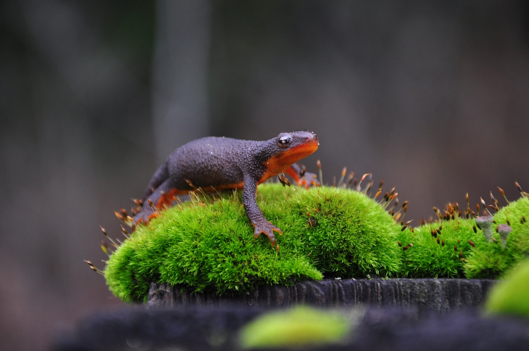
Why herps?
They also provide us with ecosystem services.
Notes:
Ecosystem services are benefits that people get from ecosystems and wildlife.

Slide 16
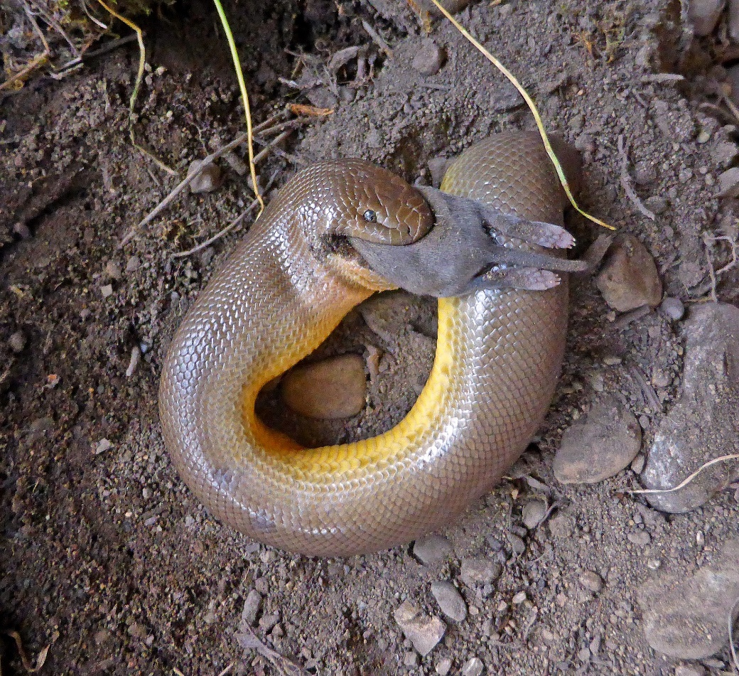
Pest control
For example, snakes eat many different types of animals, including rodents which can be considered “pests” to some people.
Without snakes to eat the rodents, rodent populations may increase.

Slide 17
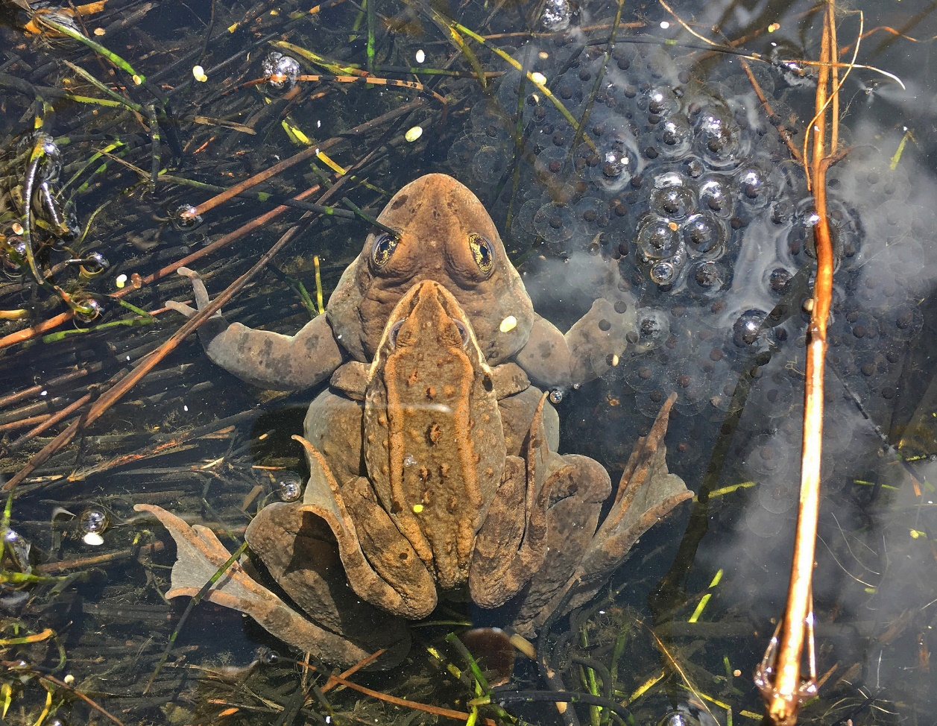
Pest control
Frogs and toads eat many insects (including mosquitos!) which helps farmers use less pesticides on their crops.

Slide 18
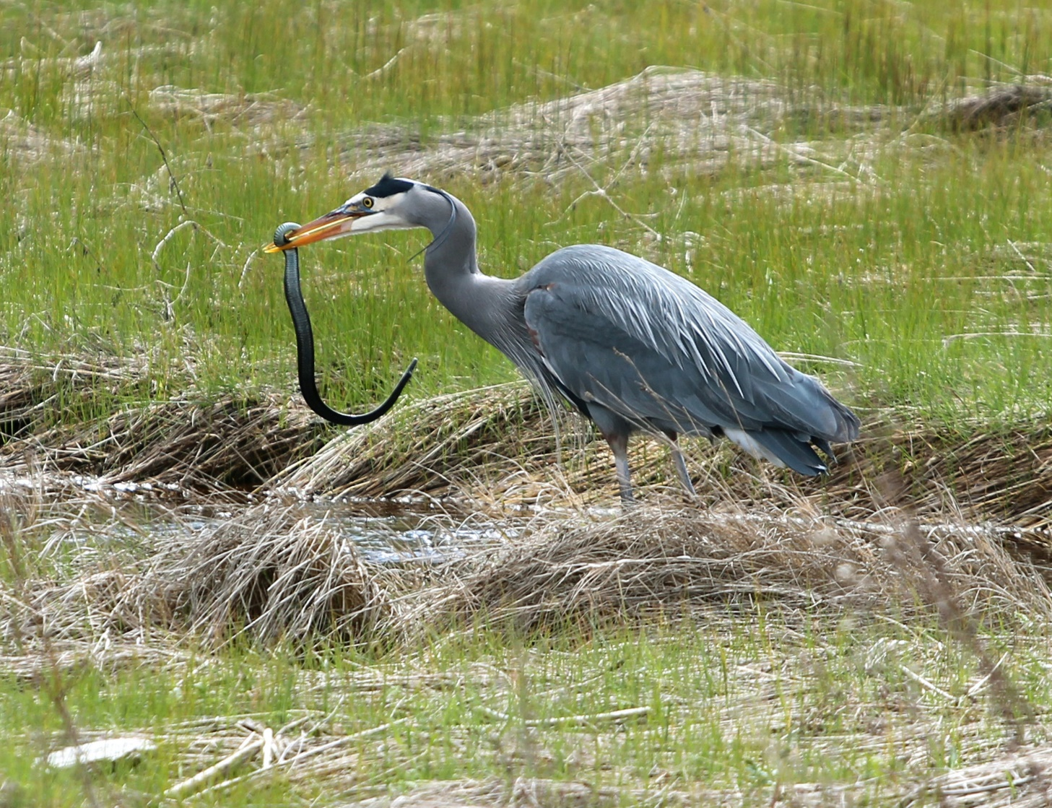
Role in food webs
As both predator and prey, reptiles play a very important role in food webs.

Slide 19
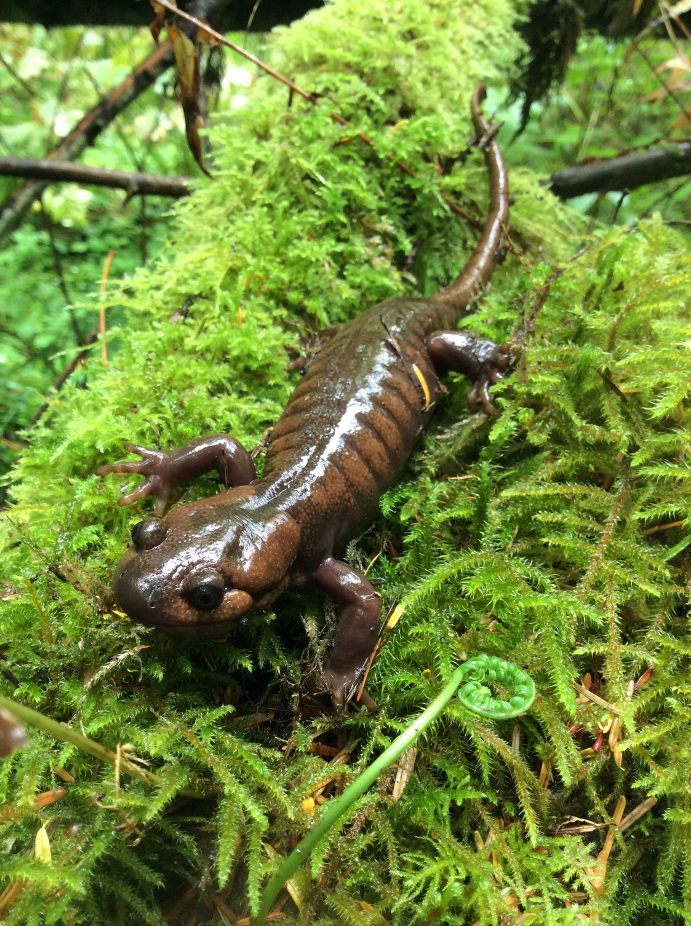
Amphibians
What is special about amphibian skin?
Amphibians breathe through their skin!
Because their skin is so thin and delicate, they absorb any chemicals that may be in the water.
Notes:
Ask students if they can recall what is special about amphibian skin.

Slide 20
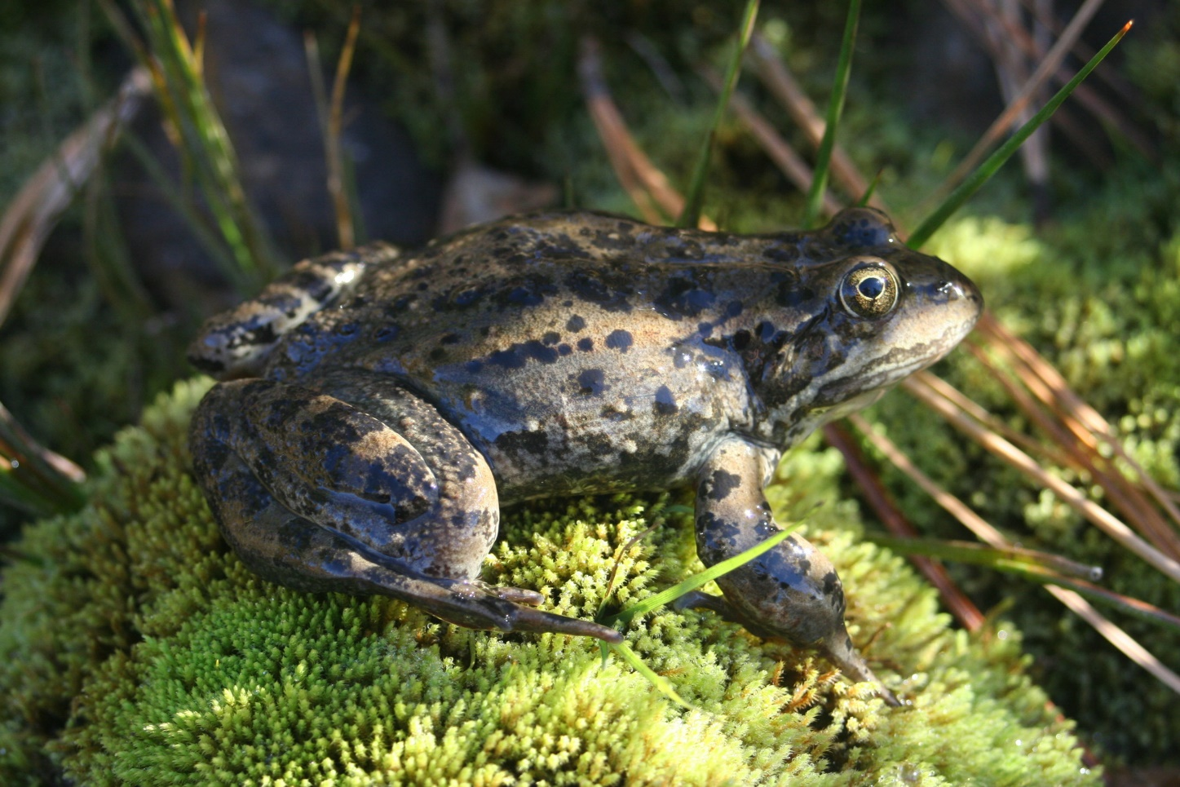
Amphibians
This means that any chemicals, pesticides, fertilizers, and pollution that goes into water may be absorbed by amphibians.
Notes:
We should always be careful about what we put into our stormwater drains, on our lawns and in our gardens. Any chemical runoff may harm amphibians.

Slide 21
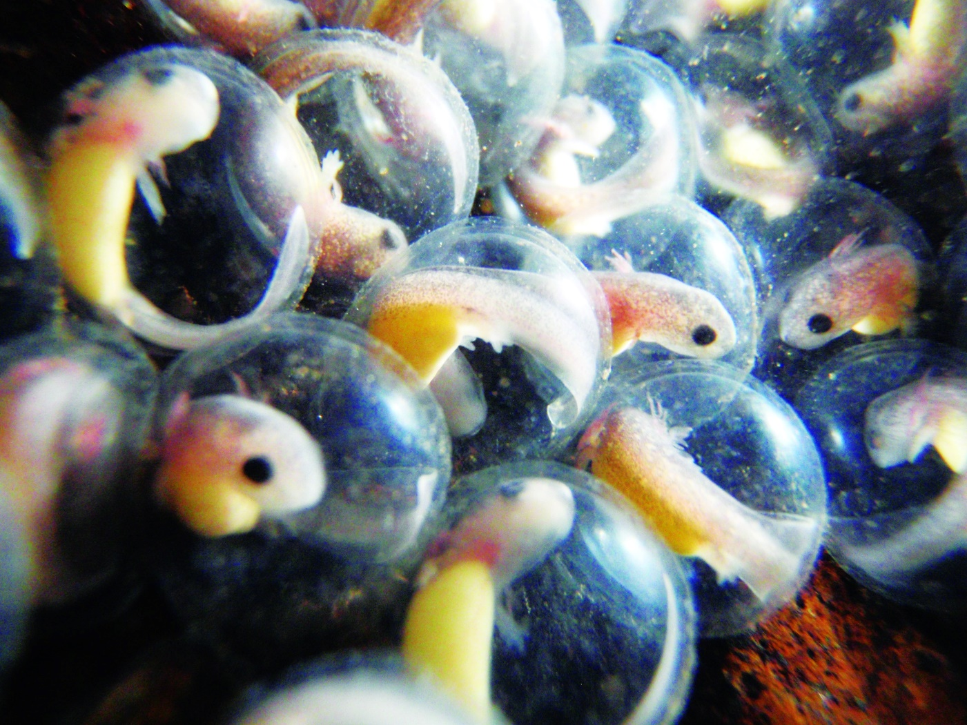
Amphibians
Because amphibians are so sensitive to changes in water quality, they are seen as indicators of the health of their ecosystems.
Notes:
If many amphibians start dying, this could mean the ecosystem is in trouble!

Slide 22
What can we do?
You can help protect reptiles and amphibians by:
Dispose of chemicals properly,
Try to avoid herbicides and pesticides,
Put down natural and artificial cover (dead wood or plywood boards) in your backyard- this provides a moist shelter for herps,
Leave aquatic vegetation growing in wet areas. This can provide food, refuge and habitat for amphibians, and
Protect herps from your pets! Don’t let your dogs or cats harass or disturb herps.
Notes:
If many amphibians start dying, this could mean the ecosystem is in trouble!

