Slide 1
Rut/Breeding Season in Ungulates

Slide 2
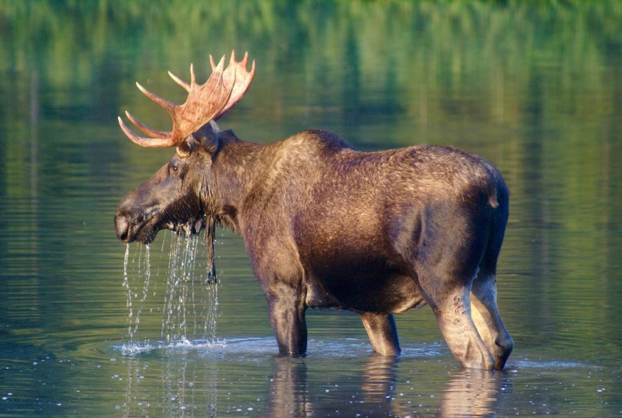
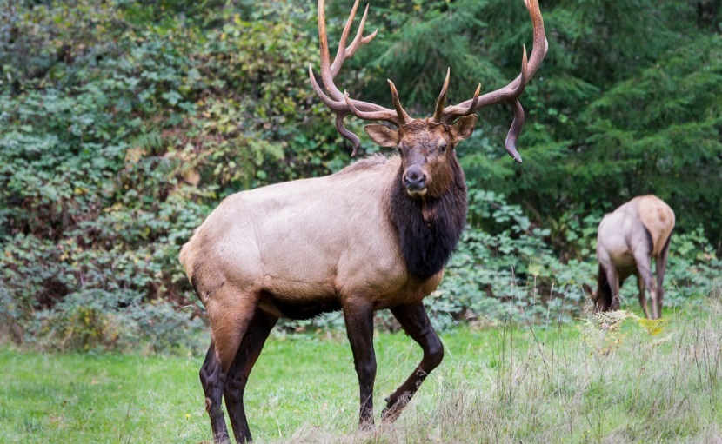
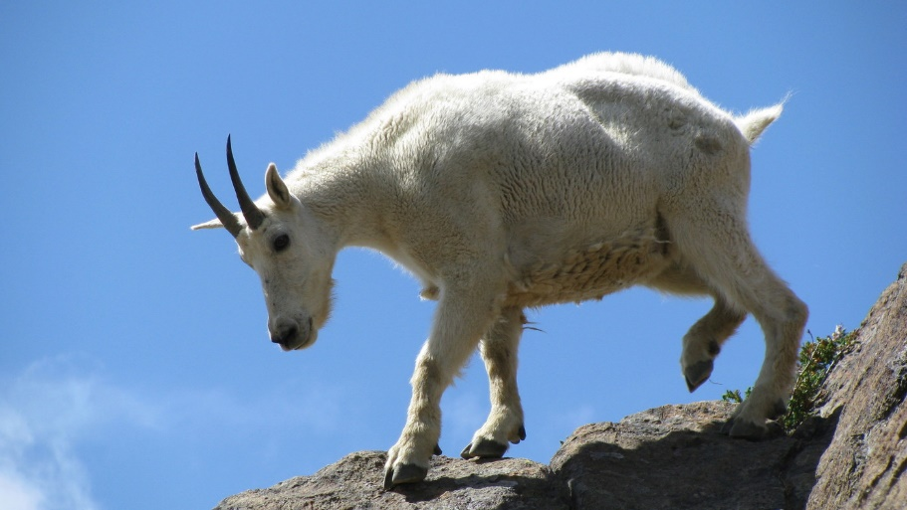
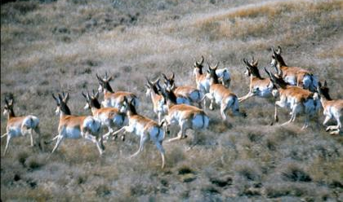
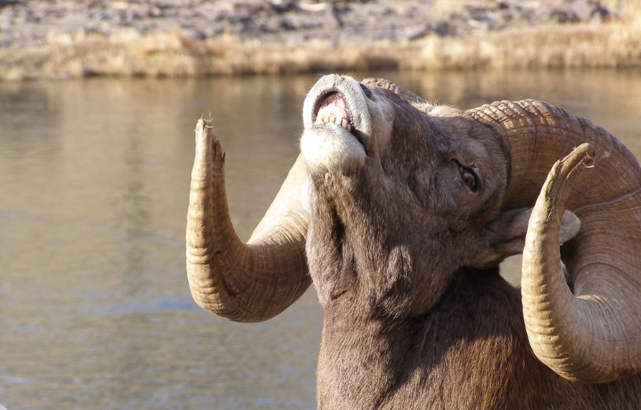
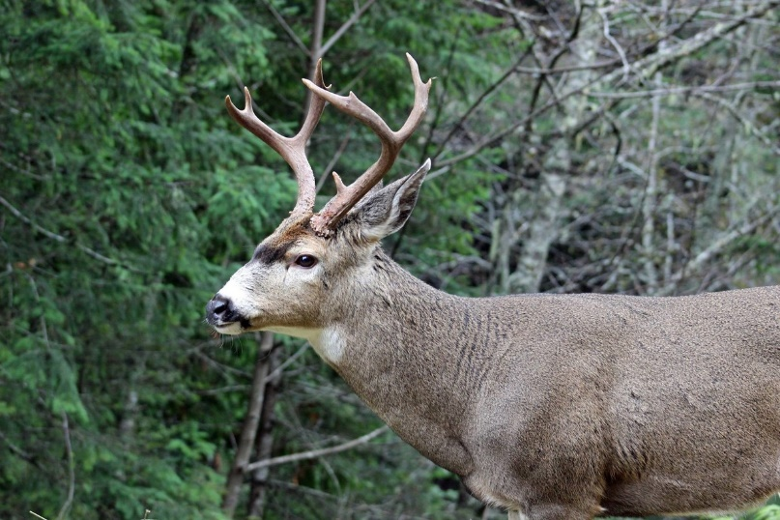
Ungulates in Washington
Notes:
Review with students the ungulates found in Washington from the previous lesson (moose, elk, mountain goat, pronghorn, bighorn sheep, and deer).

Slide 3
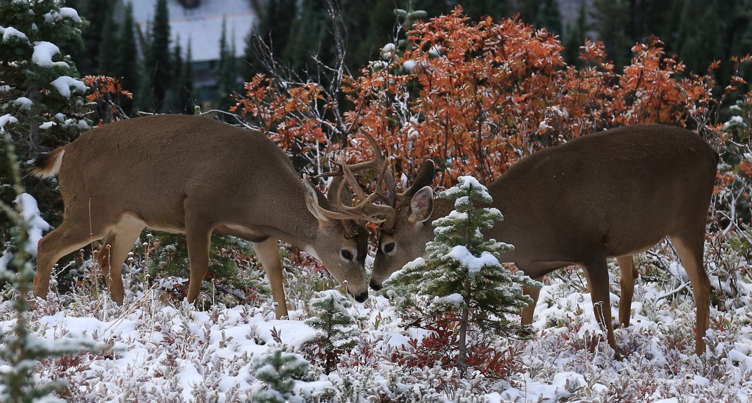
What is Rut?
Rut is the breeding season for ungulates, and some other species, including skunks and elephants.
During rut, animals will go through physical and behavioral changes to provide the best breeding opportunities.
Photo courtesy of Genie Cary
Notes:
Vocabulary word: Rut is the mating season in some animals when males have increased testosterone, exaggerated sexual dimorphisms, and increased aggression and interest in females.
This would be a good time to remind students about ungulates (mammals with hooves, and are ruminants).

Slide 4
What is Rut?
Mating or breeding season of certain mammals, including ruminants like deer, sheep, camels, goats, pronghorns, bison, giraffes, and antelopes.
In rut, males will have:
increased testosterone
exaggerated sexual dimorphism
increased aggression and interest in females.
Notes:
Vocabulary word: sexual dimorphism is where the two sexes of the same species exhibit different characteristics beyond the differences in their reproductive organs. This can be observed in many animals and some plants. These differences can include size, weight, color, markings, and antlers/horns. In mammals males are usually larger than females of the same species.

Slide 5
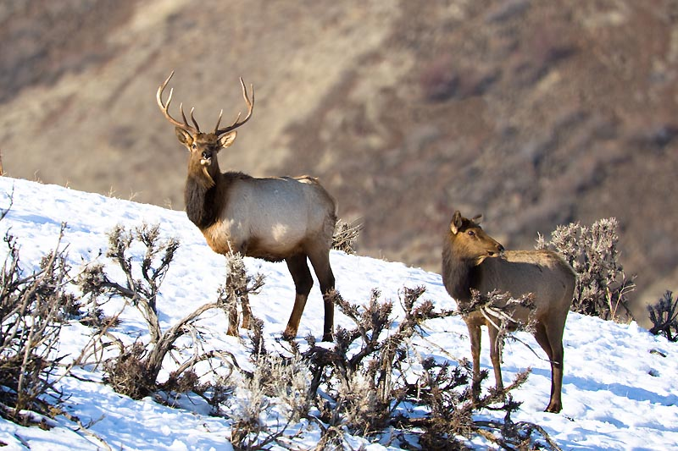
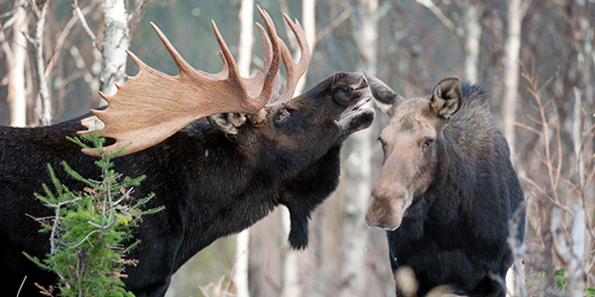
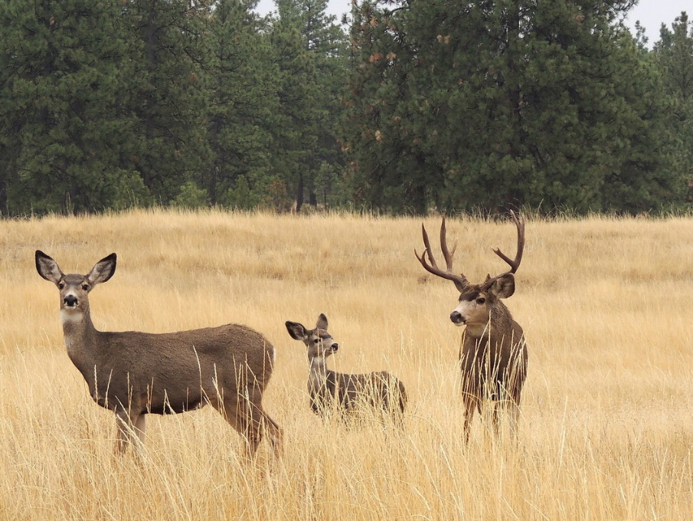
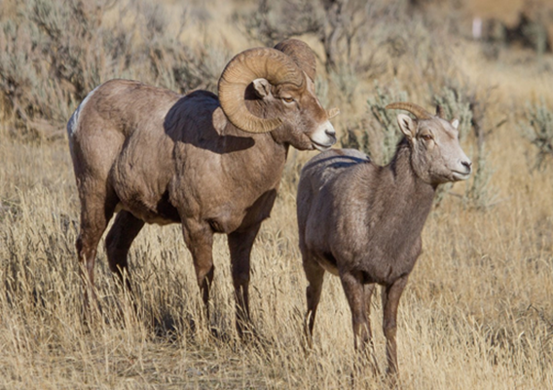
Examples of Sexual Dimorphism
Photo credit National Wildlife Federation
Photo courtesy of Jim Cummins
Photo courtesy of Tony Sirgidas
Photo courtesy NPS Diane Renkin
Notes:
Elk, moose, bighorn sheep, and deer in Washington all show examples of sexual dimorphism. Besides having antlers and larger horns, males are larger than females of the same species.

Slide 6
Breeding in Ungulates
Females only breed once per season so they must pick the “best” male to mate with to increase the survival and success of their offspring.
Males can breed with many females during one season.
Notes:
Question: If a female makes a bad mating choice how does that effect her and her offspring?

Slide 7
Breeding: Why be choosey?
Why do females care about males’ physical characteristics?
Biologically fit male
Female looking for mate
Biologically fit offspring
Biological fitness is how successful an individual is at reproducing relative to others in the population.
Showy traits like large antlers may be an indicator of good health to a female.
Notes:
Ask students to repeat what they just learned. Why do students care about who they breed with?
Introduce new vocab term: biological fitness. Example, An individual who has 10 surviving offspring has a higher fitness than an individual who has 4 offspring surviving offspring.

Slide 8
Breeding: Why be choosey?
Why do females care about males’ physical characteristics?
A mate with large antlers or horns is likely a healthy and strong individual who has shown their ability to survive and fend off competitors.
A female chooses the best male because he has displayed good genetics which should result in her offspring possessing a similar fitness.
Biologically fit male
Female looking for mate
Biologically fit offspring

Slide 9
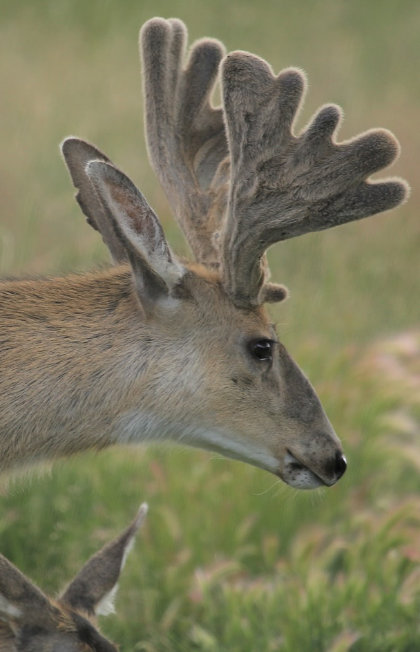
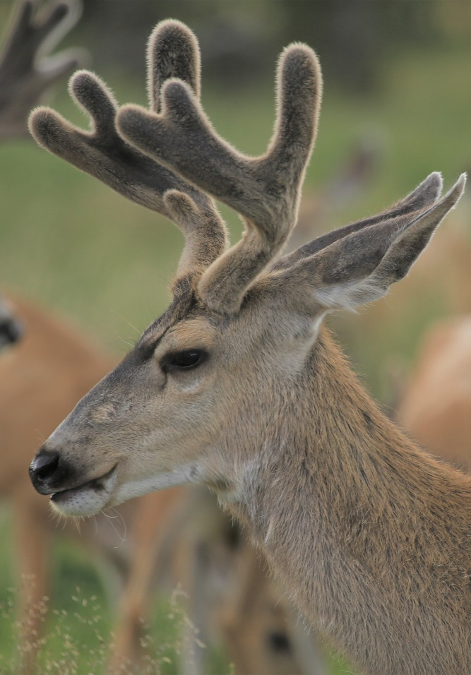
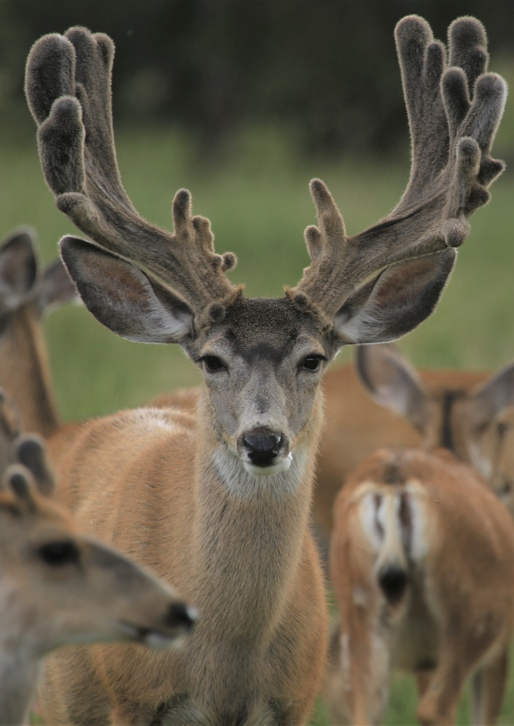
A
If you were a female mule deer, which male would you choose?
C
B
D
Notes:
Have students choose by letter which deer looks the most biologically fit, or healthy for a female to reproduce with. The likely answer should be B, but encourage other reasoning as well.

Slide 10
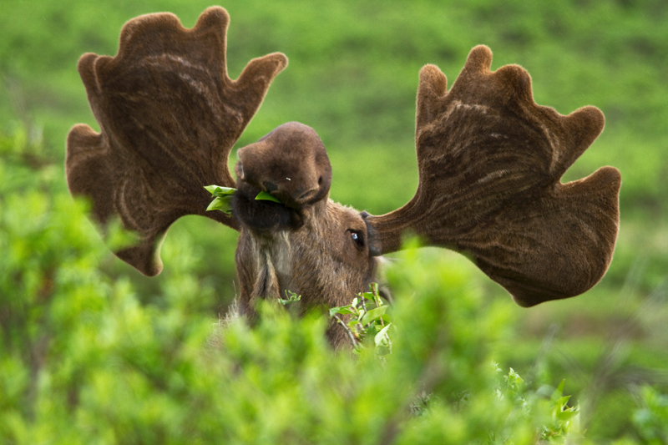
Antler Growth
When antlers first start to grow, they are covered with a soft, fuzzy skin called velvet.
The velvet has blood vessels in it that deliver nutrients that help the antlers grow.
By late summer, when the antlers reach full size, the blood supply dries up and the velvet starts to drop off.
Photo by: Jacob W Frank, NPS.
Notes:
What happens to the antlers after they fall off? People will sometimes go out looking for them or pick them up while hiking. Mice and other rodents will chew on the antlers for the calcium.
Velvet is a vocabulary word.

Slide 11
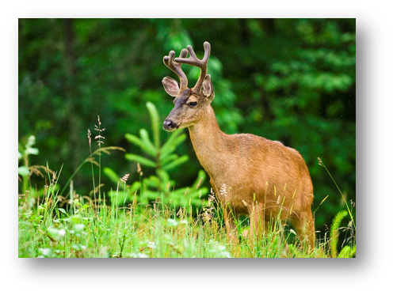
Antler Growth
Growing antlers requires a lot of energy! A male that can grow large antlers and still have energy to defend potential mates demonstrates to females that the individual is biologically fit. ​
Antlers size is a function of age, genetics and nutrition.
What does this say about males with the largest antlers?
Photo by: Antony Sirgedas

Slide 12
Horn Growth
Horns on male bighorn sheep will continue to grow throughout their lifetime, showing their maturity and their “fitness.”
Notes:
Photo note: horns can become damaged and are subject to normal wear and tear. This photo is a good example of normal damage done to the end of the horn (called "brooming" describes the chips and frays on the horns, usually caused by fighting, accidents or digging).

Slide 13
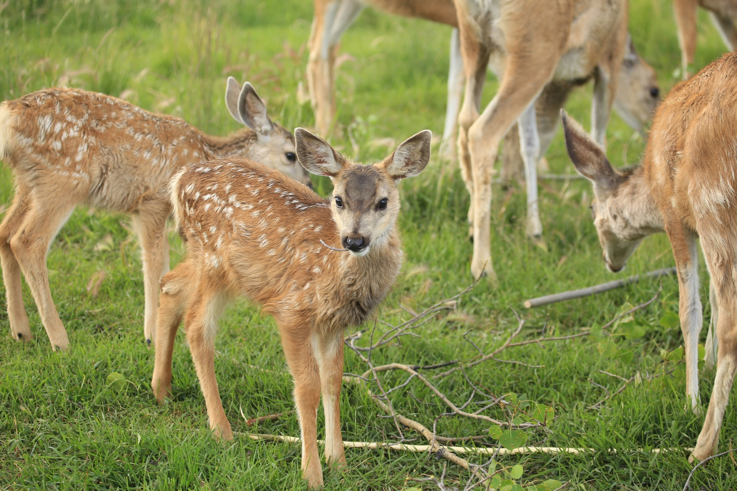
Breeding Cycles in Ungulates

Slide 14
Moose
Calves are born in May-June
Velvet dries and comes off when antlers reach full size
Rut starts mid-Sept to early Oct
Bones weaken at antler attachment
Antlers fall off late Feb to late April
Bulls leave cows and herds disperse
Spring: Antlers start to grow in velvet
Mating occurs

Slide 15
Deer
Fawns are born in May-June
Velvet dries and comes off when antlers reach full size
Mating occurs
Bones weaken at antler attachment
Antlers almost immediately start to grow back
Rut starts Nov-Dec
Antlers fall off

Slide 16
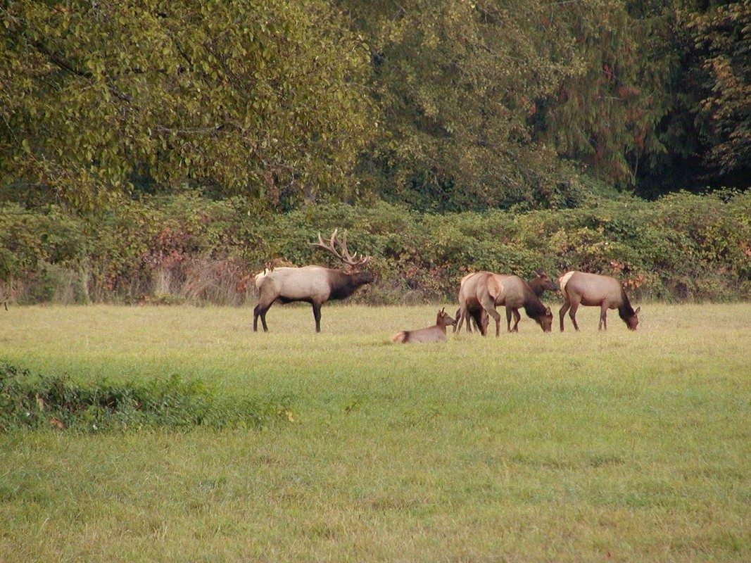
Elk
Calves are born in May-June
Velvet dries and comes off when antlers reach full size
Mating occurs
Bones weaken at antler attachment
Antlers almost immediately start to grow back
Rut starts Sept-Oct
Antlers fall off
Males guard harems
Bulls leave cows and herds disperse
Notes:
A harem is a group of breeding females associated with one male.

Slide 17
Bighorn Sheep
Rut Oct-Jan
Males guard females
Mating
Males disperse from females
Lambs are born in April-June

Slide 18
Mountain Goats
Kids are born in May-June
Males and nursery groups live separately
Billies move closer to nannies in Nov-Dec
Mating
Males and females form separate groups
Notes:
Activity: Have students complete activity to fill in the missing cycle events (provided in lesson plan).

Slide 19
Pronghorn
Fawns born May -June
Rut begins Sept - Oct
Males defend harem
Mating
Males and females form separate herds

