Slide 1
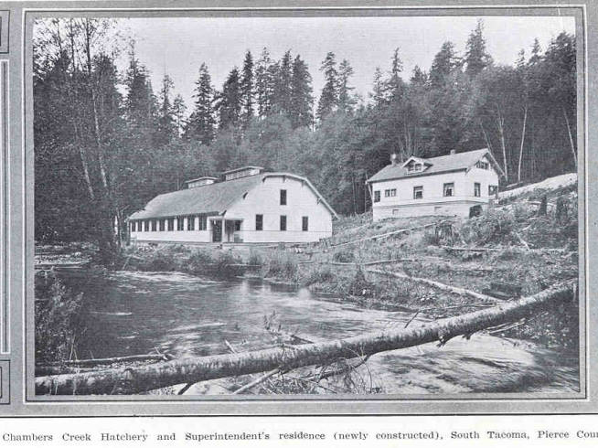
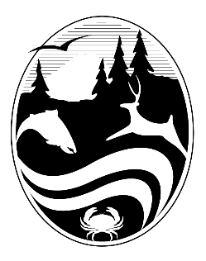
History of fish hatcheries in Washington

Slide 2
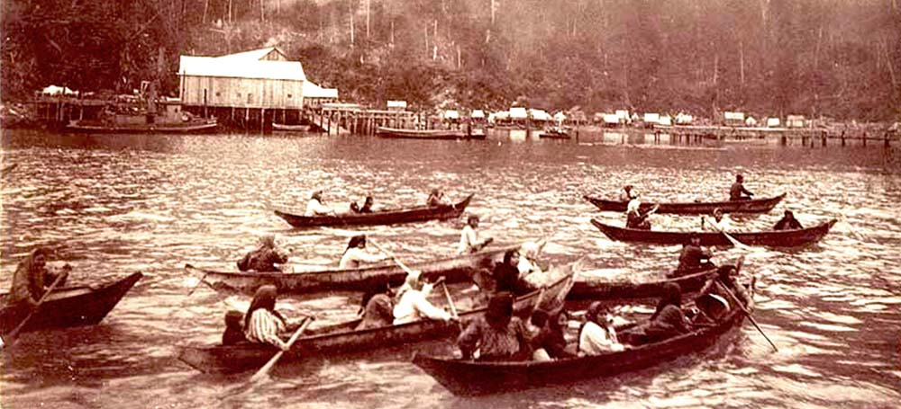
Photo courtesy of Olympia.wa.gov

Slide 3
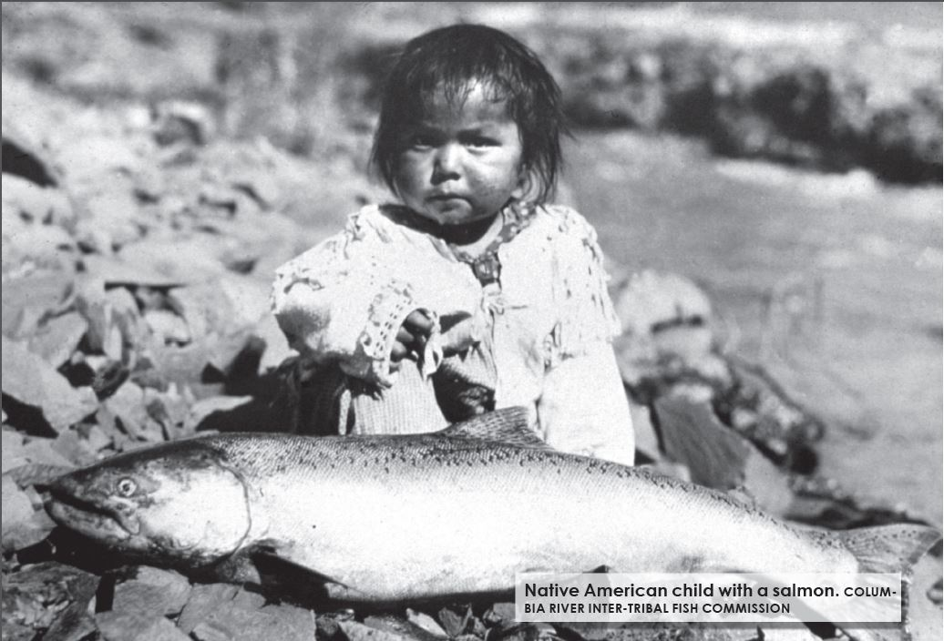
Type text here. Bullet points are not always necessary
  Remove bullets if it is more impactful
    Simplify text, convey concepts
    Place your talking points in the notes section
    Carry the stage with your presence

Slide 4
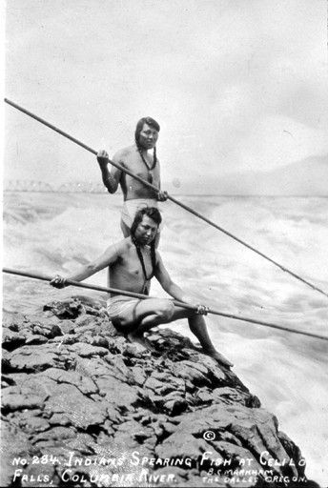
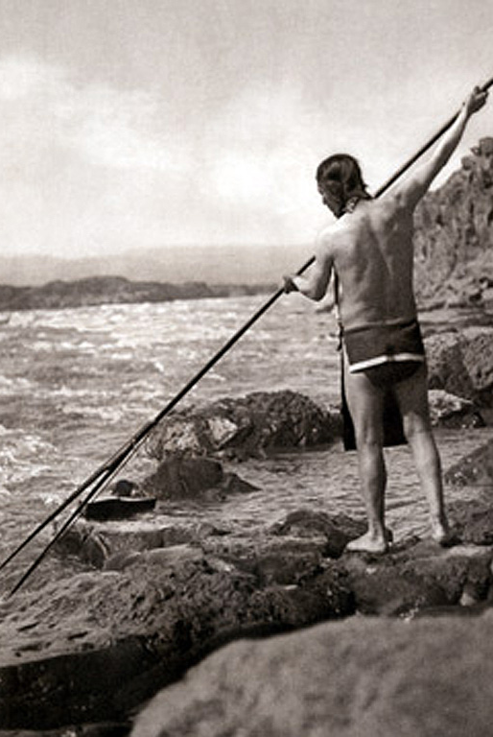
IMPACTFUL STATEMENT/ key findings or quote
Important topic or attraction
Photos courtesy of Columbia River Inter-tribal fish commission

Slide 5
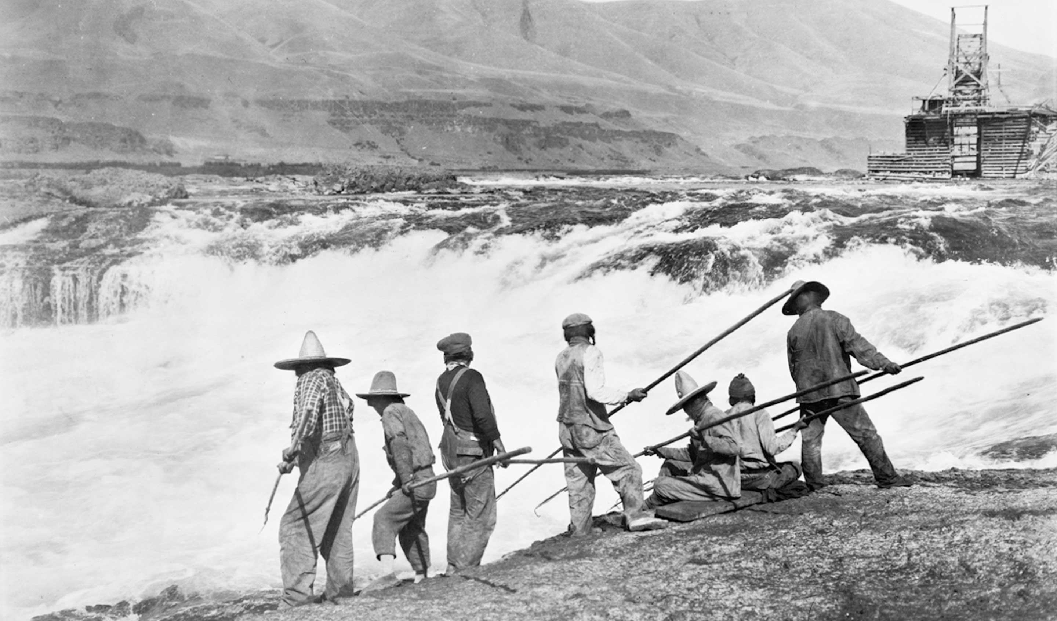
Transition slide title

Slide 6
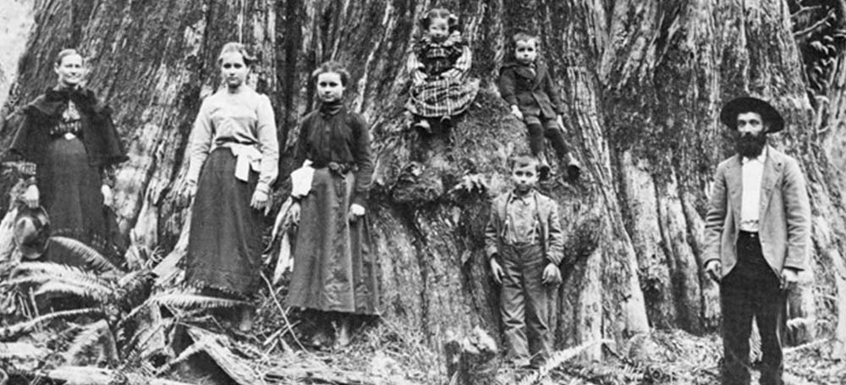
Photo courtesy of Olympia.wa.gov

Slide 7
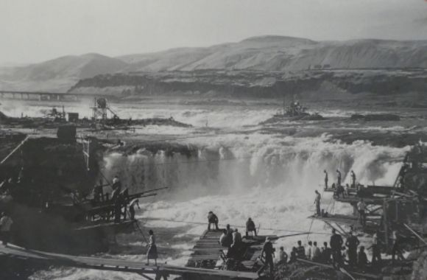
Photo courtesy of education.blogs.archives.gov

Slide 8
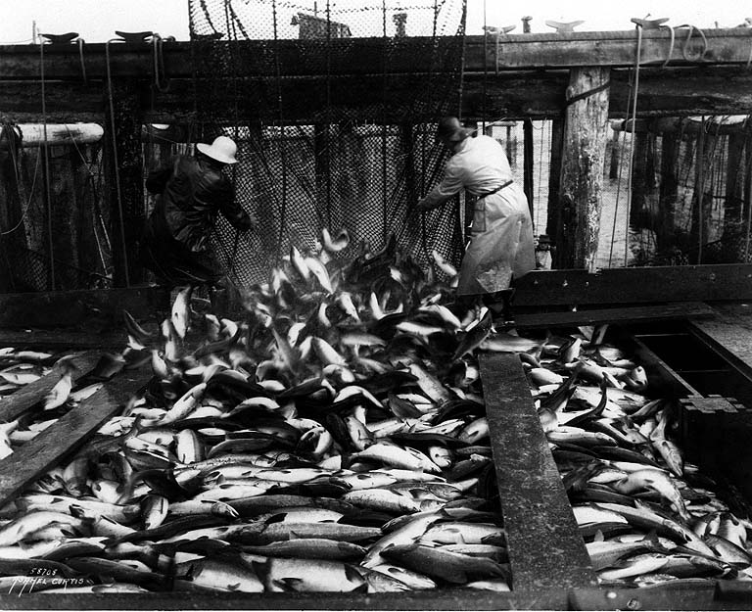
Photo courtesy of University of Washington

Slide 9
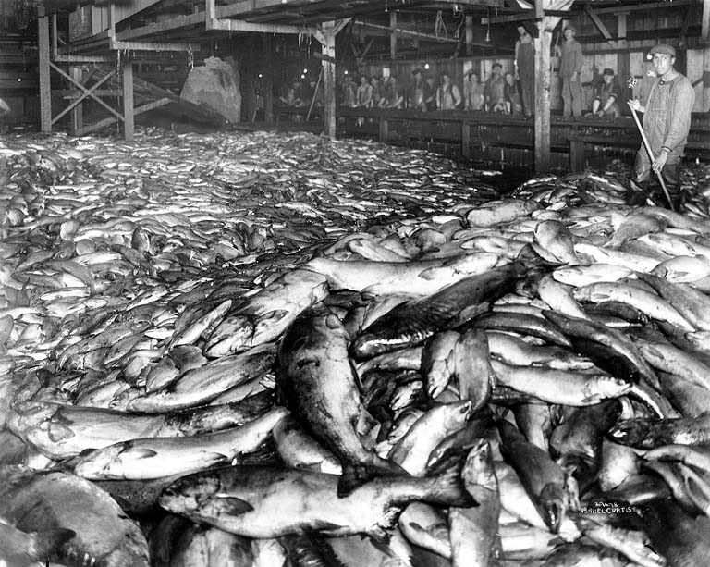
Photo courtesy of University of Washington

Slide 10
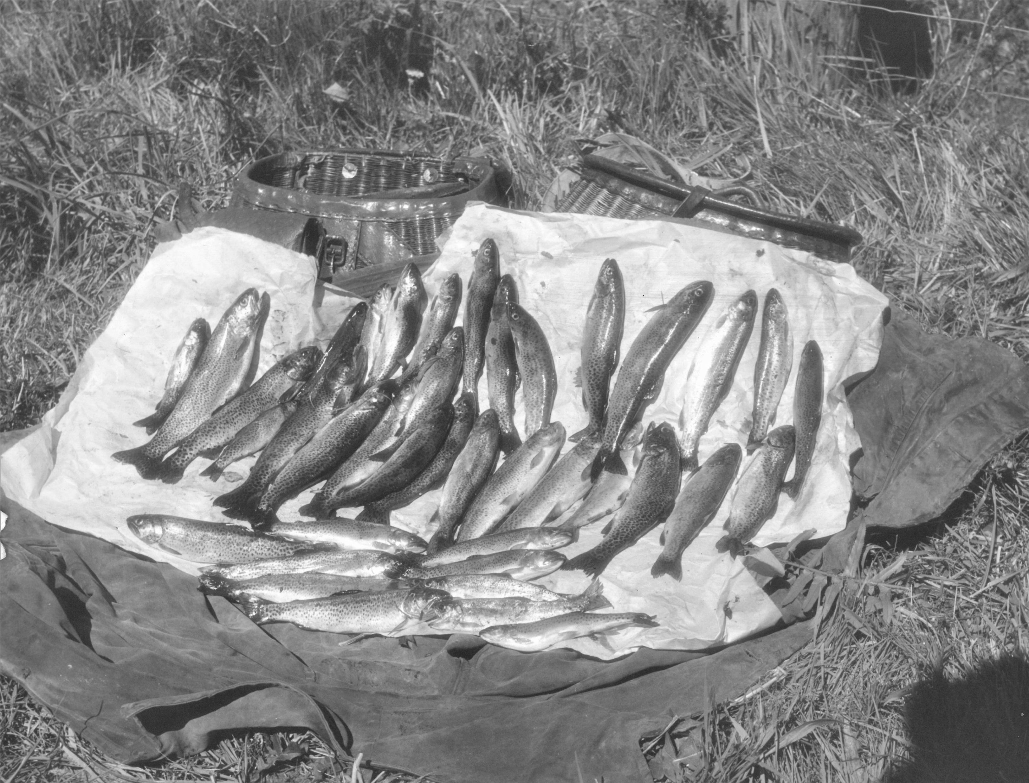

Slide 11
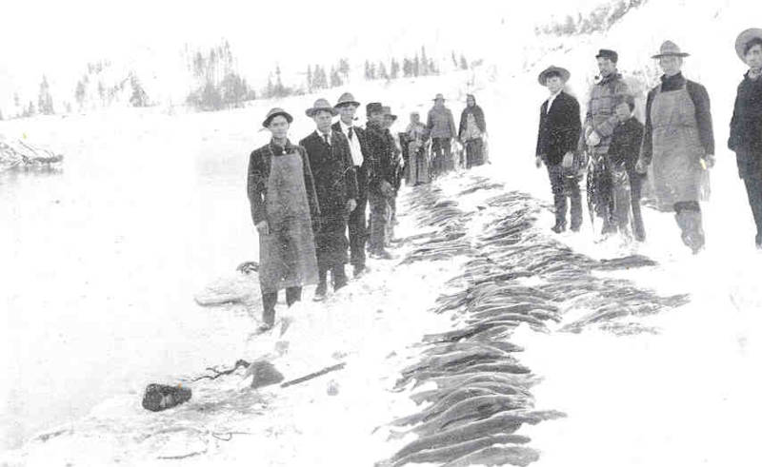

Slide 12
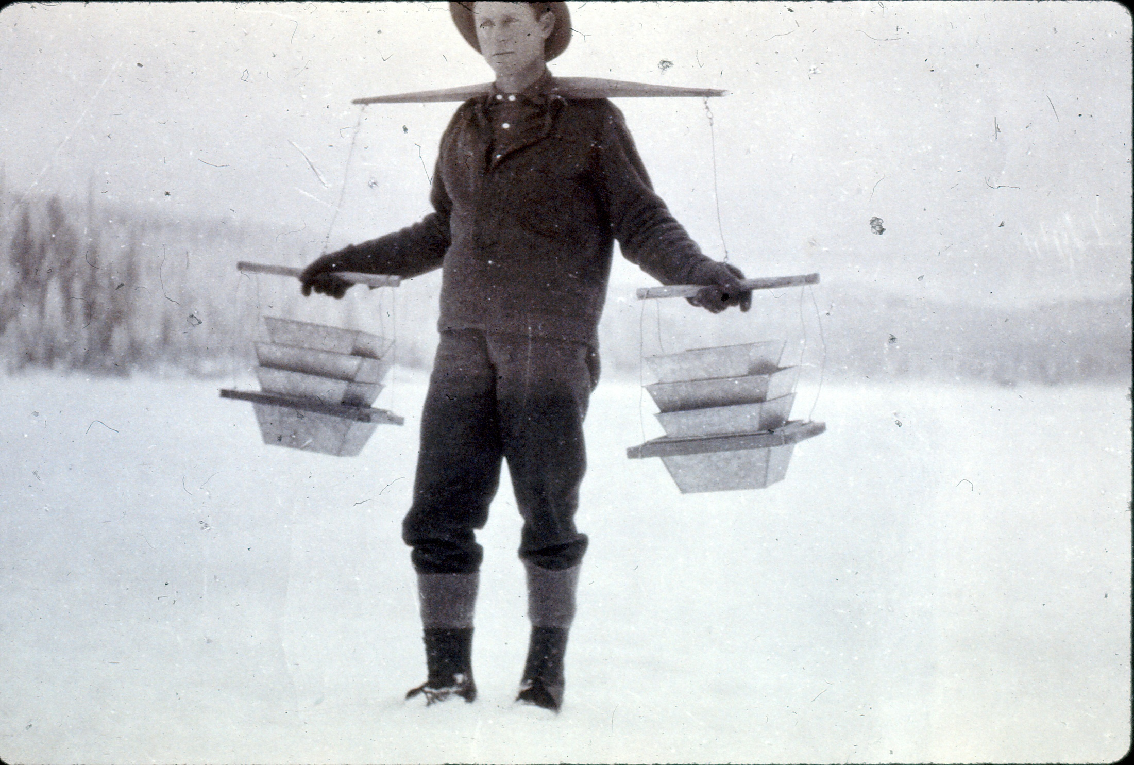
A man carrying salmon eggs

Slide 13
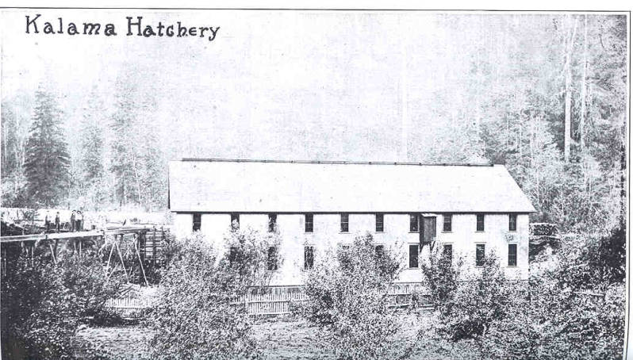

Slide 14
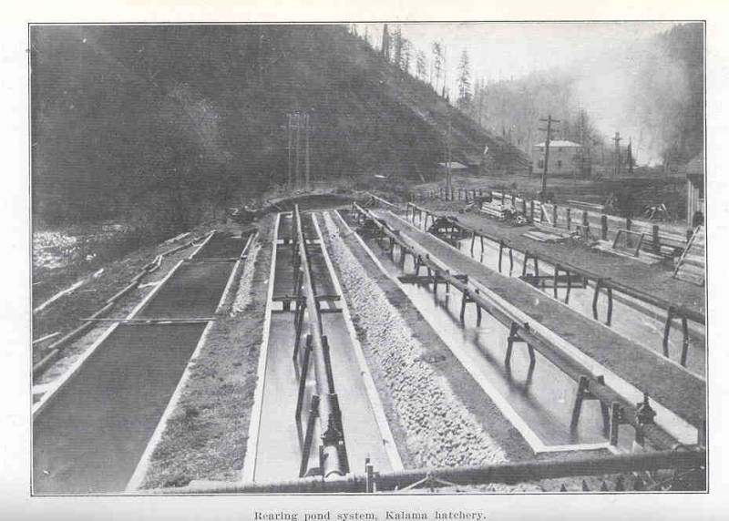

Slide 15
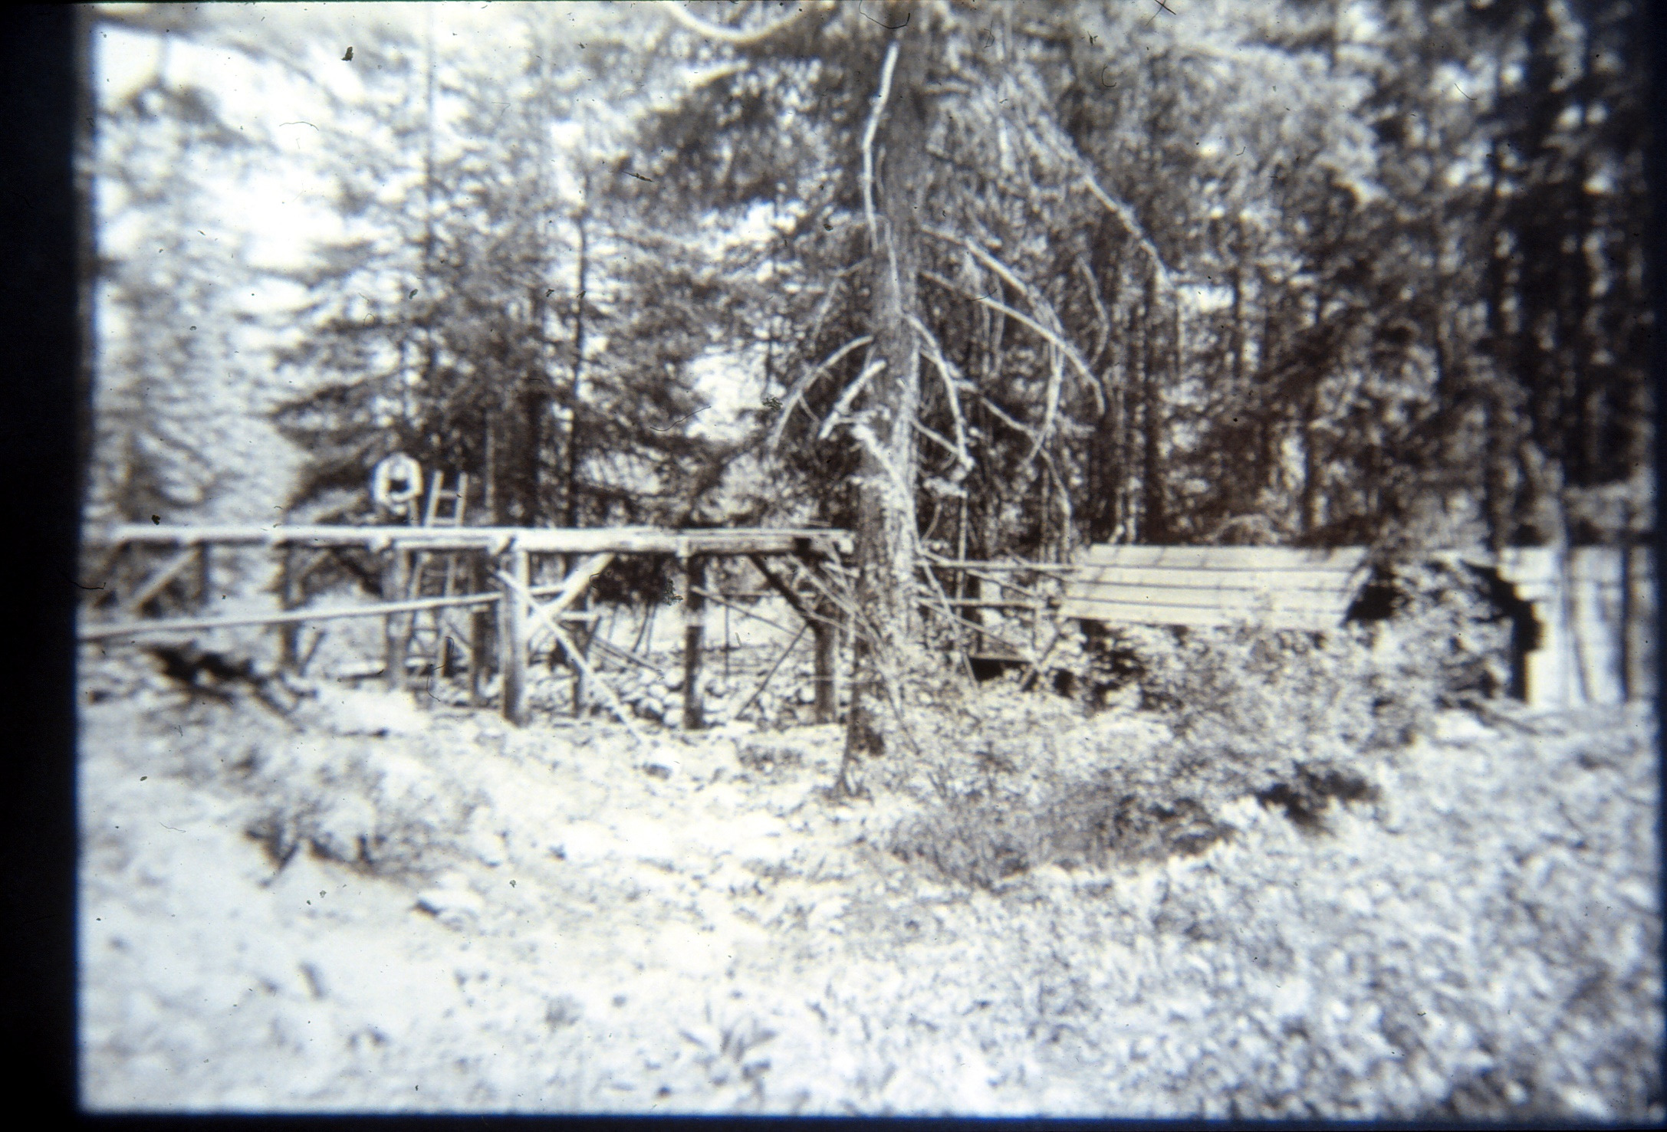
Lake Chelan trout hatchery 1903

Slide 16
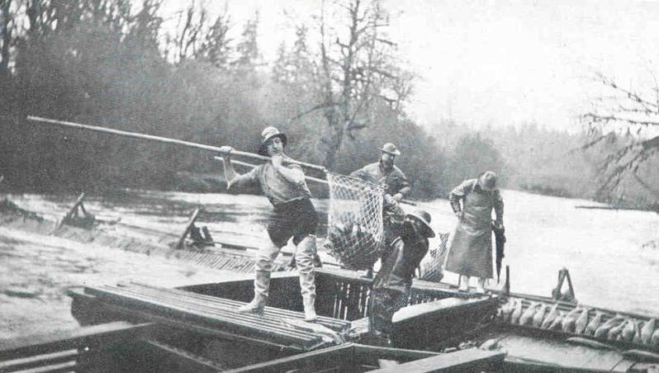
Catching fish for the Chehalis salmon hatchery 1916

Slide 17
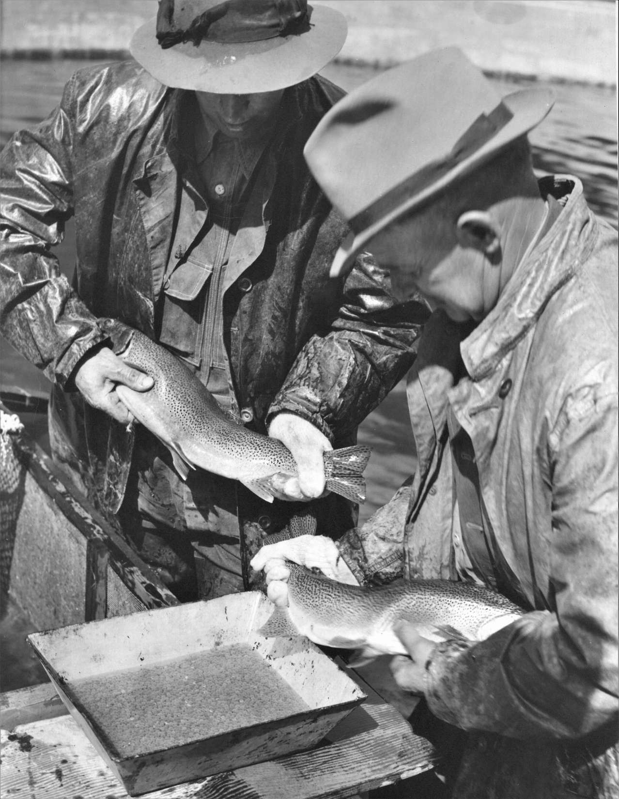
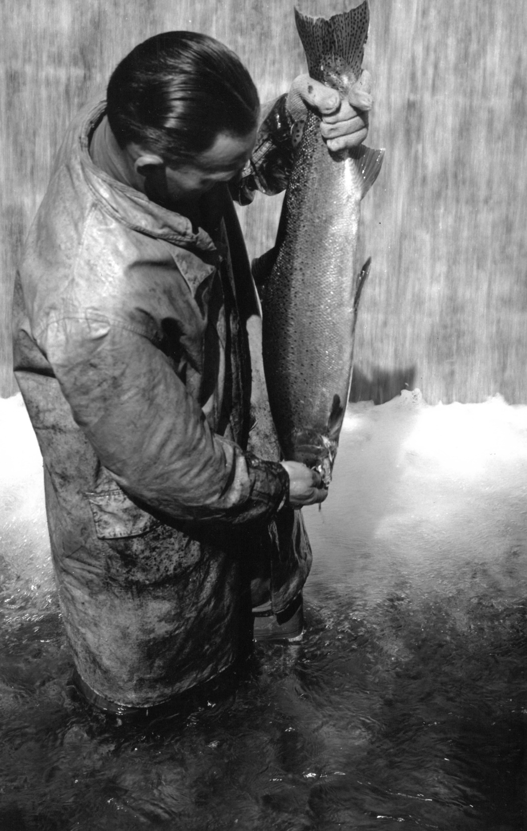
Lake Chelan trout hatchery 1903

Slide 18
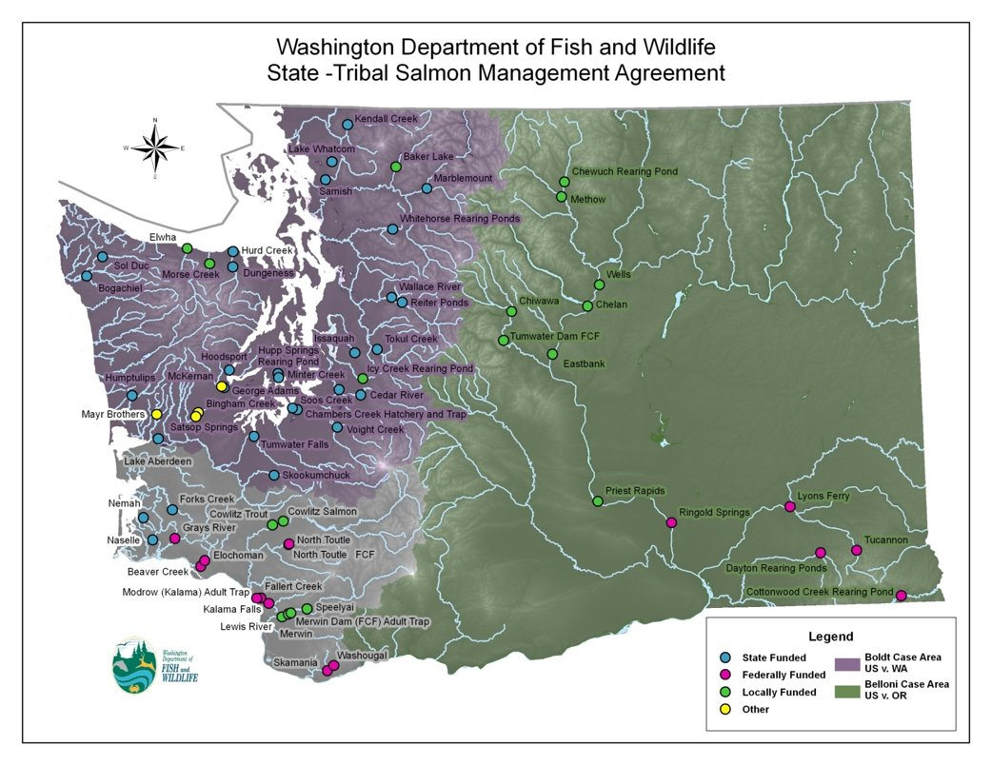
Notes:
This map shows all of the state, federal, tribal, co-run, and other hatcheries in Washington.

Slide 19
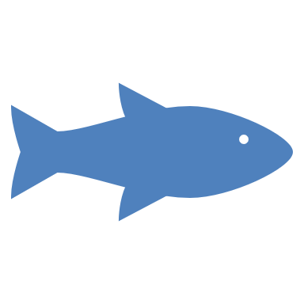

Fish hatcheries today
Why are hatcheries still important today?
Enhancement
Mitigation (relief)
Education
Conservation

Slide 20
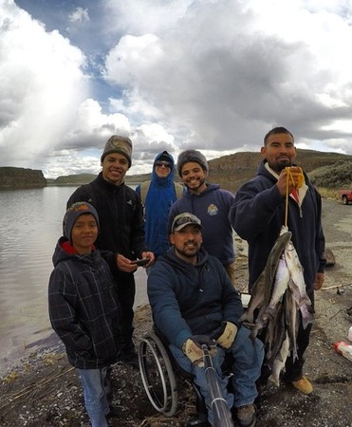
Enhancement- Production of extra fish to increase harvest by sport and commercial fishers.

Slide 21
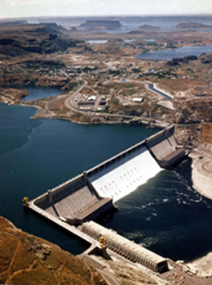
Mitigation- to replace natural spawning lost when dams cut off or flooded spawning and rearing areas.

Slide 22
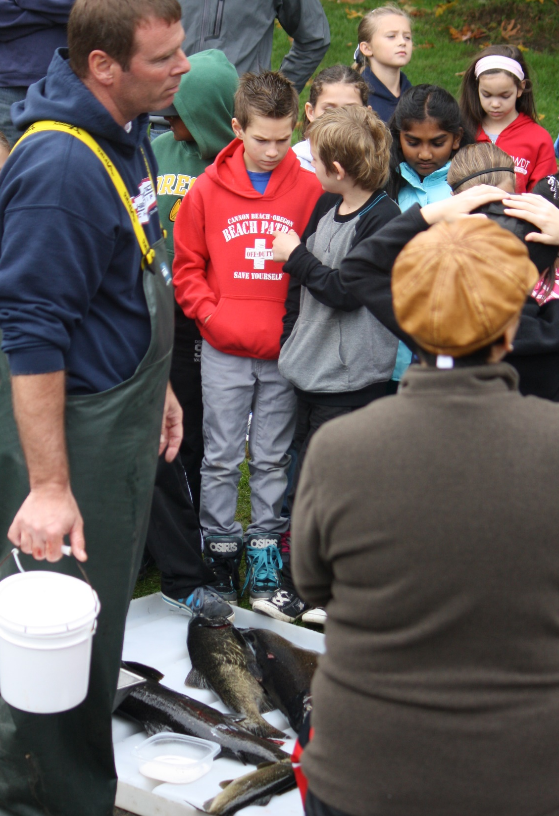
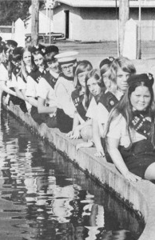
Education- Hatcheries provide the public a chance to see spawning fish and learn about fish and habitat.

Slide 23
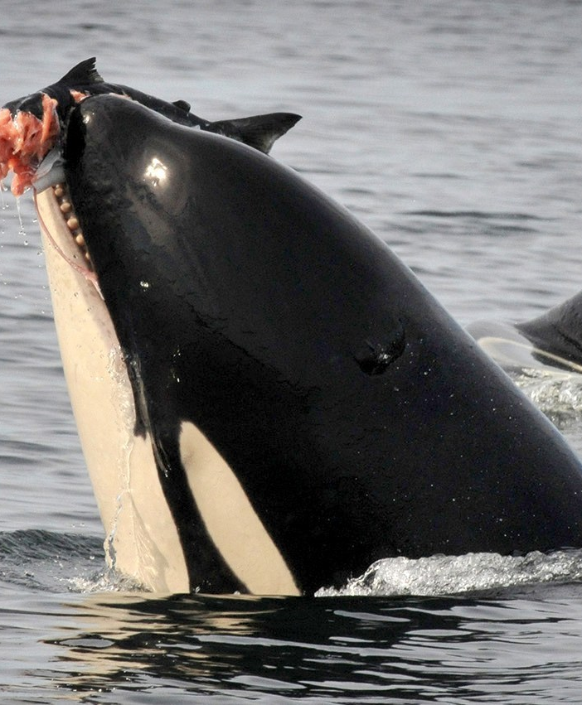
Conservation- Hatcheries are used to rehabilitate declining stocks of fish, and even support endangered species like the orca.

Slide 24
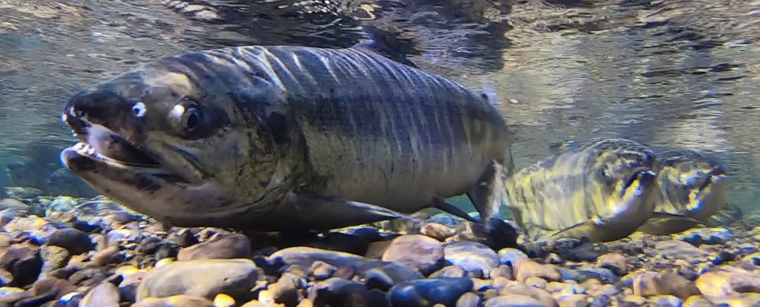
With the need for recreational and commercial fish and the need to protect wild fish, hatcheries work in partnership with wild stocks.
This allows us to maintain healthy supplies of native and local stocks. .

