Slide 1
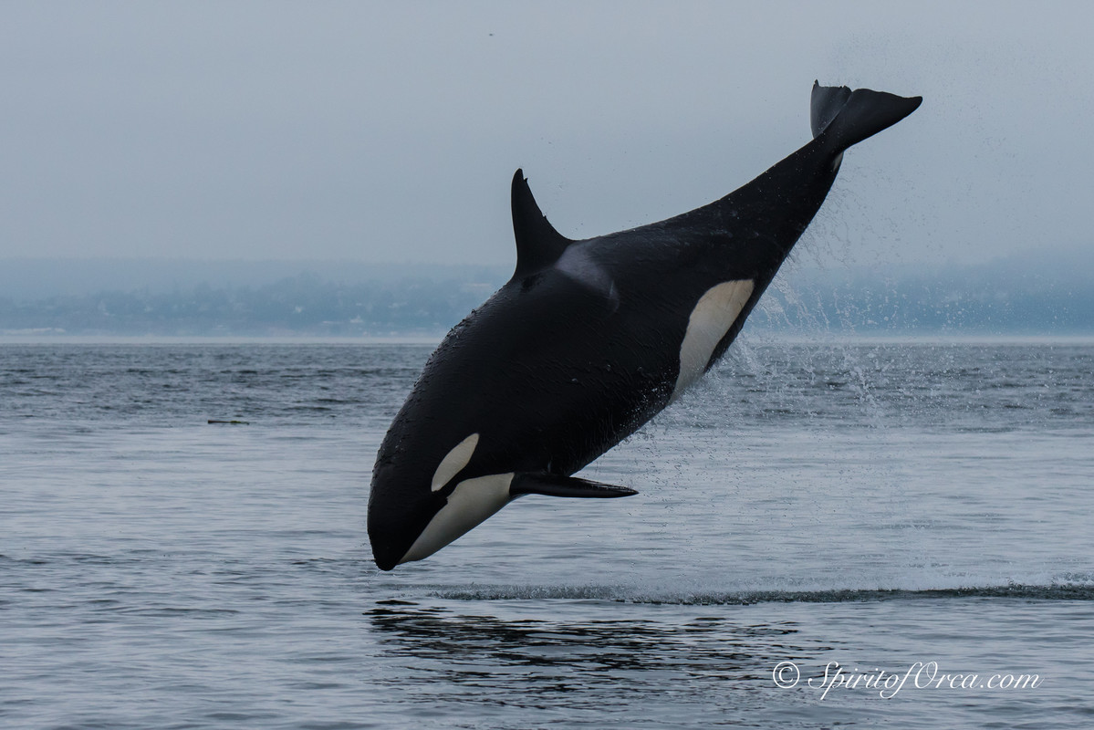
Marine Mammals in Washington

Slide 2
How to read a species’ name.
Humpback Whale, Megaptera novaeangliae
Scientific name
Common name
Notes:
What does the second name mean?
Common names are names we use to identify species within our communities. The trouble with common names is that one species may have multiple common names, and different species may have the same common name.
In order to make sure each species is identified, researched and spoken about correctly, scientists use a species’ scientific name to identify it. Scientific names are a global system of naming all living things including plants, bacteria, fungi, and more.

Slide 3
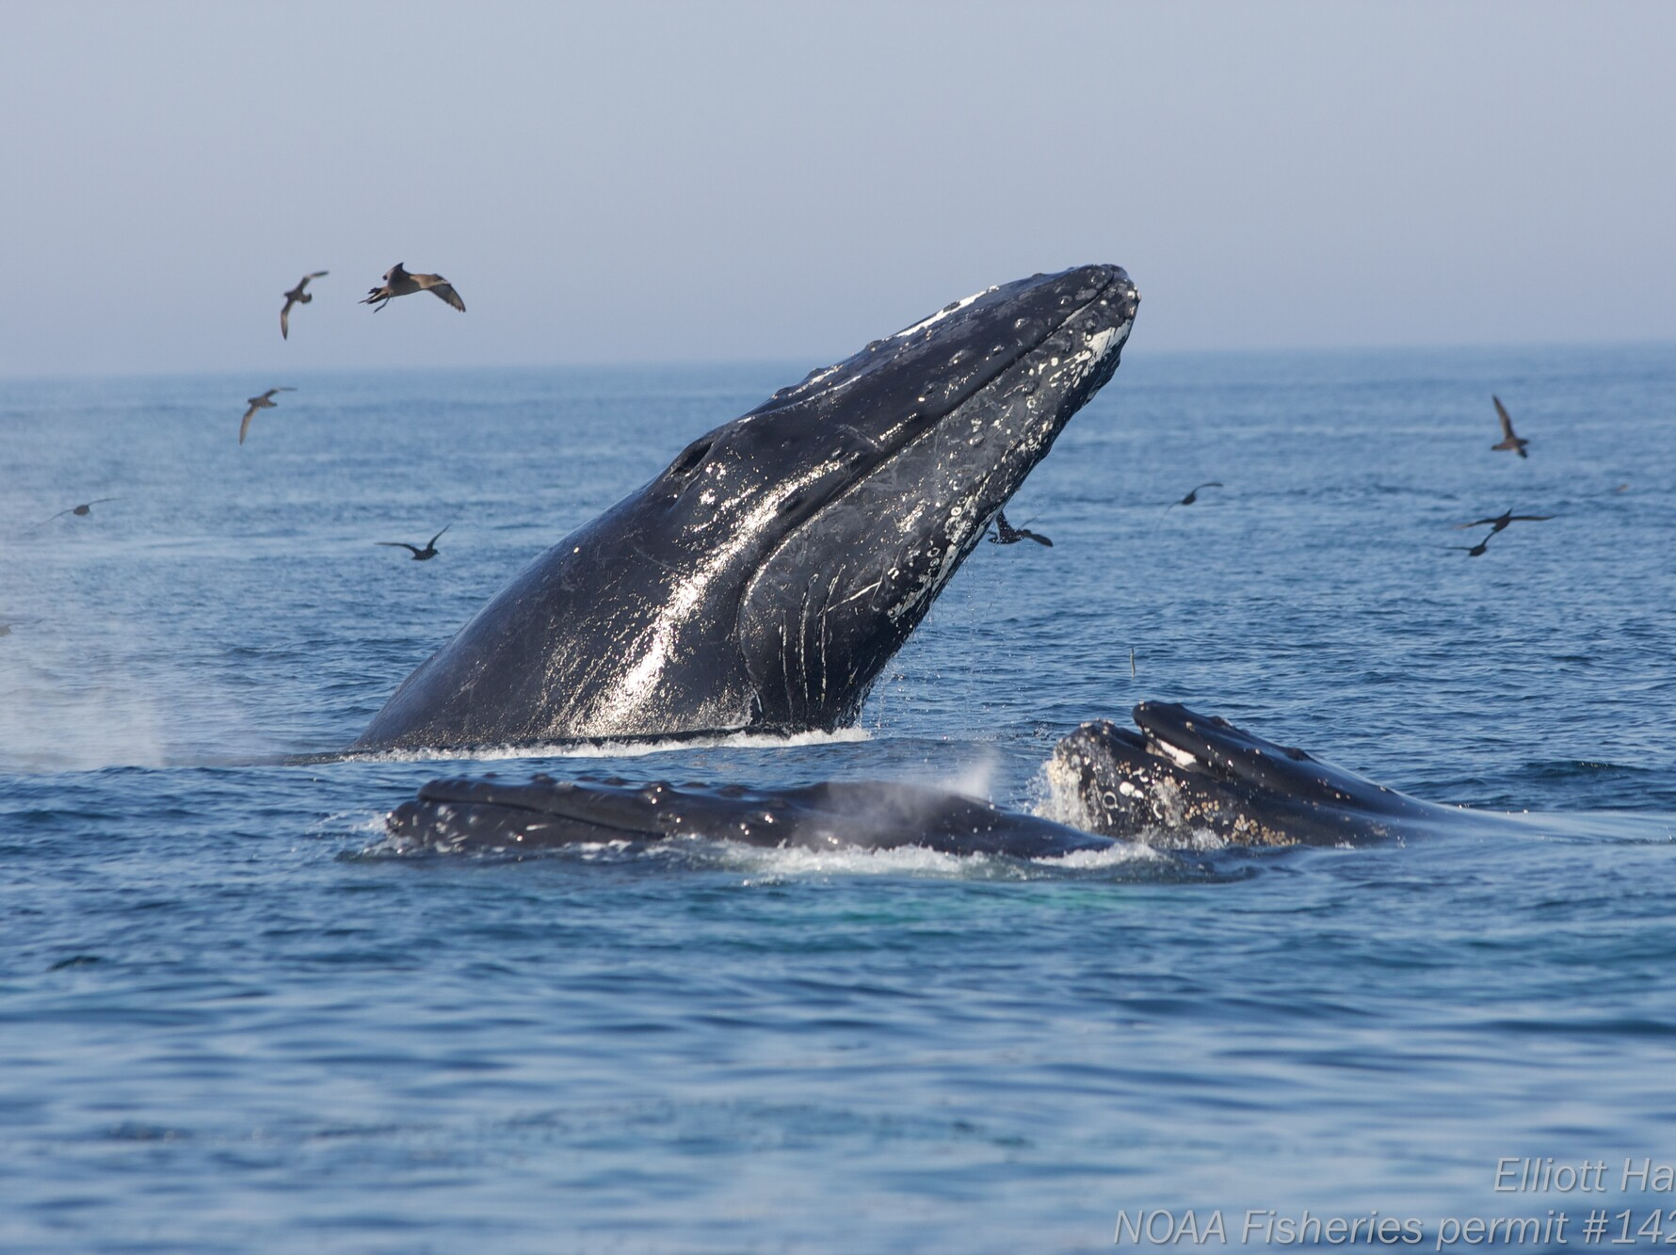
Whales
Humpback Whale, Megaptera novaeangliae
Adult Length: About 52 ft. Adult Weight: Up to 90,000 lbs. Description: Large baleen whale with a black to slate gray back and white markings underneath. Behavior: Exhale with a large blow that is visible for long distances. Can be very active, often breaching, flipper slapping or tail lobbing. Listen to their song!

Slide 4
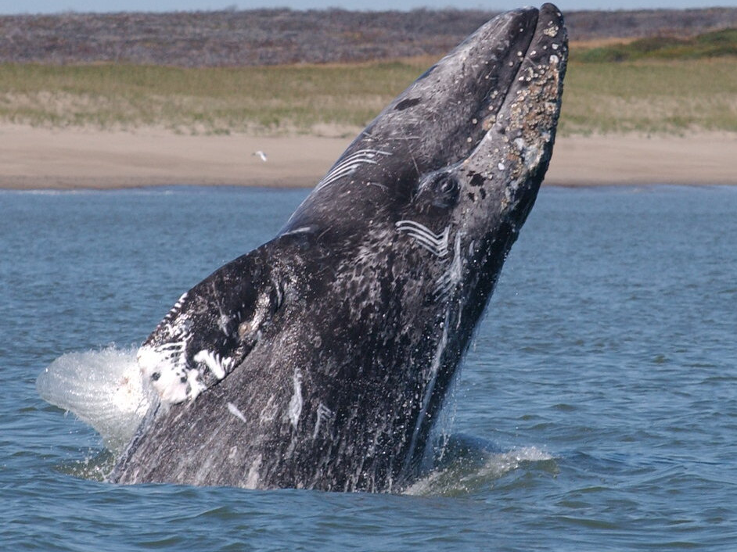
Whales
Gray whale, Eschrictius robustus
Adult Length: 39 to 46 ft., Adult Weight: 15,000 to 39,000 lbs. Description: A mottled gray color. Behavior: Feeds on the ocean floor in shallow water (usually 150-400 feet) by rolling onto its side, sucking up sediment, and pressing water and sediment out through the baleen to filter out and eat organisms living in the mud. It is normal to see these whales kicking up sediment while they feed.

Slide 5
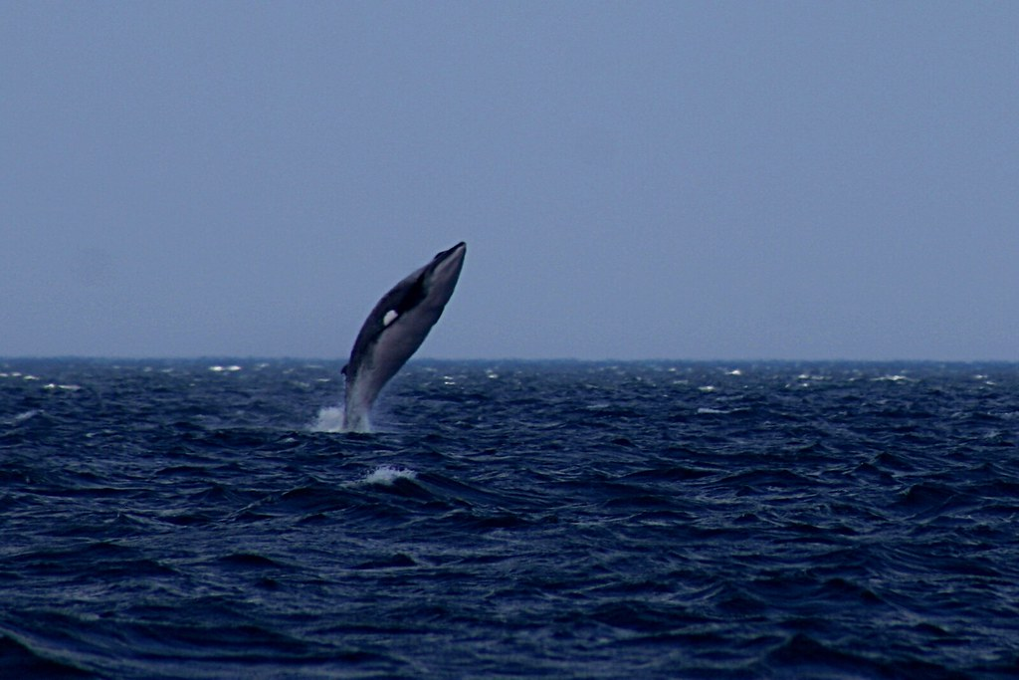
Whales
Minke Whale, Balaenoptera acutorostrata
Adult Length: About 50 ft. Adult Weight: Up to 20,000 lbs. Description: The smallest baleen whale in North American waters. Has a dark gray or black body with a white underside. Behavior: Usually solitary and the blow is rarely visible. Can be active at the surface, but does not typically display tail flukes when diving. Listen to their song!
"Minke Whale Breaching" by Martin Cathrae is licensed under CC BY-SA 2.0

Slide 6
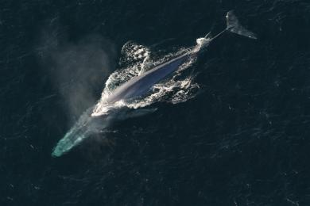
Whales
Blue whale, Balaenoptera musculus
Adult Length: 110 ft. Adult Weight: 330,000 lbs. Description: Blue whales are the largest animal on the planet! They have a long body and generally slender shape. Their mottled blue-gray color appears light blue under water Behavior: Blue whales sometimes swim in small groups but are more often found alone or in pairs. When blue whales hunt for food, they filter feed by swimming toward large schools of krill with their mouth open. Listen to their song!

Slide 7
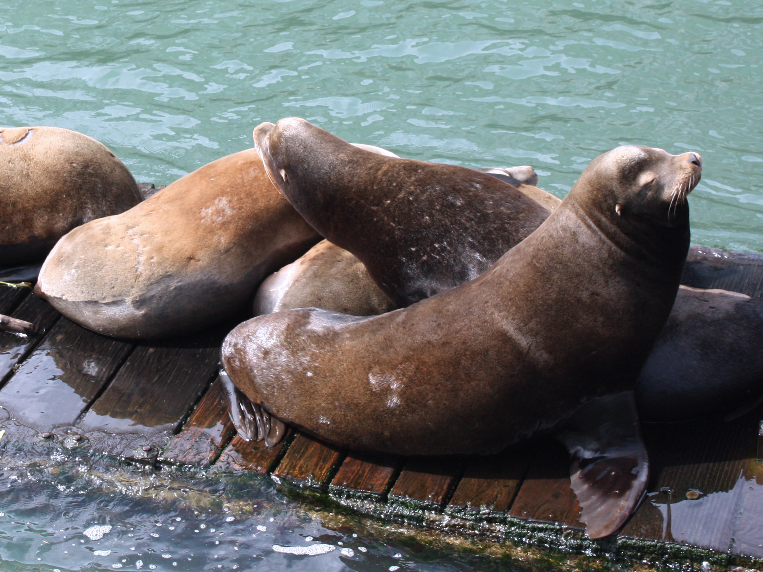
Sea lions
California Sea Lion, Zalophus californianus
Adult length: Males 8 ft., females 5 ft. Adult weight: Males 800 lbs, females 250 lbs Description: Fur ranges in color from dark brown in males to a lighter golden-brown in females. At around five years, the males develop a bony bump on the top of their skulls, called the sagittal crest. Behavior: Very social and playful, frequently seen on piers or buoys, or floating together on the surface in “rafts.” A behavior called “sailing” is common: the animals will hold a motionless flipper out of the water as they float on the surface. This helps them regulate their body temperature. They walk on all four flippers on land.

Slide 8
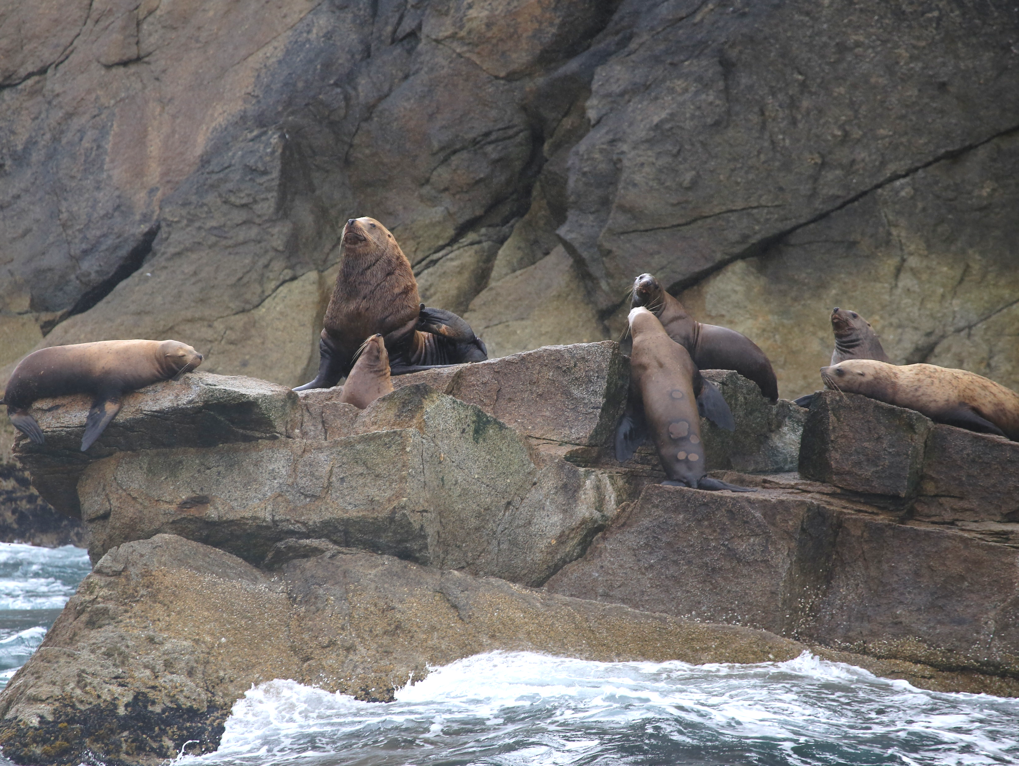
Sea lions
Steller Sea Lion, Eumetopias jubatus
Adult Length: Males 8.5-11 ft., females 6-7 ft.
Adult Weight: Males to 2,500 lbs., females to 1000 lbs. Description: Steller sea lions are much larger and lighter in color than California sea lions. They have light brown to reddish-brown coats. Males do not have a sagittal crest. Behavior: They are often seen leaping or swimming quickly along the surface. When on land they walk on all four flippers.

Slide 9
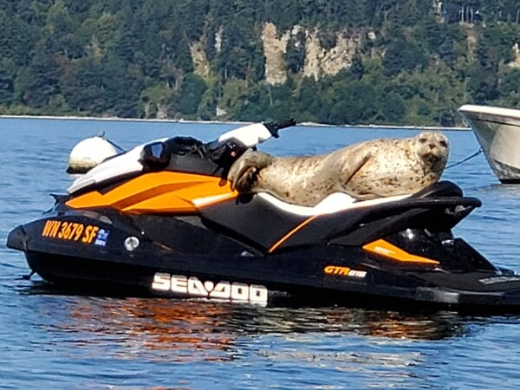
Seals
Harbor seal, Phocea vitulina
Adult Length: 4-6 ft. Adult Weight: up to 300 lbs. Description: Spotted coat in colors ranging from silver-gray to tan-brown. White whiskers. Behavior: Adults commonly haul out on beaches during the day to rest, warm their bodies and socialize. Seals can sleep underwater, surfacing every 30 minutes to breathe. Adults are usually wary of humans and enter the water when disturbed. They move with an awkward wriggling motion on land, called “galumphing”. Listen to their growl!

Slide 10
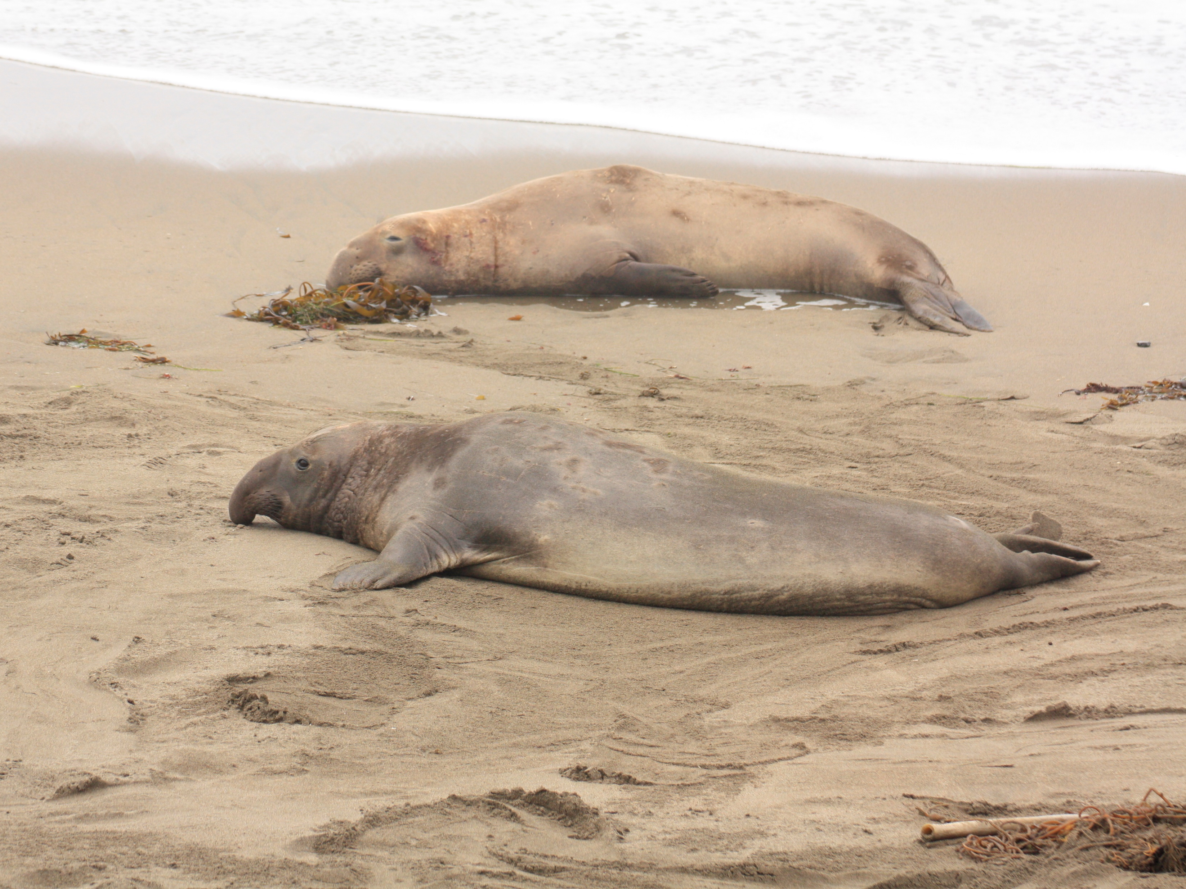
Seals
Elephant seal, Mirounga angustirostris
Adult Length: Males 12-16 ft., females 7-12 ft. Adult Weight: Males to 5000 lbs, females to 2000 lbs. Description: Pups are born with a black coat which turns silvery-gray and then brown as an adult. Males start developing a large, characteristic, elephant-like nose between three and five years-old. Behavior: They spend up to 90 percent of their lives underwater and can dive to 5000 feet, holding their breath for up to 80 minutes, but they move with an awkward wriggling motion on land.

Slide 11
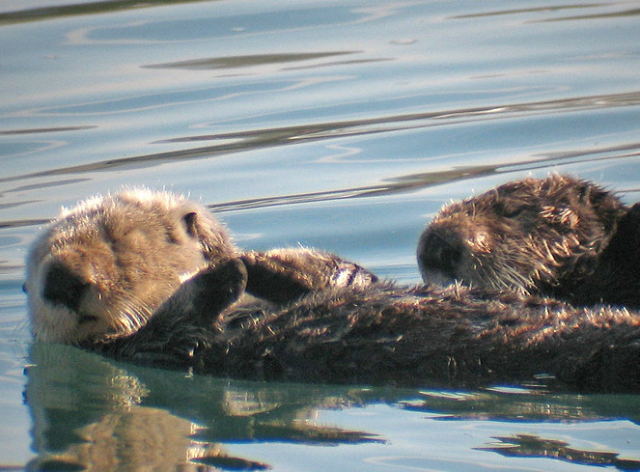
Weasels
Sea otter, Enhydra lutris
Sea Otters" by K Schneider is licensed under CC BY-NC 2.0
Adult length: Up to 5 ft. Adult weight: Up to 100 lbs. Description: Brown body with light gray head. Short, stocky tail. Webbed, flipper-like feet. Behavior: Rarely leave the water. Almost always swim, rest and feed while on their backs.

Slide 12
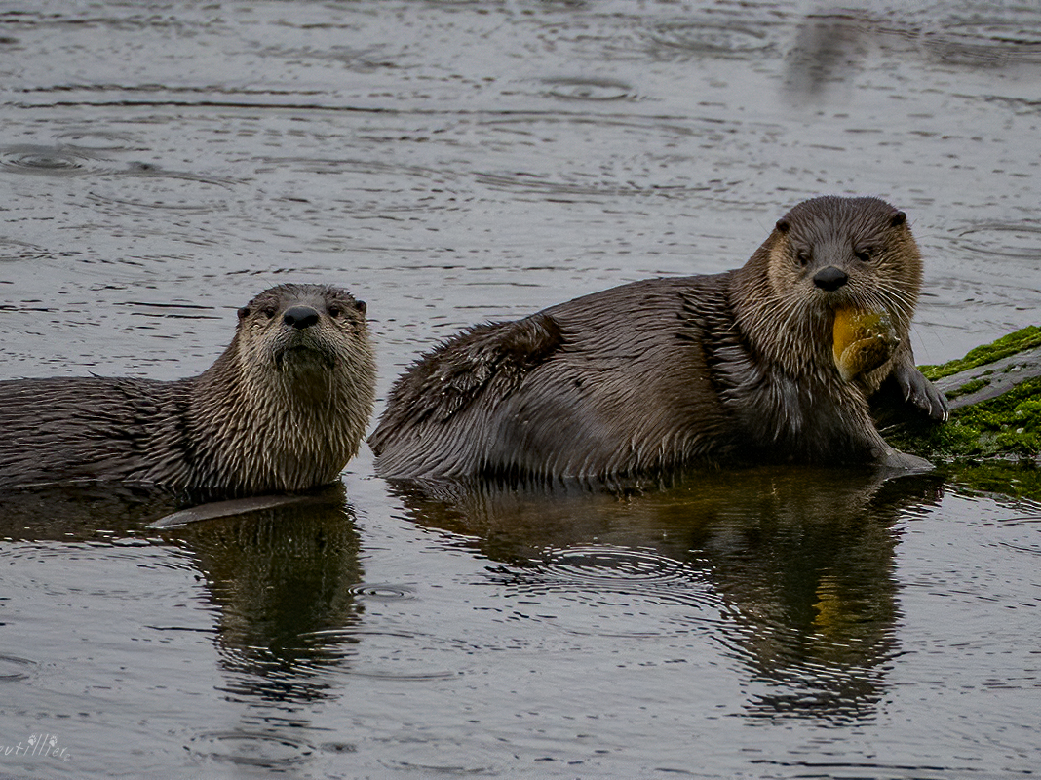
Weasels
River otter, Lontra canadensis
Adult length: 3-5 ft. Adult weight: 15-30 lbs.
Description: Brown, thickset body with small ears. No webbing on back feet like sea otters. Behavior: Found on land and in fresh water as well as the coast. They will dive 60 feet to catch fish. They also eat crabs, mussels, shrimp, and even young seabirds when they have the chance.

Slide 13
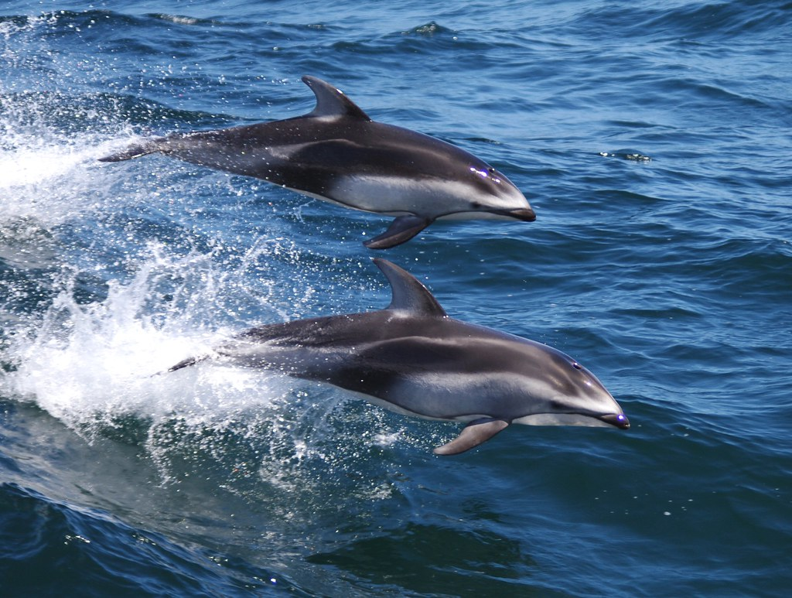
Dolphins
Pacific white-sided dolphin,
Lagenorhynchus obliquidens
Photo courtesy of NOAA fisheries
Adult length: 5-8 ft. Adult weight: 300-400 lbs.
Description: Their back, fluke (tail), and lips are black; their sides, dorsal fin, and flippers are gray; and their belly is white. They have a white or light gray stripe along their sides that extends from the eye to the tail, sometimes referred to as "suspenders." Behavior: They can be seen travelling in schools of thousands, but group sizes are usually between 10 and 100 animals. These extremely playful dolphins are often seen “bow riding” (swimming near the front part of a ship) and jumping, somersaulting, or even spinning in the air.

Slide 14
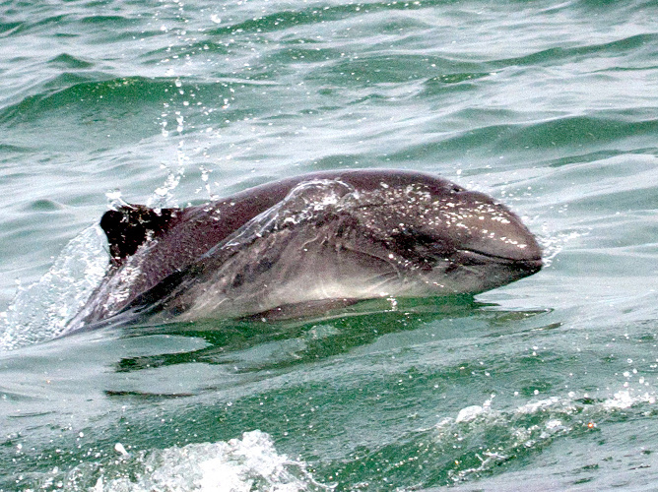
Dolphins
Harbor porpoise, Phocena phocena
Adult Length: 5 ft. Adult Weight: 135 to 175 lbs . Description: Gray brown to black on top with a light gray underside. Small, triangular dorsal fin. Behavior: Travel in small groups of 1-6 animals, surfacing with a slow roll and sharp exhale of breath. Prefer shallow coastal waters; generally shy and avoid boats. Listen to echolocation!

Slide 15
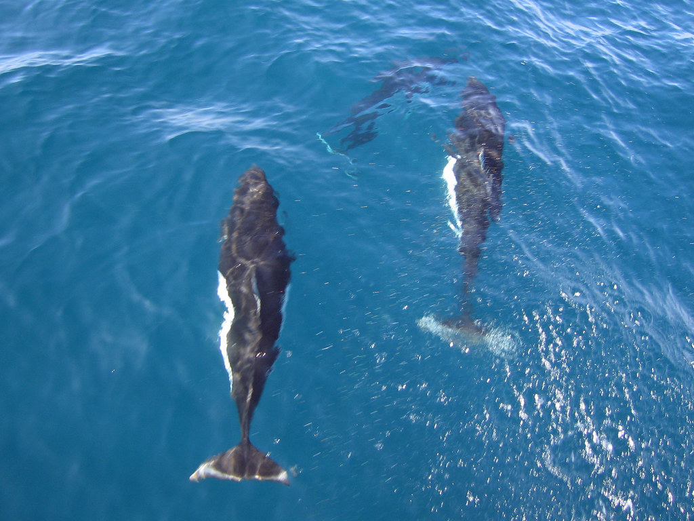
Dolphins
Dall’s porpoise, Phocoenoides dalli
"Dall's Porpoise" by Greg Schechter is licensed under CC BY 2.0
Adult Length: 6 ft. Adult Weight: Up to 490 lbs . Description: Black with white markings on flanks and belly, white tip on the dorsal fin and white edging on the tail fluke. Behavior: Typically seen in groups of 2-20 animals in areas of deep water. Very fast swimmers, often seen racing along the surface creating a "rooster tail" of spray. Known to seek out boats in order to ride the bow waves.

Slide 16
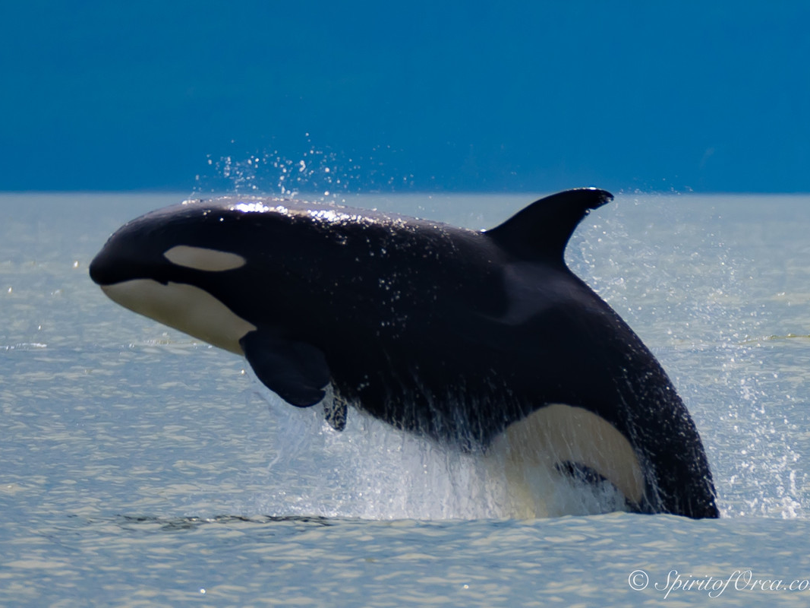
Dolphins
Orca, Orcinus orca
Photo by Ken Rea
Adult Length: Males to 32 ft., females to 28 ft. Adult Weight: Males to 22,00 lbs., females to 16,500 lbs. Description: Black on top, white undersides and a white patch near each eye. Each whale also has a unique gray or white “saddle” patch behind the dorsal fin. Behavior: Usually travel in groups of 5-20 individuals, but can be in larger or smaller groups. Can travel up to 100 miles in one day. Listen to their call!

Slide 17
Marine mammal adaptations
What do you think are some adaptions that Washington’s marine mammals have?
What were some differences you noticed?
Why do you think are some mammals huge (blue whale) and others are smaller (otters)?
Why do you think some are social and some are solitary (alone)?
Notes:
Have students think-pair-share.

Slide 18
Let’s dive deeper
You will choose one of the marine mammals we just learned a little bit about.
You will research and explore how they use their senses and what adaptations they have to help them survive.

Slide 19
Let’s dive deeper
After choosing a species you will report on:
What senses are used to travel, find food, mates, etc.
How they forage/catch their food/eat.
Are they social or solitary (alone)?
If they ever go on land. If they do, why this is important?
How do they get oxygen?
How do they stay warm?
Where are their babies born?
Are there other special senses or unique adaptations (like echolocation)?

