Slide 1
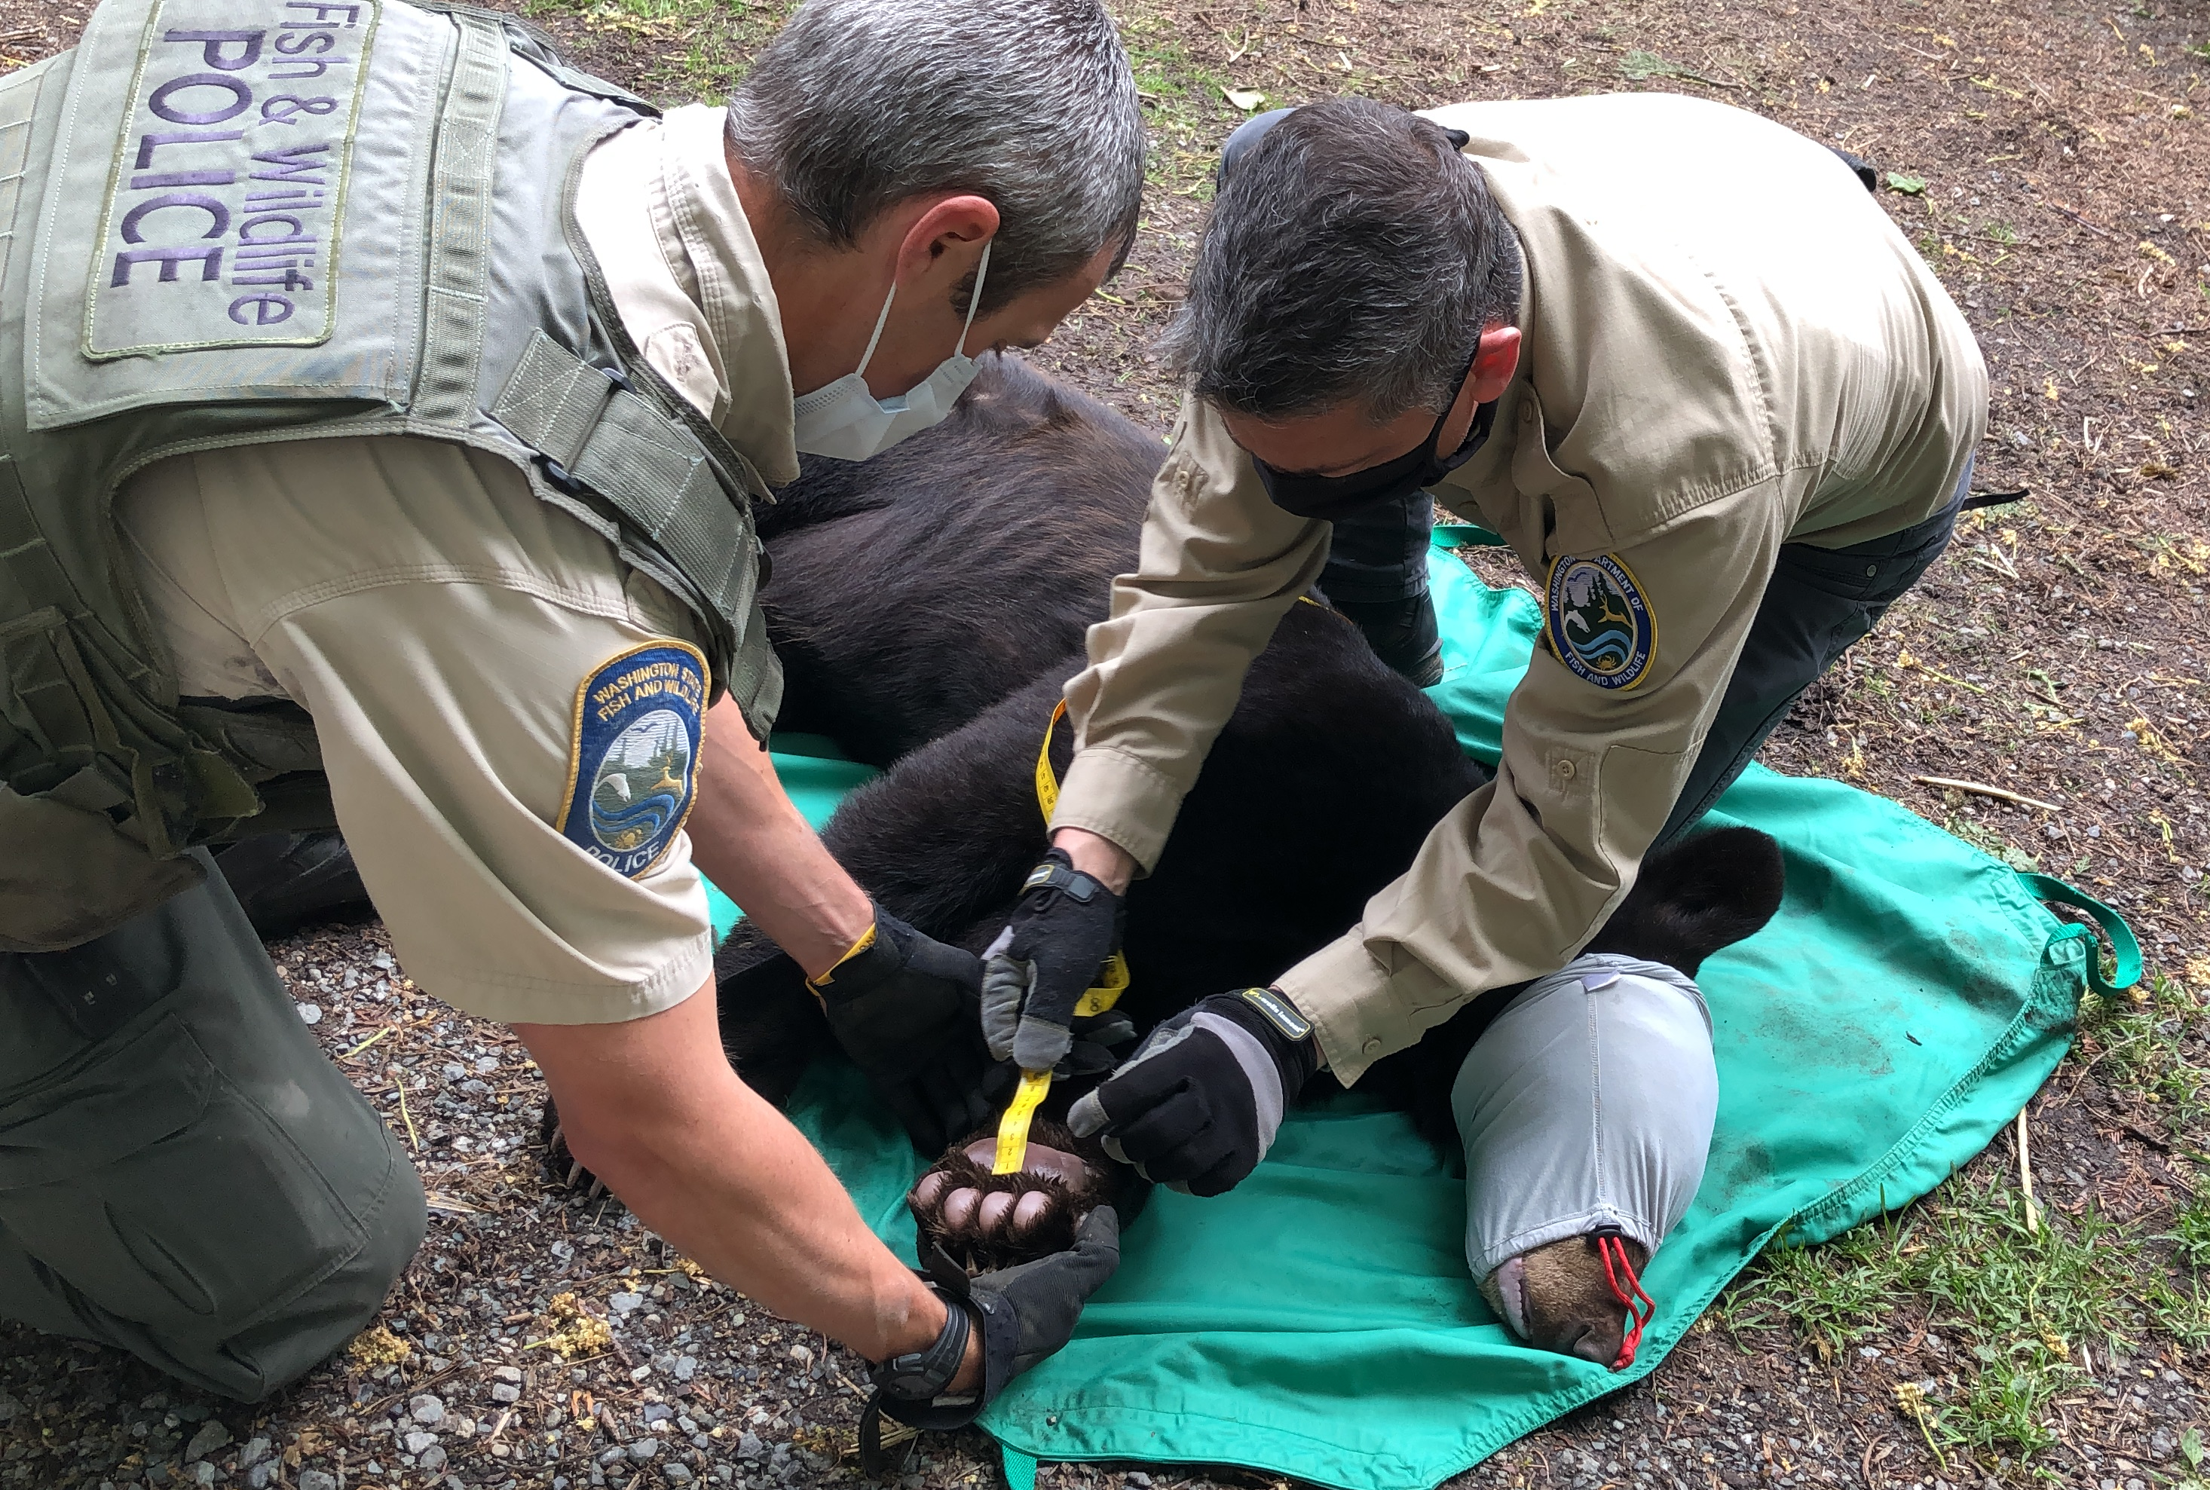
What is wildlife rehabilitation?

Slide 2
What is wildlife?
Notes:
It may seem like a simple question, but ask students what it means for an animal to be considered wildlife?

Slide 3
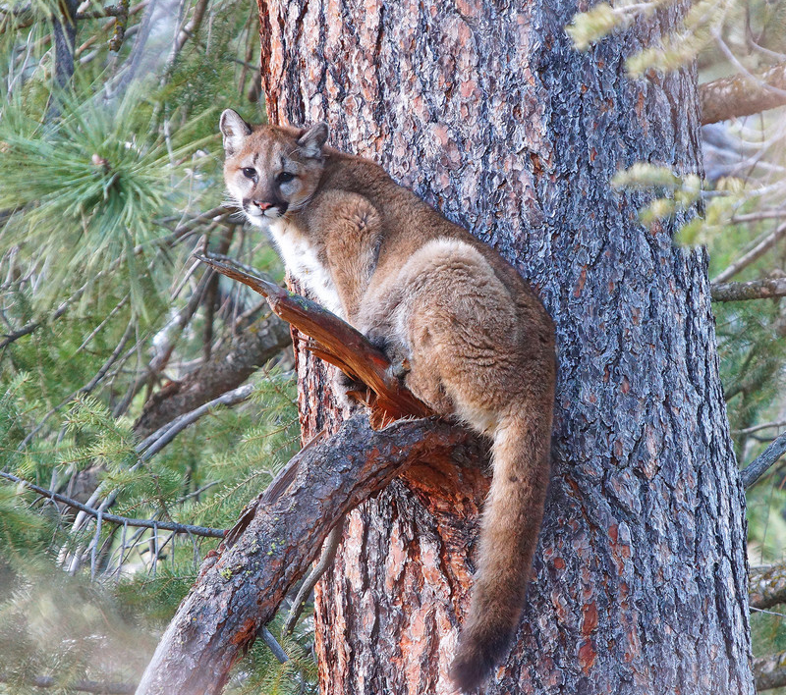
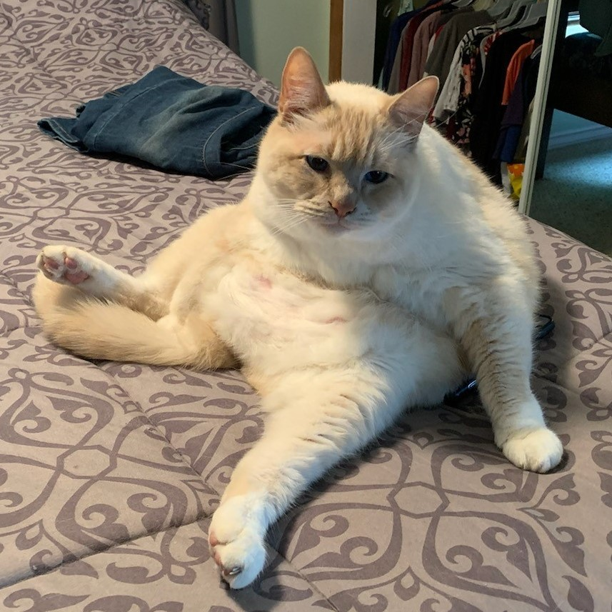
How are wildlife and domestic animals different?
Domestic animals have been selectively bred by humans over many generations.
Wild animals have survived in their ecosystems for the entire existence of their species. They have never been selectively bred for the purposes of humans.
Notes:
There are differences between wildlife and domestic animals. Domestic animals often rely on humans for food, water, and shelter and sometimes companionship. Where wild animals are self-reliant and should fear and/or avoid humans to prevent conflict.

Slide 4
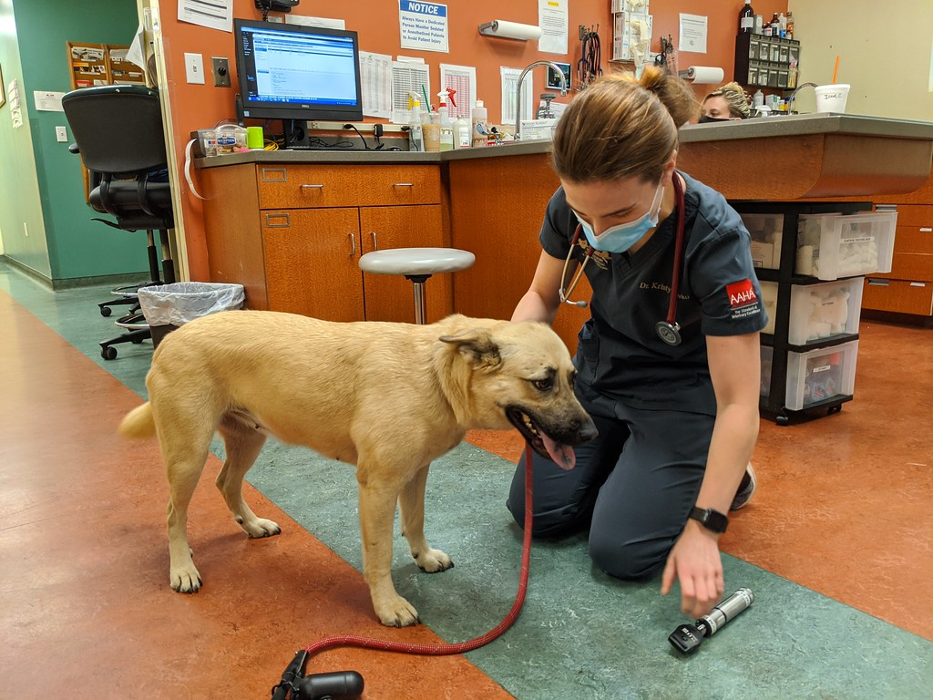
If your pets or livestock are sick, where do they go?
Photo by Kerri Lee Smith is licensed under CC BY-NC-SA 2.0
Notes:
People take sick or injured domestic animals to a veterinarian. Most people know how to feed and care for domestic animals, but lack the training and experience to care for wild animals.

Slide 5
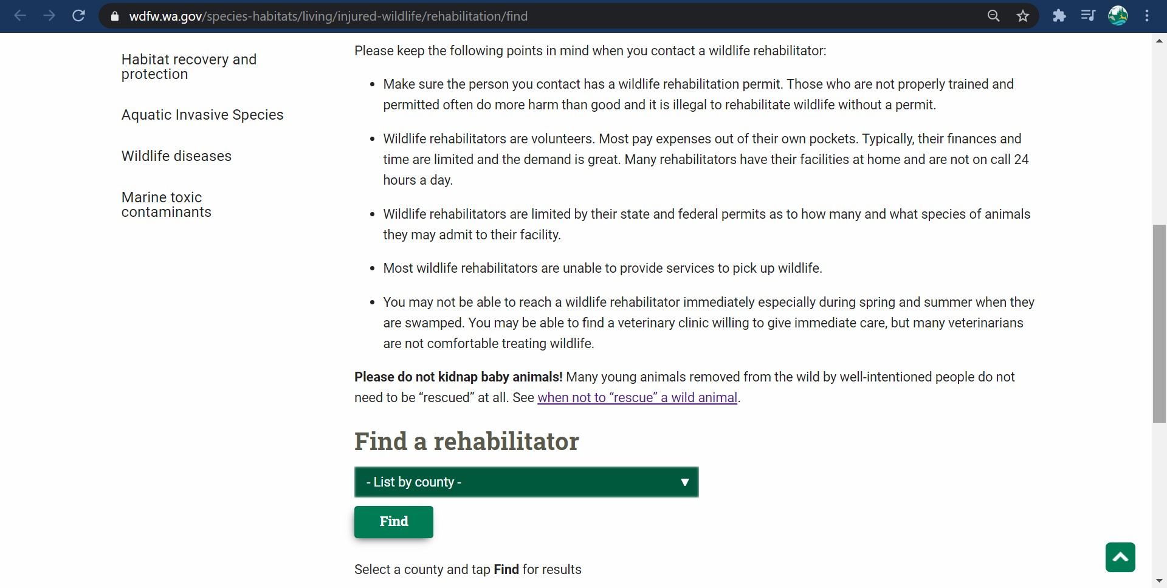
Where does wildlife go when they are sick or injured?
If you have found a wild animal in need of care, call a permitted rehabilitator as soon as possible and follow their instructions.
https://wdfw.wa.gov/species-habitats/living/injured-wildlife/rehabilitation/find
Notes:
Just like veterinarians, wildlife rehabilitators are trained medical professionals. In fact, wildlife rehabilitators work with wildlife veterinarians to help wildlife. Here’s the address where you can find a licensed rehabilitator near you. You can also Google, “WDFW wildlife rehabilitation”.

Slide 6
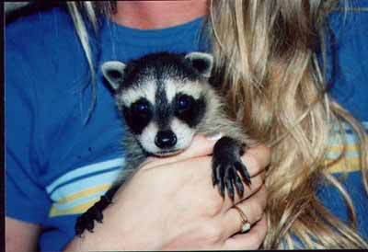
Keeping Wildlife Wild
Although well intentioned, members of the general public who try and care for wild animals often end up doing them more harm than good.
Caring for an orphaned wild animal at home can be dangerous for the animal and person.
Notes:
It may be surprising, but a wild animal’s needs and requirements vary from species to species and are much different than the domestic animals we know how to care for.

Slide 7
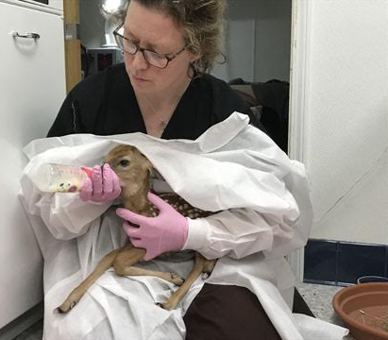
Why is it important to contact a licensed rehabilitator?
They are trained medical professionals.
Just like doctors and veterinarians, they have the education and experience to take in and release wild animals.
Photo from Fellow Mortals Wildlife Hospital-Wisconsin
Notes:
A wildlife rehabber is working to prevent imprinting and human habituation in this fawn. Imprinting is s a natural process that describes how an animal decides “who they are.” It is a critical behavior that helps to establish the concept of “parent” and “self.” Taking place early in life, it is a process that is irreversible and when wild animals are imprinted or habituated with humans, they most likely have to be euthanized.

Slide 8
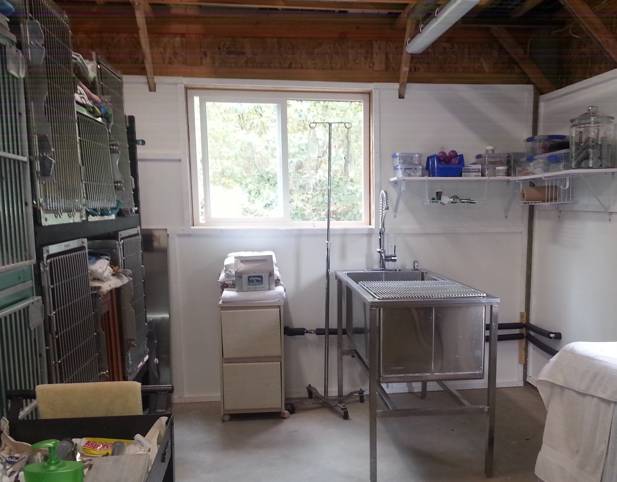
Why is it important to contact a licensed rehabilitator?
They have the space, equipment, tools, and knowledge required to care for sick and injured wild animals.
Treating a wildlife patient can include taking blood, x-rays, special diets, housing, medications, and so much more!
Photo from Discovery Bay Wild Bird Rescue
Notes:
Despite their best intentions, people without these resources, knowledge, space, and equipment are going to harm the animal more than help it.

Slide 9
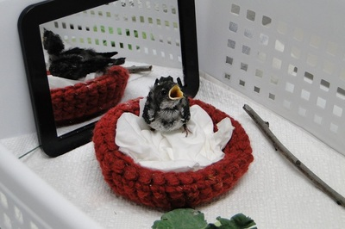
Why is it important to contact a licensed rehabilitator?
Rehabbers know species’ ecology.
What to feed them, how much, and how often.
Animals’ behaviors and social or solitary needs.
Diseases or pests the animal may carry, and the proper personal protective equipment (PPE) needed to prevent transmission.
Photo from Featherhaven
Notes:
Introduce new vocabulary word species ecology.

Slide 10
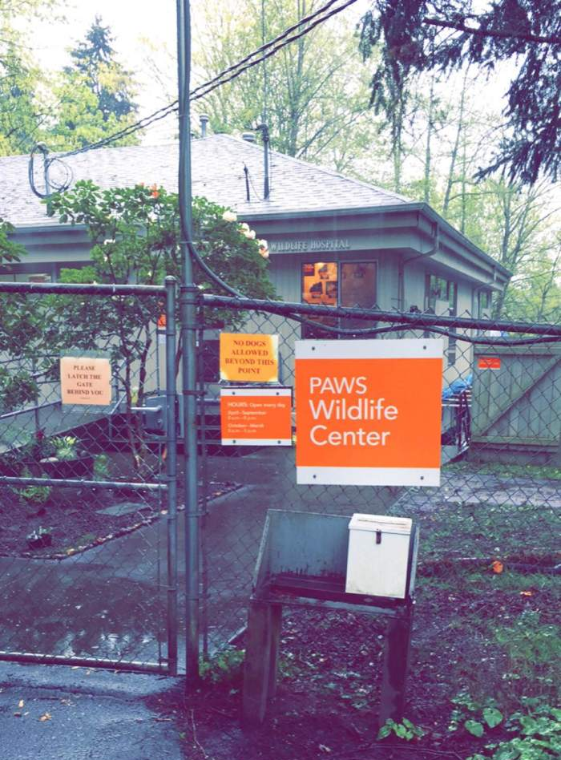
Keeping Wildlife Wild
Let’s take a visit to PAWS wildlife rehabilitation center to see how it’s done.
Notes:
Introduce new vocabulary word species ecology.

Slide 11
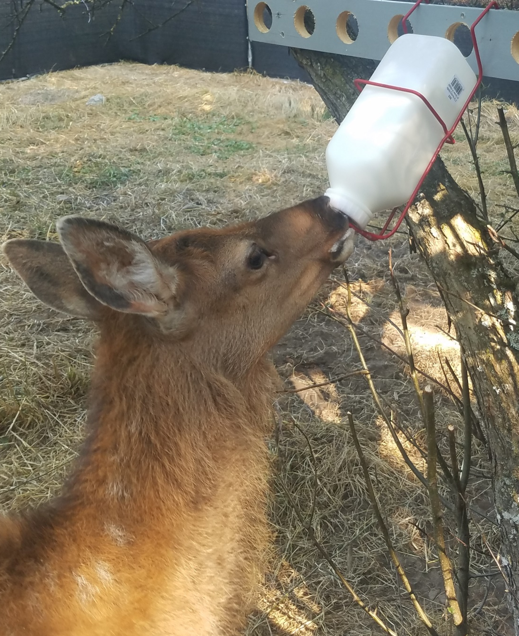
Keeping Wildlife Wild
Wildlife species differ widely in terms of their capture, care, and handling requirements.
If you are not properly trained, you could make an animal’s situation worse, or kill it.
You could also unknowingly bring disease and pests into your home, family, and pets.
Photo from A Soft Place to Land
Notes:
Wildlife rehabilitators like PAWS use special equipment to care for animals without allowing them to learn that people are a good source of food. This keeps the wild animals safe.

Slide 12
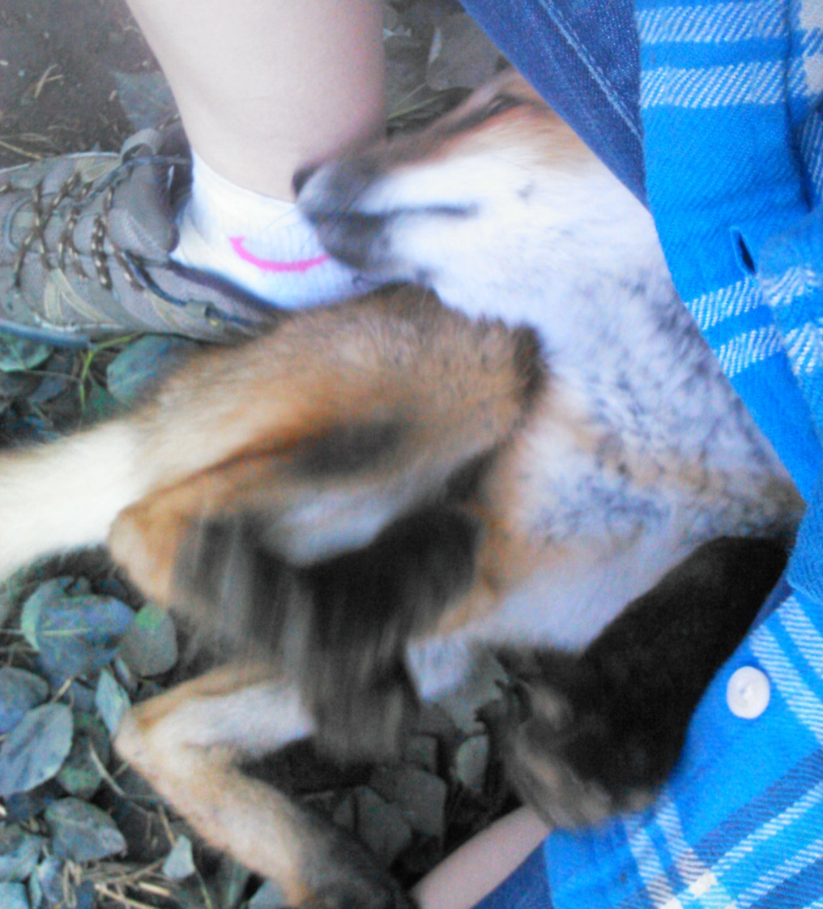
Keeping Wildlife Wild
If kept improperly, animals may lose their natural fear of humans and become more vulnerable to predation or injury.
Euthanasia is often the only option for wild animals that become habituated to humans.
Keeping wildlife either as pets, or to try and rehabilitate them yourself, is illegal.
Notes:
In this picture, a baby fox plays with a human. When the fox grows up, it will likely continue to go to humans for socialization and food, making it a likely candidate for euthanasia.

Slide 13
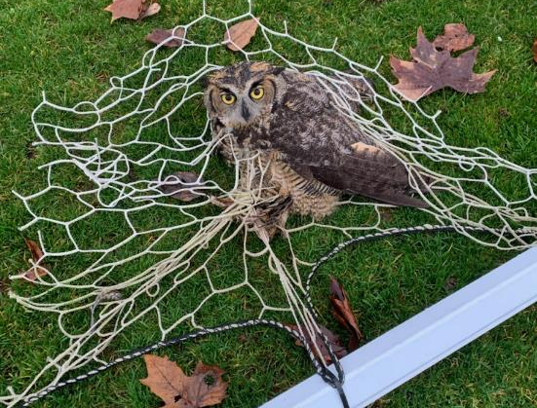
Why is wildlife rehabilitation important?
Washington Department of Fish and Wildlife works with rehabilitators to serve the public for the sustainability of fish and wildlife populations.
Wildlife rehabilitators provide a place for community members to bring sick or injured wildlife.
They also help reduce human impact on wildlife.
This great-horned owl got tangled in a soccer net on Mercer Island. A caring community member detangled the owl and brought it to PAWS for rehab. It was successfully released and can go back to catching mice and rats!
Notes:
The most common reasons wildlife are brought in to rehabilitation center include: being hit by a vehicle, caught by a domestic cat, hitting powerlines (birds), and more! Unfortunately, human activities can have a negative impact on wildlife. Rehabilitators help care for these animals and do their best to heal them.

Slide 14
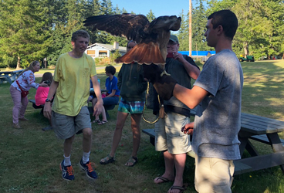
Why is wildlife rehabilitation important?
Washington Department of Fish and Wildlife works with rehabilitators to serve the public for the sustainability of fish and wildlife populations.
Provide education and outreach
Photo from Discovery Bay Wild Bird Rescue
Notes:
Education and outreach includes providing information about what to do in a wildlife emergency as well as fostering connections between the general public and wildlife species through licensed and permitted events.

Slide 15
Why is wildlife rehabilitation important?
Washington Department of Fish and Wildlife (WDFW) works with rehabilitators to serve the public for the sustainability of fish and wildlife populations.
By helping WDFW track diseases in populations such as white-nose syndrome, turtle shell disease, salmonella, etc.
At PAWS wildlife rehabilitation center, a bat is swabbed for white-nose syndrome (a deadly fungal disease for bats).
Photo from Paws Wildlife Rehabilitation Center
Notes:
This helps WDFW biologists see how disease may be spreading, and where it is spreading to. It also helps WDFW figure out how to best manage the disease in populations.

Slide 16
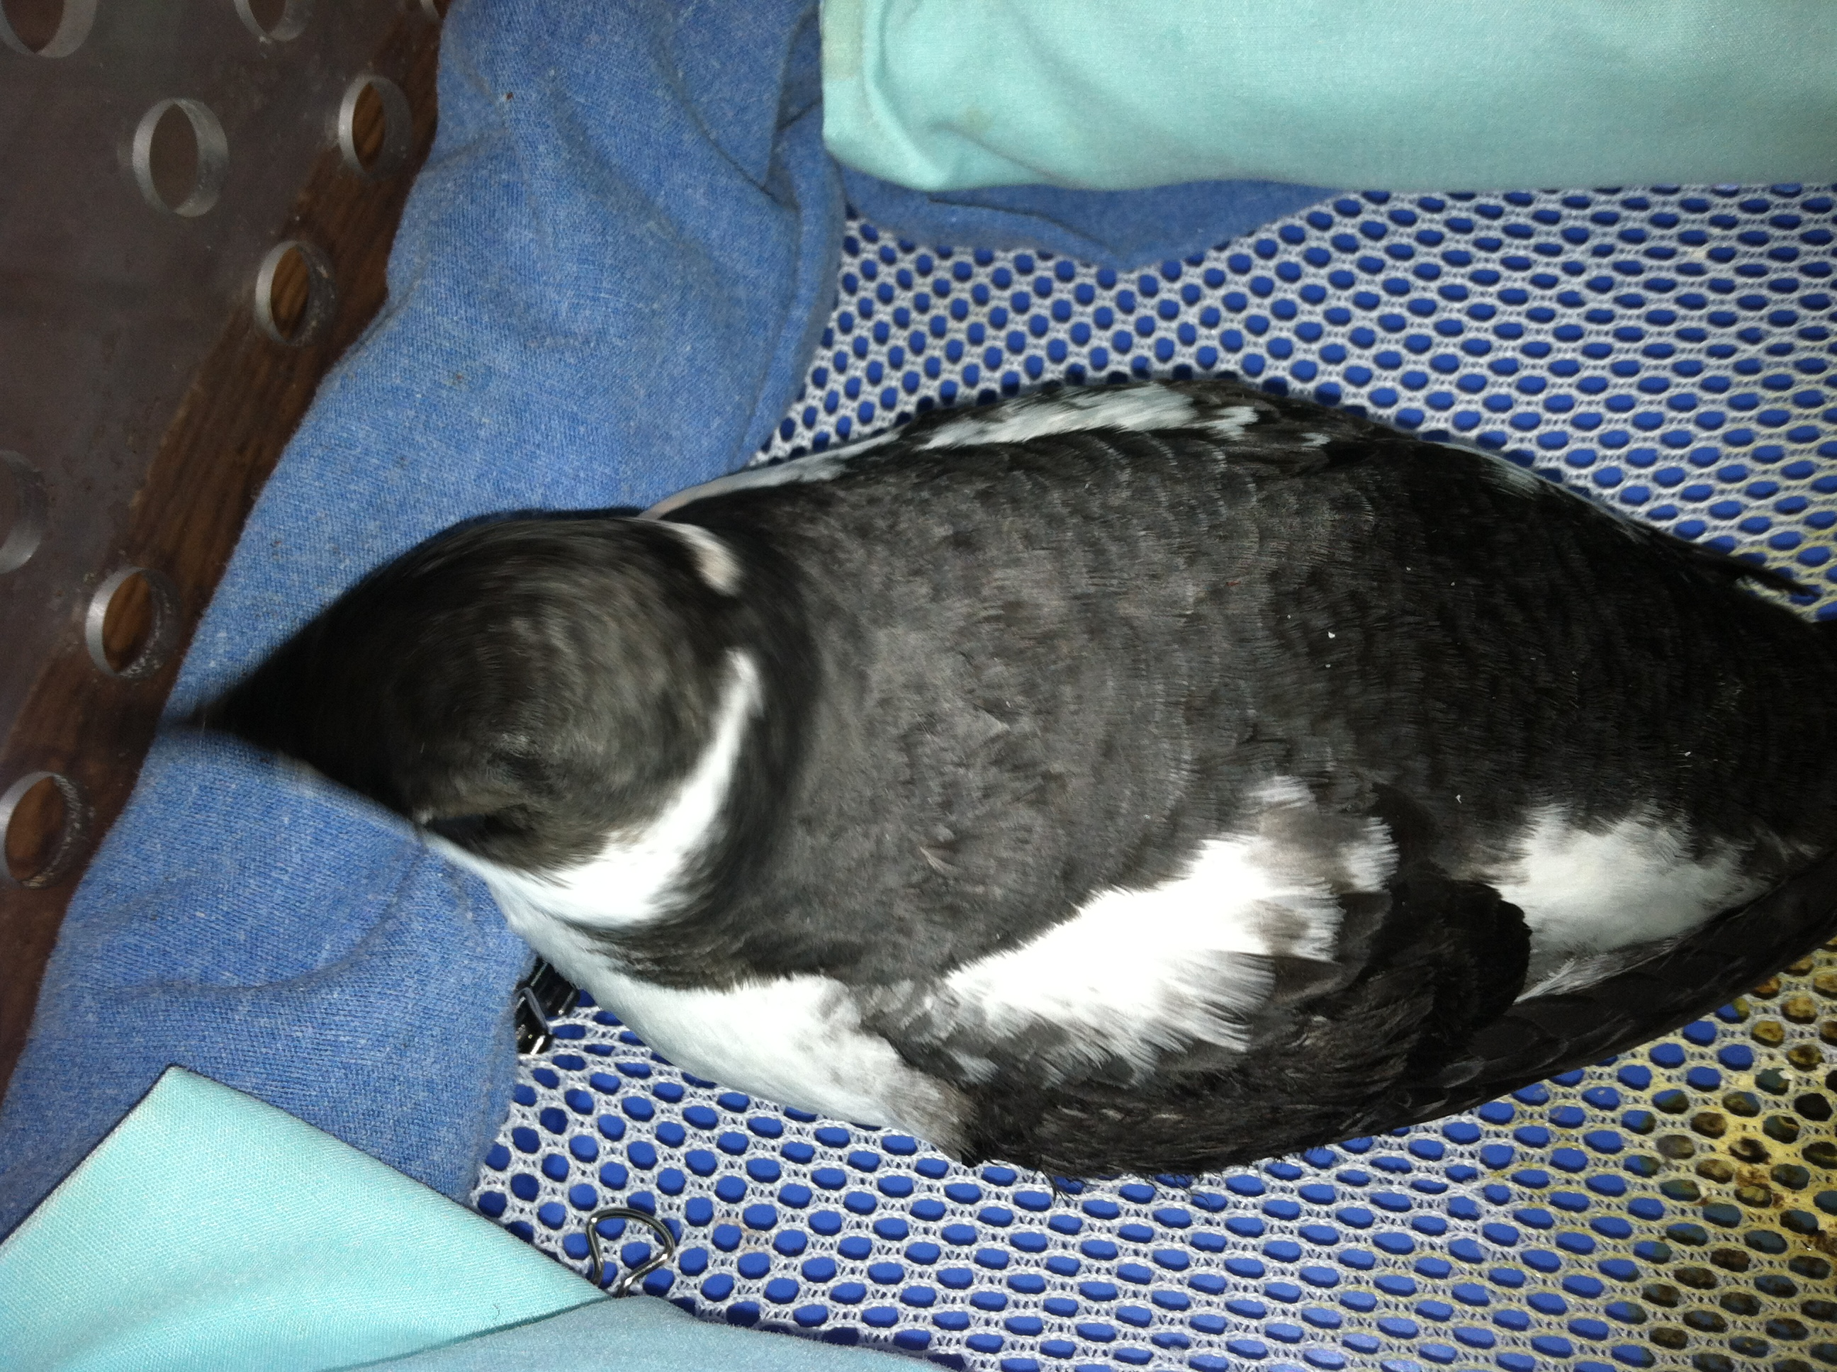
Why is wildlife rehabilitation important?
Washington Department of Fish and Wildlife works with rehabilitators to serve the public for the sustainability of fish and wildlife populations.
Help populations when endangered species are taken in.
A marbled murrelet is treated at Sarvey Wildlife Care Center
Photo from Sarvey Wildlife Care Center
Notes:
Endangered species are species at risk of extinction because they have so few individuals in the population. Even just saving one individual could help prevent the population survive.

Slide 17
What should I do if I find a wild animal I think is sick or injured?
Don’t touch the animal. With an adult, make sure the animal is clearly sick or injured.
Signs of serious distress include bleeding, vomiting, panting, shivering, lethargy, obviously ruffled feathers or fur, or evidence of an attack by a cat, dog, or other predator.
Most baby animals don’t need rescuing! Young animals are often left alone for hours while their parents gather food.
Next, call a wildlife rehabilitator near you!
Notes:
The link takes you to a video from PAWS that reiterates why it’s important to contact a rehabilitator. The next slide will show students once again how to find a licensed rehabilitator near them.

Slide 18
Find a wildlife rehabilitator near you
https://wdfw.wa.gov/species-habitats/living/injured-wildlife/rehabilitation/find
Notes:
Here’s the address where you can find a licensed rehabilitator near you. You can also Google, “WDFW wildlife rehabilitation”.

