Slide 1
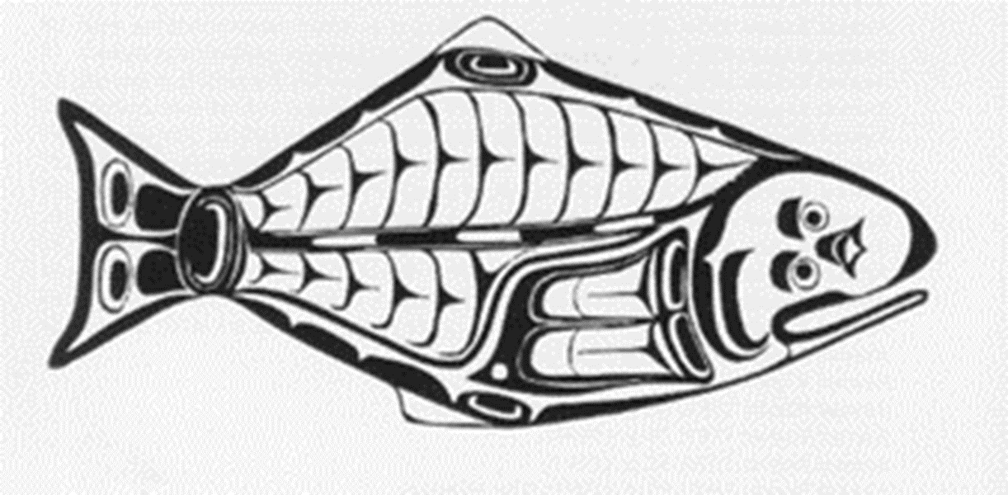
Pacific Halibut Plan 2023
October 4, 2022
Heather Hall and Lorna Wargo
WDFW Intergovernmental Ocean Policy

Slide 2
Agenda
5:00 – 5:15 pm Introductions/Purpose of the Meeting/Review Agenda
Purpose: Review discussion from August meeting including the preliminary 2022 catch summary, review the proposals and analysis for the 2023 halibut season, and discuss final recommendations.
5:15 – 5:30 pm Review IPHC Areas, Catch Sharing Plan, and halibut management history
5:30 – 6:00 pm Review 2022 catch and analysis of alternatives
6:00 – 7:00 pm Discuss 2023 season structure, finalize season dates
7:00 – 7:30 pm Next steps
2023 Catch Sharing Plan – Final Action
PFMC November 2-8, 2022, Hybrid
Pacific Halibut is tentatively scheduled for Thursday, November 3
IPHC Interim Meeting, November 30 – Dec 1, Webinar
IPHC Annual Meeting, January 24 – 28, TBD
7:30 pm ADJOURN
Notes:
Good evening
Don’t forget to hit record
(See next slide for talking points)

Slide 3
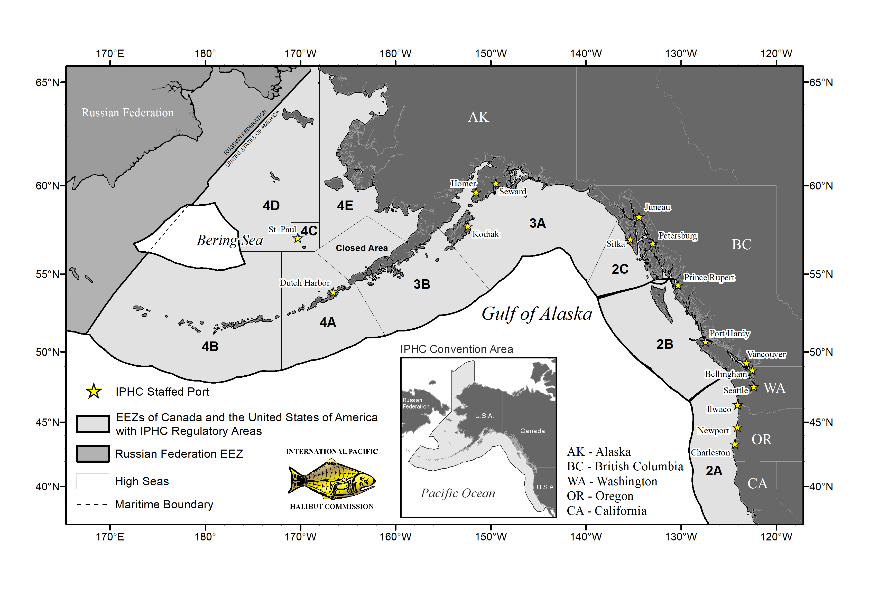
IPHC Regulatory Areas
Notes:
Start with a map to orient you to IPHC’s regulatory areas:
WA falls in catch Area 2A
At tail end of range – our fisheries are inconsequential to status of halibut resource
The purpose of this meeting are to consider changes to halibut season dates which are made through the PFMC process at the Sept and November meetings
Preliminary changes for public review in September
In preparation for the November Council meeting, we get together in October to discuss those proposals and get input on a final recommendation

Slide 4
Catch Sharing Plan
Management Goals
Establish season structures for each subarea that maximize fishing opportunity and achieve but not exceed subarea quotas.
Flexibility through timely inseason action(s), such as opening additional fishing days or shifting quotas between subareas, may be necessary to achieve the overall Washington sport allocation and fishery objectives.
Notes:
The Catch Sharing Plan is the Pacific Fishery Management Council’s plan that outlines how the Area 2A quota is divided among the Area 2A subareas. In addition to outlining allocations there are the management goals for the WA sport fishery.

Slide 5
2022 Catch Sharing Plan
Objectives
All Sub-areas
Season dates will be developed at the end of November each year for the following year
Open up to 3 days per week April, May, June; may include at least one weekday and one weekend day
If quota remains after final open day in June, additional openings may be implemented in August and September
Sub-area specific
Puget Sound – earliest date to open April 1
Coastal subareas – earliest date to open April 30
Columbia River – season dates coordinated with Oregon, no Saturdays
Columbia River Nearshore – open Monday – Wednesday following opening of the all-depth fishery through September 30 or until 500 lb. quota attained
South Coast Nearshore – May open if balance of primary fishery quota is insufficient for a full fishing day, open first Saturday after closure of primary fishery, seven days per week until quota taken
Notes:
The CSP also describes the general season structure. We are here tonight to discuss any potential changes to the CSP that would need to be made to accommodate the 2023 season dates in the recommendation we develop tonight.

Slide 6
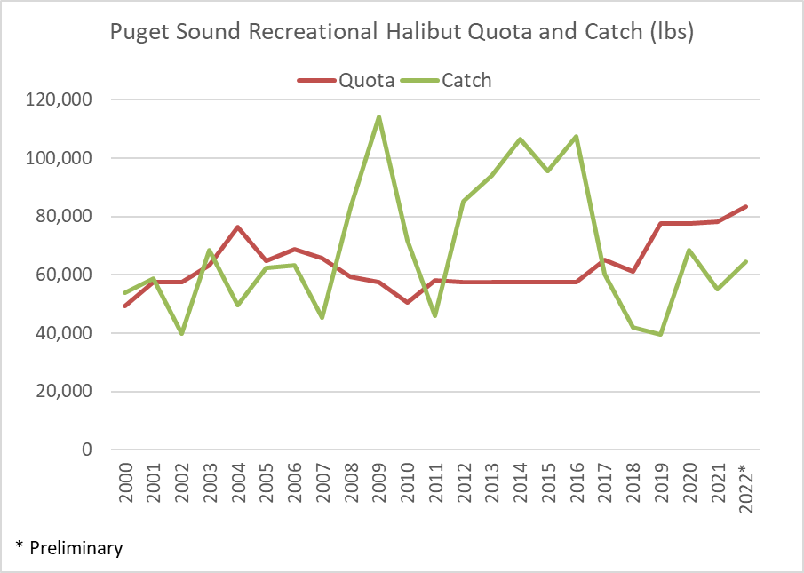
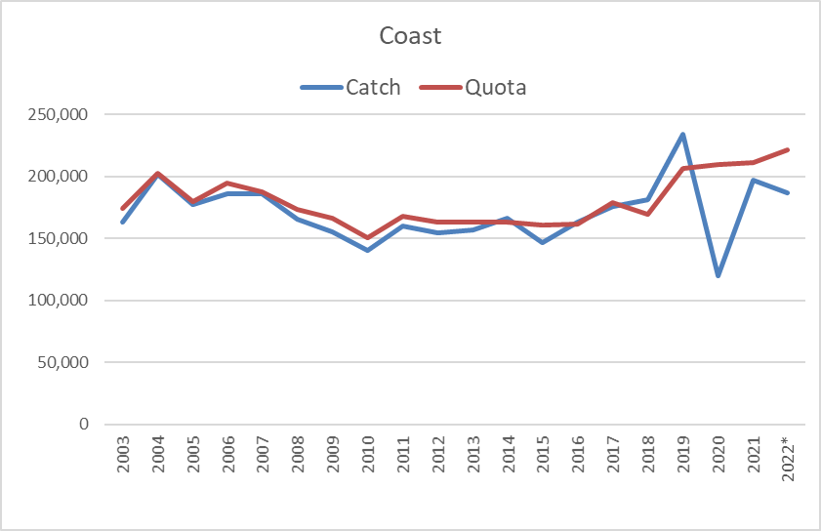
Review
Notes:
Exceeded the PS quota from 2008 through 2016
Intensive sampling approach provided inseason estimates which allowed us to close on projected quota attainment
In the 2010-2014 period, only the CR was open for more that 20 days and the north coast and Westport were open for fewer than 10 days
In the 2015-2019 period, the north coast and Westport were open for 8 and 5 days on average

Slide 7
WDFW Season Setting Principles
Avoid effort shift: continue to align fishing days as much as possible, particularly Columbia River/ South Coast and North Coast/Sekiu to maximize season length and fishing opportunity
Provide advance notice of season dates to allow anglers to plan rather than add dates inseason
Provide more fishing opportunity in areas where catch was below the subarea allocation
Recognize traditional days if possible (e.g., North Coast: Thu/Sat, South Coast: Sun/Thu, MA 5: Memorial Day derby)
Notes:
We’ve been working for several years to develop a season structure that accommodates different interests in different subareas, maximize season length, provide fishing opportunity to state recreational halibut stakeholders all while keeping catch to the subarea allocations.
We adjusted, such as opening all areas at the same time – we started that with having every subarea, coast and PS open on the same days, since then we’ve moved a little bit away from that be we kept season dates aligned, especially the season opening date.
During this time, we were uncertain about the Area 2A or WA, Or, CA Total Allowable Catch
In 2019, in an effort led largely by the Makah Tribe with support from other tribes and state managers on the west coast, the IPHC adopted a consistent Area 2A allocation of 1.65 million pounds.
Nothing has provided greater stability for all of our fisheries than the subarea allocations under this quota. The agreement to have the consistent quota went through 2022; now will have discussions with IPHC again.
The first year of that agreement was 2019 and we had already established our season dates before we knew what the WA sport allocation would be. We had to shuffle a bit to add more fishing days and had good support from NMFS to help us flexible management.
When we discussed changes for 2020, with the new allocation in mind, we were excited to offer fishing a season structure with new fishing opportunity in 2020 that we hadn’t had for a while, opening PS in April, opening consecutive fishing days and seasons that would go beyond three days.
Then we were hit with COVID and once again had to be flexible, even more than we had before.
As we’ve worked through these challenges, we established some season setting principles that have guided how we structure our seasons, we relied heavily on them when we revised our 2020 season dates. Once again with helpful support from NMFS to adjust our season dates using inseason rule changes.
The IPHC will be taking up the area 2A allocation at their interim meeting in November where we’ll get the first look at the 2022 stock assessment
And they’ll take final action at their annual meeting at the end of January
We will be coordinating with our state partners and tribal co-managers as we prepare for these two meetings.
I hope this information provides some context as we discuss the season structure for the 2023 sport halibut season
Lorna will walk us through the near final catch for 2022 and the analysis of the alternatives proposed for 2023

Slide 8
2022 Catch Summary
*Does not include Puget Sound Area 7-10 July-September

Slide 9
Alternatives Approved for Public Review
Puget Sound – 5 or 7 days per week
South Coast – 3 days per week in May
North Coast and Columbia River – Status Quo
Not included in the Catch Sharing Plan:
Bag limit - Increase to 6 fish per year
Notes:
When we discussed changes for this year, there was support for implementing a season structure largely like 2021. Specifically, the proposed changes to the CSP for 2022 included:
Open Puget Sound earlier in April
Open Puget Sound more days per week
Coast: strong preference for status quo
Some interest to look at a sharing for coastal areas – stability
At our meeting in August to begin the discussion about changes for 2023, after another year of quota remaining at the end of the season, we heard support for adding more days per week in the Puget Sound and the south coast with input for the north coast and Columbia river supporting status quo

Slide 10
Analysis – Coast
Notes:
For Coast: Here we are looking at the subarea quotas from 2022 and the maximum daily catch, and the average daily catch from 2022 to get a sense of how many days the season could potentially be open. Note, using the 2022 subarea quotas is using a “high” quota amount.
For comparison and context to the single year daily catch, we also computed the average daily catch for each area using data from 2018, 2019 and 2021.
Walk through table…

Slide 11
Proposal for Discussion Coast
Marine Area 1:
May 4 through May 21: 2-days per week, Thursday, and Sunday
Memorial Day weekend: Thursday, May 25
June 1 through June 25: 2-days per week, Thursday and Sunday, and Thursday, June 29
Marine Area 2:
May 4 – 21: 3 days per week, Tuesday, Thursday, Sunday, and Tuesday, May 30
If sufficient quota remains: June 15, 18 (Thursday, Sunday) and June 22, 25 (Thursday, Sunday)
Marine 3 and 4:
May 4 through May 21: 2-days per week, Thursday, and Saturday
Memorial Day weekend: Friday, May 26 and Sunday, May 28
June 1 through June 24: 2-days per week, Thursday and Saturday, and Thursday, June 29
All Areas:
If quota remains after June 30, consider August and September dates.
Notes:
Marine Area 3 and 4: Do they want to consider going to 3 days per week in June?
We can wait to see how the fishery is progressing after June to recommend dates for August and September – need three weeks for federal rule making
Have generally been waiting until after Chinook season (August 15th) before re-opening halibut - meet the week of July 11th to set up late season (if needed).
MA2: going to three days per week could result in six days or 13 days depending on high/low catch scenarios
Question for MA 2: what do you want to do in June? Identify four days?

Slide 12
Analysis – Puget Sound
Area 5, 6-10
Assumed Subarea Allocation: | 77,550
 | High Catch | Med Catch | Low Catch
Year Range | 2018-2022 | 2019-2022 | 2021-2022
Average Daily Catch | 2,364 | 1,902 | 1,600
Potential Days | 33 | 41 | 48
Open on: | 4/6/2023
Open through:
7 days per week | 5/8/2023 | 5/16/2023 | 5/24/2023
5 days per week | 5/20/2023 | 6/1/2023 | 6/10/2023
Open on: | 4/13/2023
Open through:
7 days per week | 5/15/2023 | 5/23/2023 | 5/31/2023
5 days per week | 5/27/2023 | 6/8/2023 | 6/17/2023
*Through date does not account for potential adjustments around Memorial Day weekend.
Notes:
For Puget Sound, two options that add more days per week were approved for public review: either five days per week or seven days per week.

Slide 13
Proposal for Discussion Puget Sound
Marine Area 5, 6-10
Open all areas at the same time.
April 6 through May 22: 5-days per week, Thursday-Monday
Memorial Day weekend: Friday through Sunday, May 26, 27, 28
June 1 through June 30: 7-days per week
If quota remains after June 30, consider August and September dates

Slide 14
Comments
Facebook Number indicates posts and/or thumbs up response
13 | Open areas 6-10 early and make it 7 days a week from the start. We never meet our quota in that area, and by end of May the dogfish have moved in so bad it's almost impossible to fish halibut anyway.
1 | Can we get August dates again in area 3 and 4? It is so nice to be able to get out and have fun in the sun!
2 | Summer halibut has been a blast!
2 | Was great having summer fishing this year!
EMAIL
Puget Sound: Recommend a 7-days a week beginning in mid-April. This would allow anglers to fish on the best weather days and avoid days with bad weather/unsafe conditions. Because the sport harvest quota has gone unfilled in recent years, there is no reason to restrict access to this fishery to preserve quota to prolong the season. Extending the halibut season into August and September does not provide a good opportunity to increase sport harvest of halibut in Puget Sound due to the increased activity/abundance of dogfish during the warmer periods. Finally, trading unused halibut sport quota from Puget Sound to coastal areas unfairly shifts opportunity away from fishers who live in or prefer to fish in the more protected Puget Sound areas. This trading of quota also favors coastal charter operators over Puget Sound private boat anglers.
Allowable bait: The bottom fish/halibut regulations should be amended to allow for use of sand dabs as halibut bait in waters greater than 120 feet deep in Puget Sound. There is no conservation reason (i.e., reduced potential bycatch of rockfish) to prohibit possession/use of sand dabs as bait for halibut in Puget Sound.
Phone messages and email: “Great to have a six fish bag limit.”
Notes:
Comments and input received in various formats since our August 9th meeting.
Facebook posts were in response to meeting reminder posted last week.
Two callers and one email requested consideration of a 6 fish bag limit.

Slide 15
2023 Recommendation
Puget Sound
Open MA 5, 6-10 in April
Five or seven days per week
Coast:
South Coast: three days per week in May, four additional days noticed in June
North Coast and Columbia River: status quo
All Areas:
Option for seven days per week in August and September

Slide 16
Plan 2023 Wrap Up
Questions
Next Steps
November PFMC Meeting
IPHC Meetings
Thank you for attending!

Slide 17
Information
IPHC
Landing updates
WDFW
Halibut and Bottomfish Regulations/Landing updates
360.581.5611
Lorna.Wargo@dfw.wa.gov
https://wdfw.wa.gov/fishing/regulations/halibut
Lorna Wargo
https://iphc.int/data/landings-2022

Slide 18
2023

