Slide 1
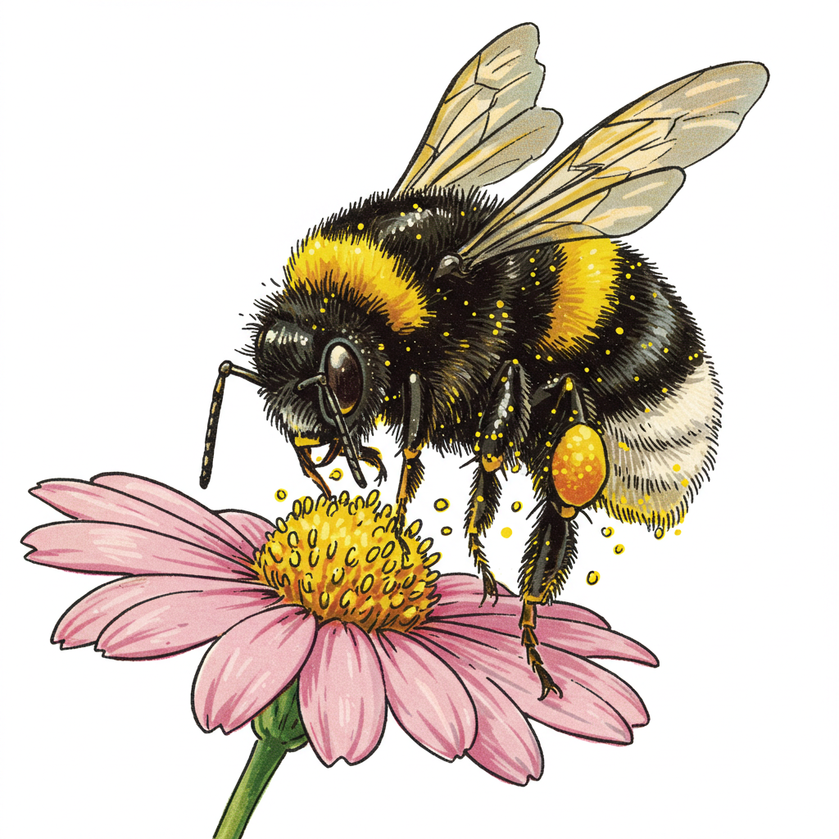
Get Wild with WDFW! Biodiversity and Pollinators

Slide 2
Where do you live?
Notes:
Ask students to think about their morning. Where did they wake up? What did they do to get ready to come to school? What did they eat? Drink?

Slide 3
Wherever you live, your home is part of your habitat
A habitat is a place where plants and animals live.

Slide 4
What is Habitat?
Habitat
Food
Water
Shelter
Space

Slide 5
Wherever you live, your home is your habitat

Slide 6
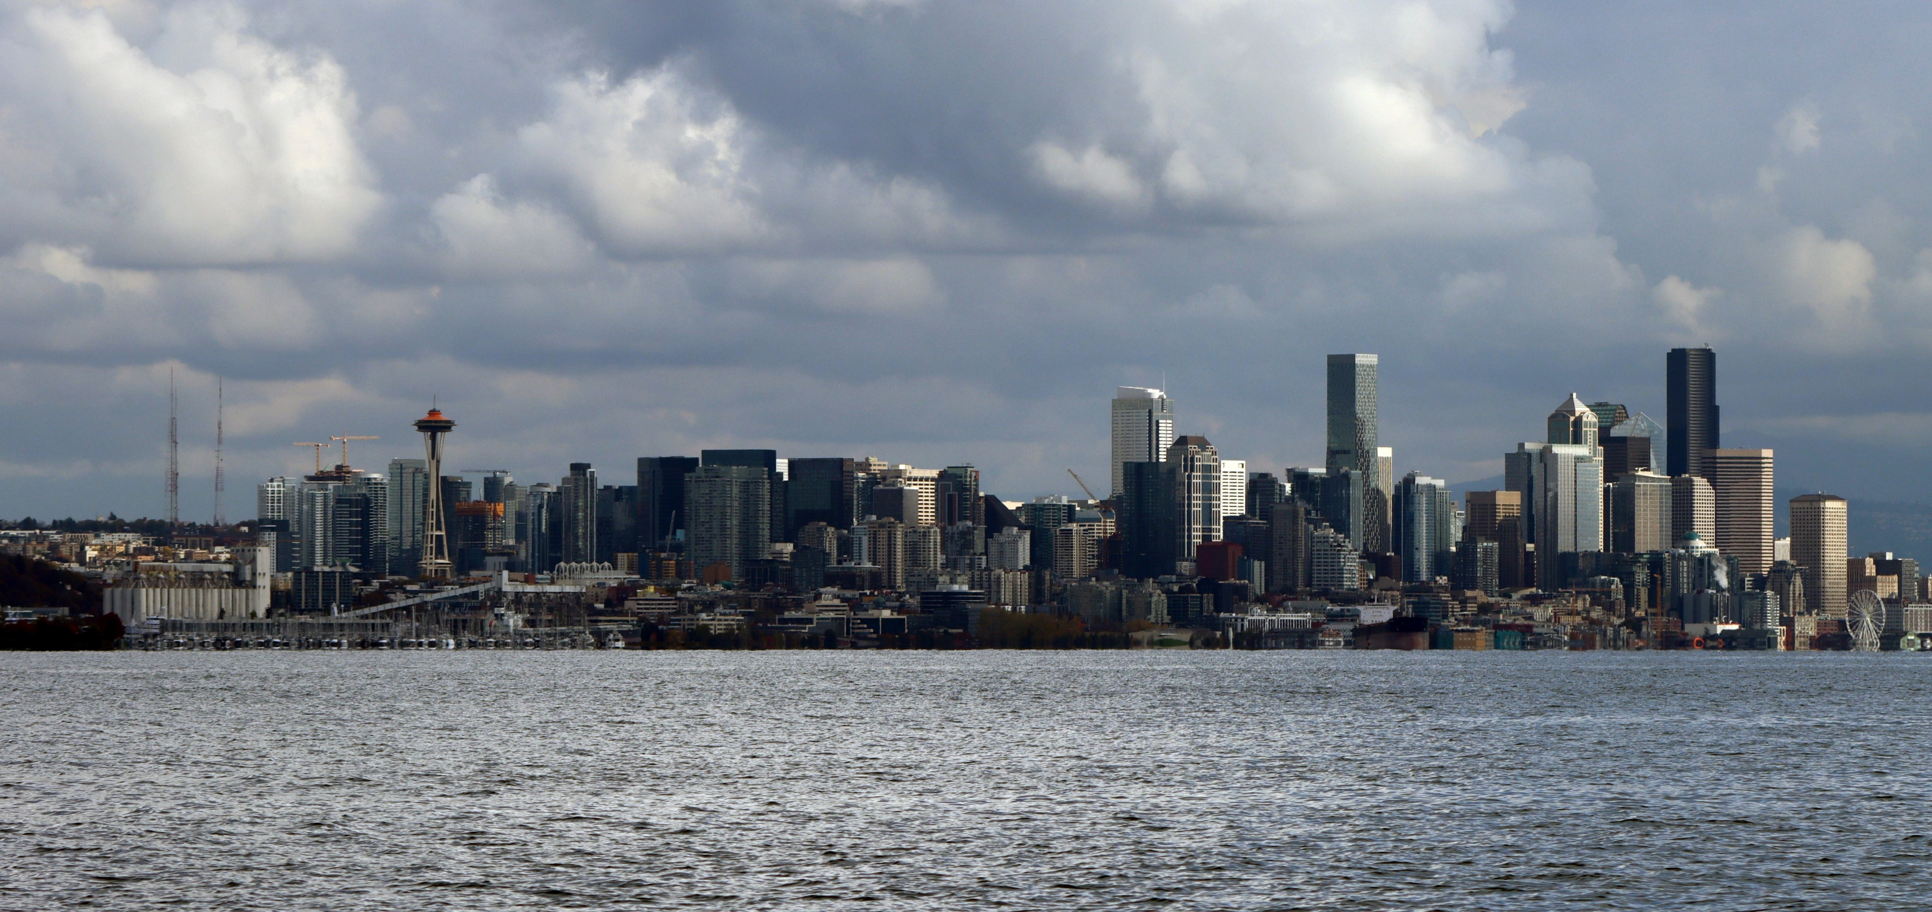
Urban Habitat
PBS Urban Habitat
Notes:
Follow the link in the slide, or copy and paste link into browser:
https://ksps.pbslearningmedia.org/resource/nature-works-everywhere-urban-habitat-clip/nature-works-everywhere-urban-habitat-clip/?student=true&focus You can end the video at 1:39

Slide 7
How do your home and community give you what you need to live?
Draw a photo of your habitat. This could include your home, school, and community.
How do you get the things you need to live? Food, water, shelter, space.
Do any plants or animals live in and around your habitat?

Slide 8
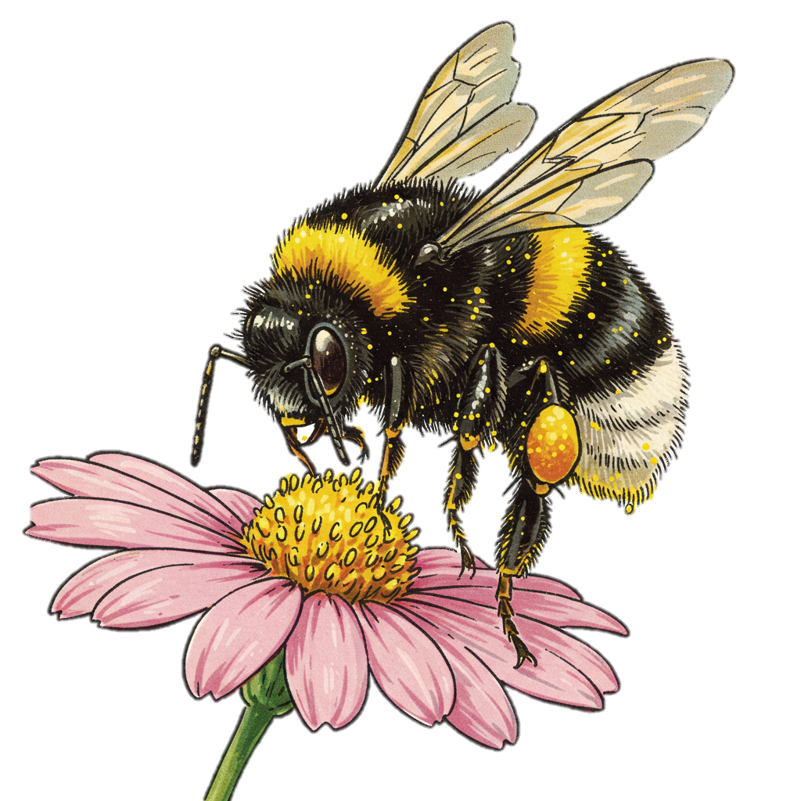
Schoolyard habitats and biodiversity

Slide 9
Many different living things can survive in a habitat.
Habitat
Food
Water
Shelter
Space
Notes:
If you have all of the components of habitat, many different living things can survive there.

Slide 10
Healthy habitats support biodiversity
Biodiversity = Different kinds of living things

Slide 11
Notes:
Stop at 2:55

Slide 12
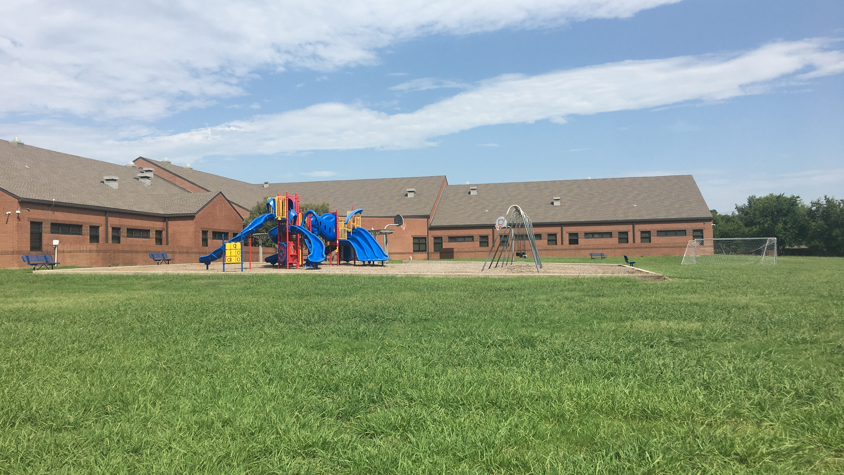
Biodiversity in our schoolyard habitats

Slide 13
How can you tell different kinds of plants apart?
Look at their features!
Color
Shape
Size
Way it grows:
Tree
Shrub
Grass
Vine

Slide 14
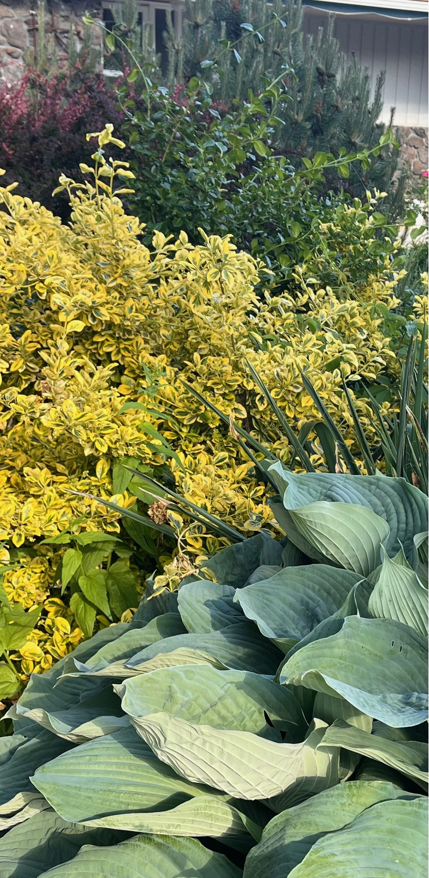
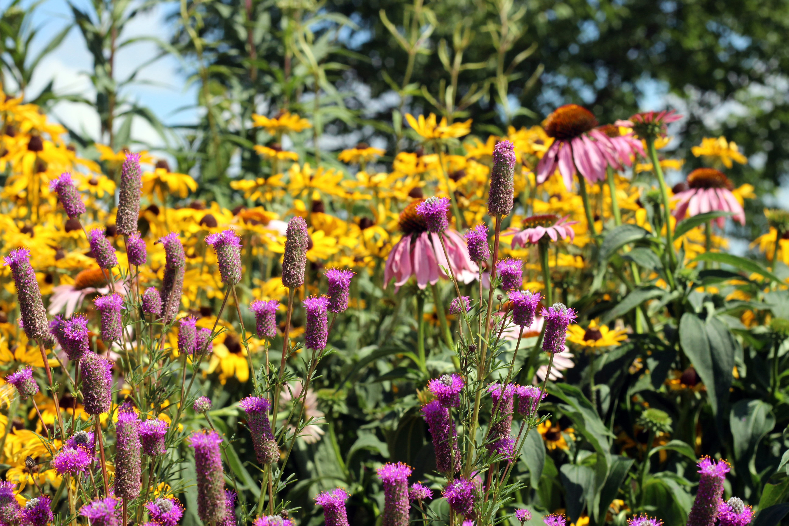
Plant features: Color
Leaves
Bark
Flowers

Slide 15
Plant features: Shape
Leaves
Whole plant

Slide 16
Plant features: Size
How big is the plant?
How big are its leaves?
How big are the flowers?

Slide 17
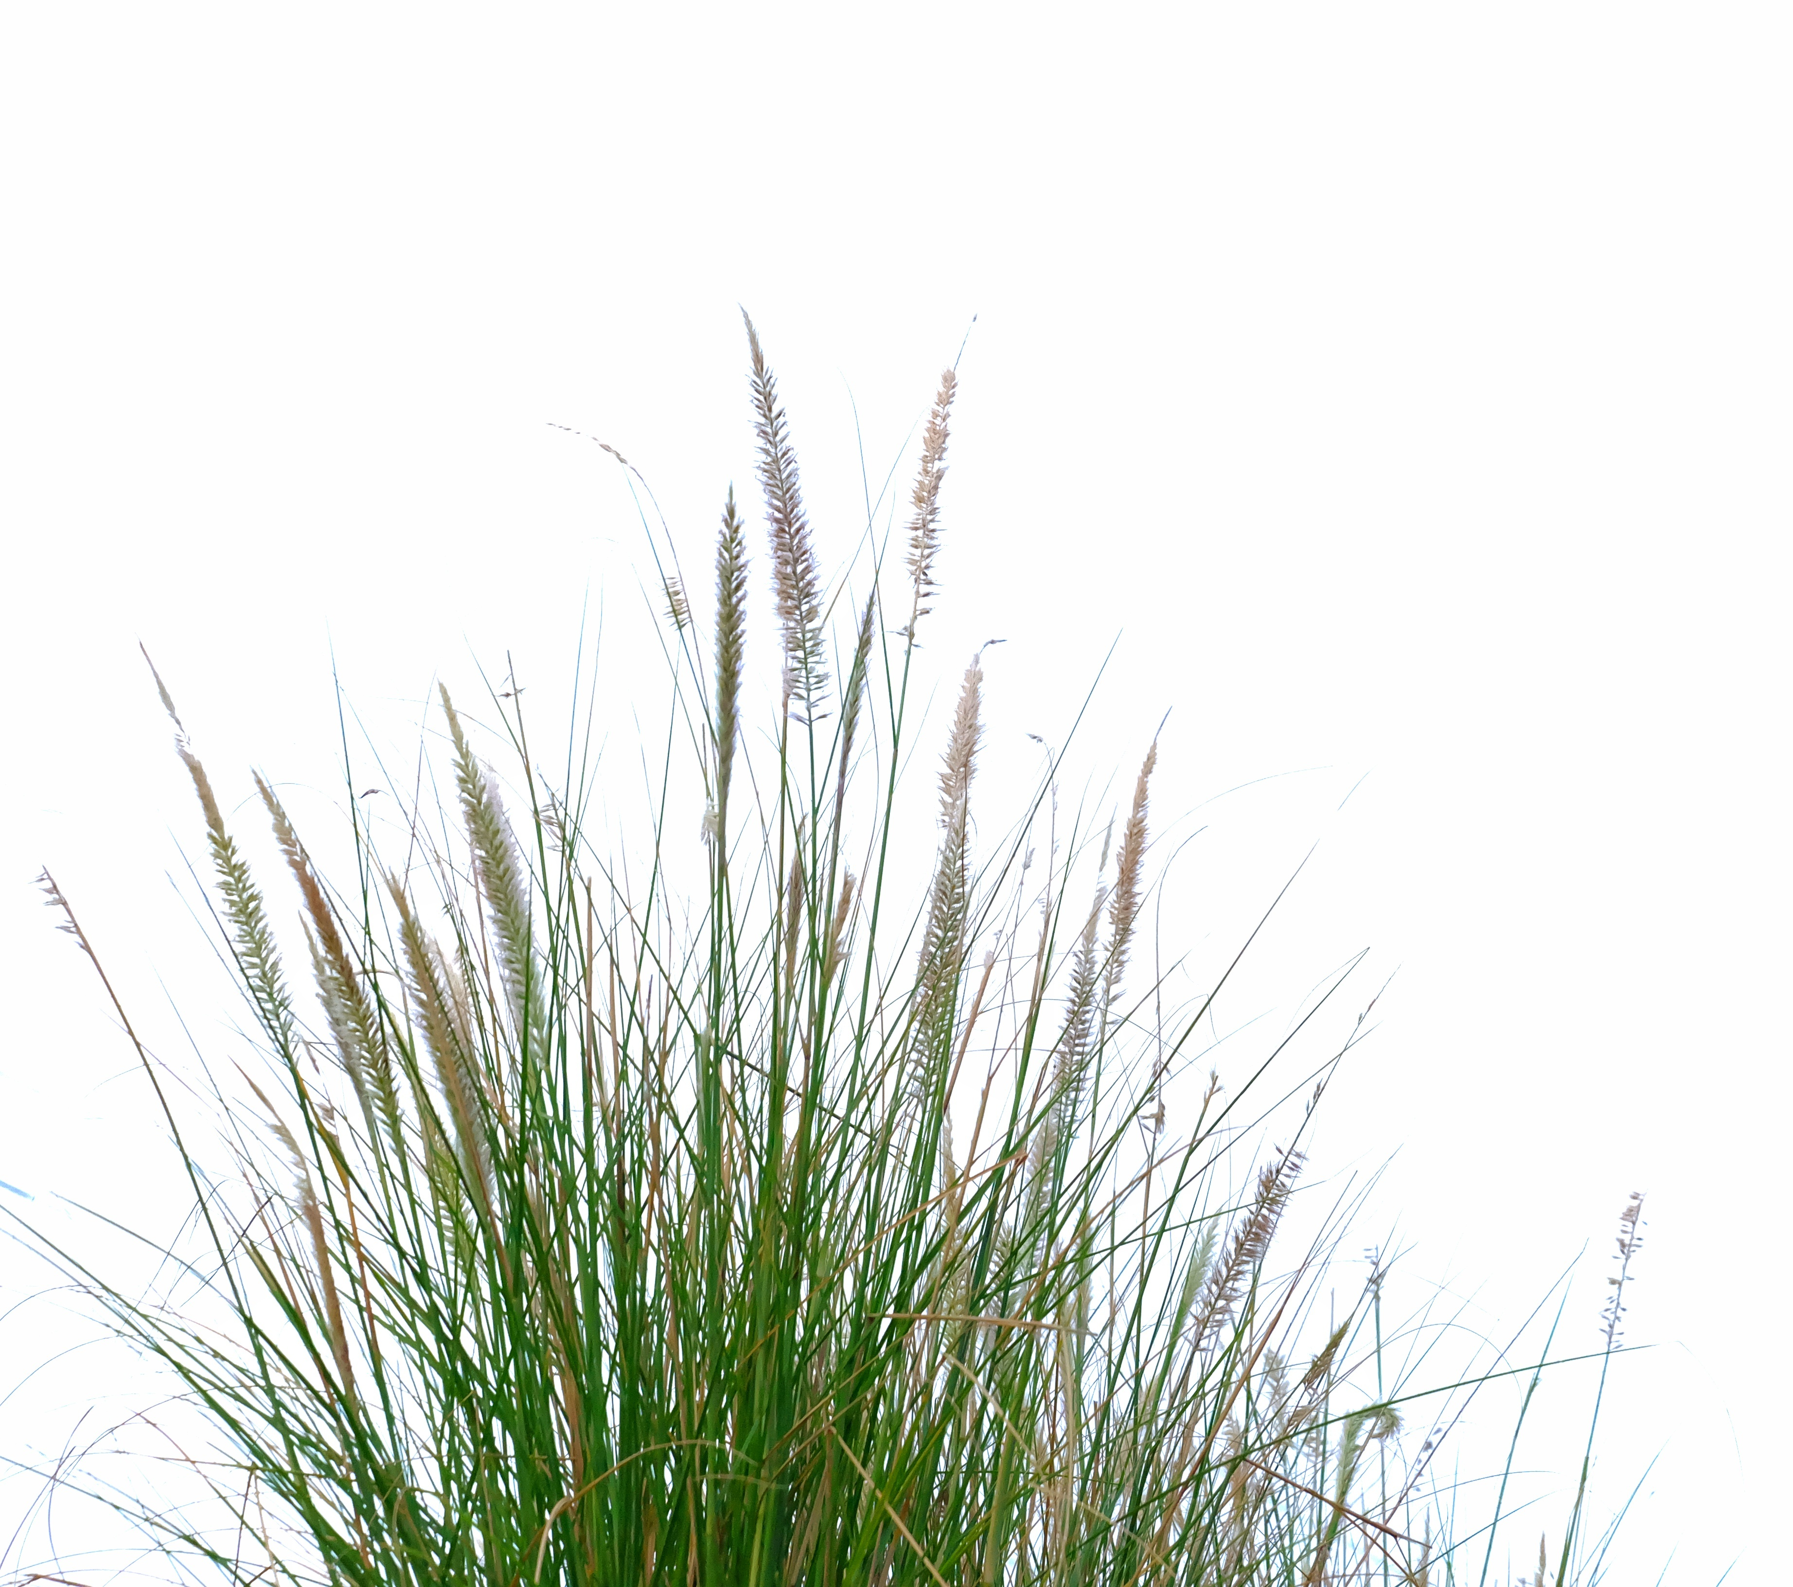
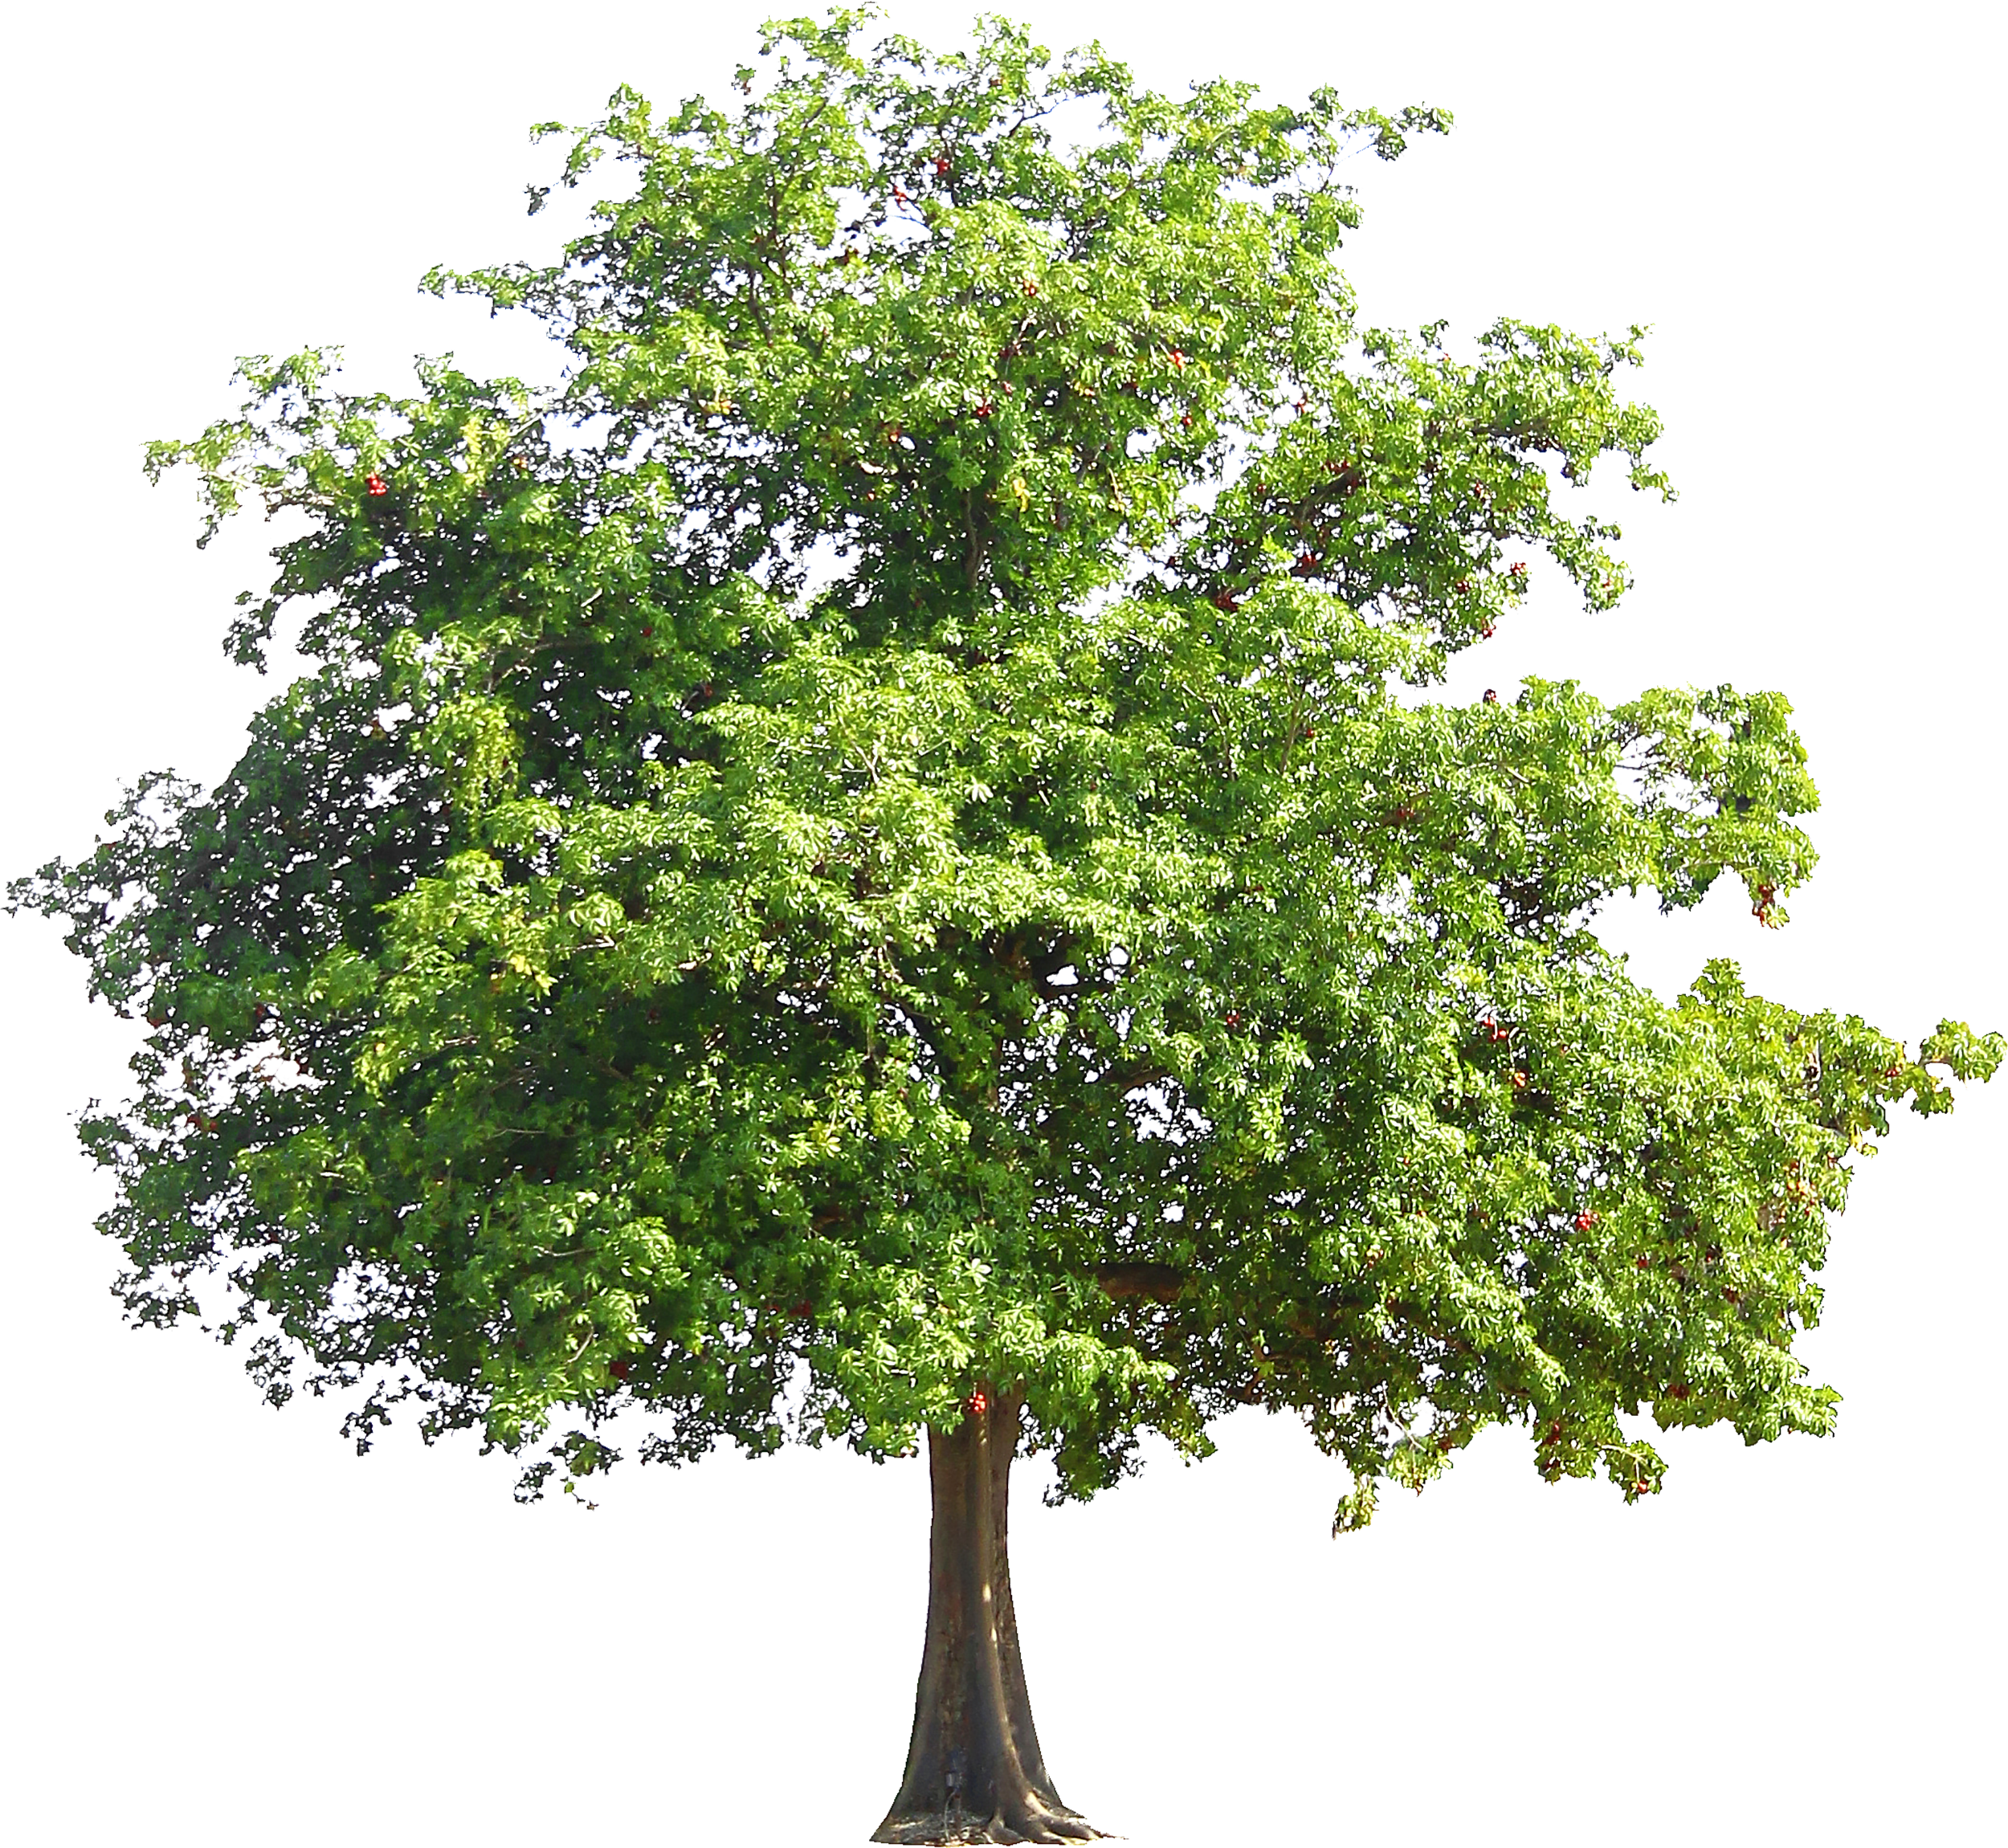
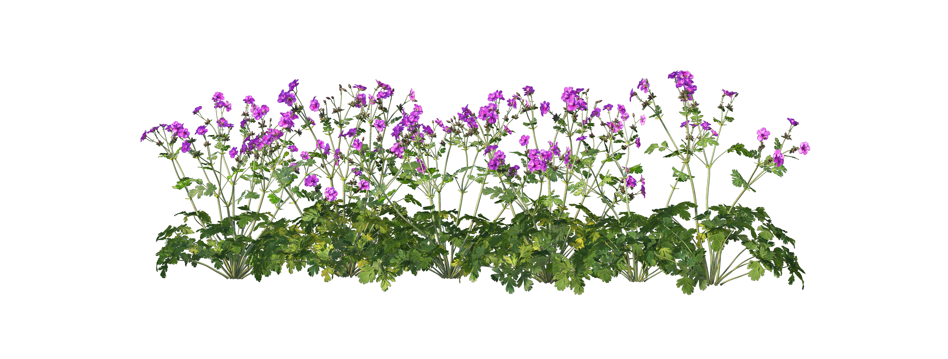
Plant features: How it grows
Trees
Shrubs
Grasses
Flowering plants
Vines

Slide 18
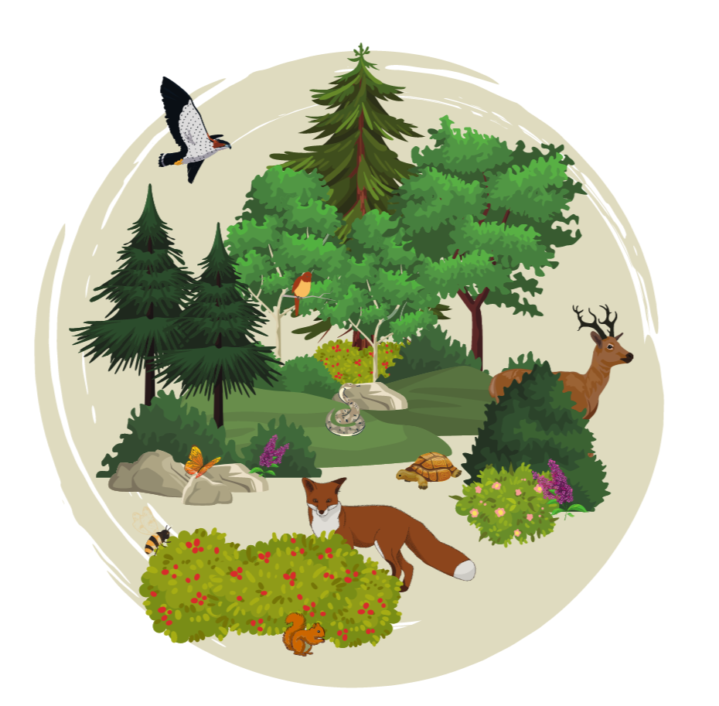
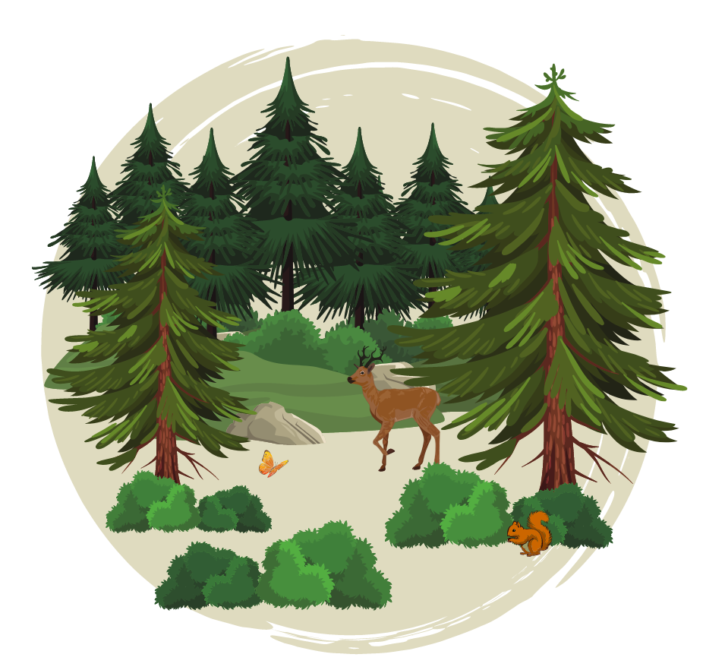
Biodiversity in habitats
How many kinds of plants can you find?
How many kinds of animals do you see?
High Biodiversity
Low Biodiversity
Notes:
Allow students to make observations of the two photos of woodland habitats. Which habitat has more kinds of plants and animals? Which habitat has more “biodiversity?”
Image from Tualatin soil and water conservation district: https://tualatinswcd.org/what-is-biodiversity-and-why-does-it-matter-for-you/

Slide 19
Plant features:
How many kinds of plants can you find? →

Slide 20
Typical schoolyard habitat

Slide 21
Schoolyard garden habitat

