Slide 1
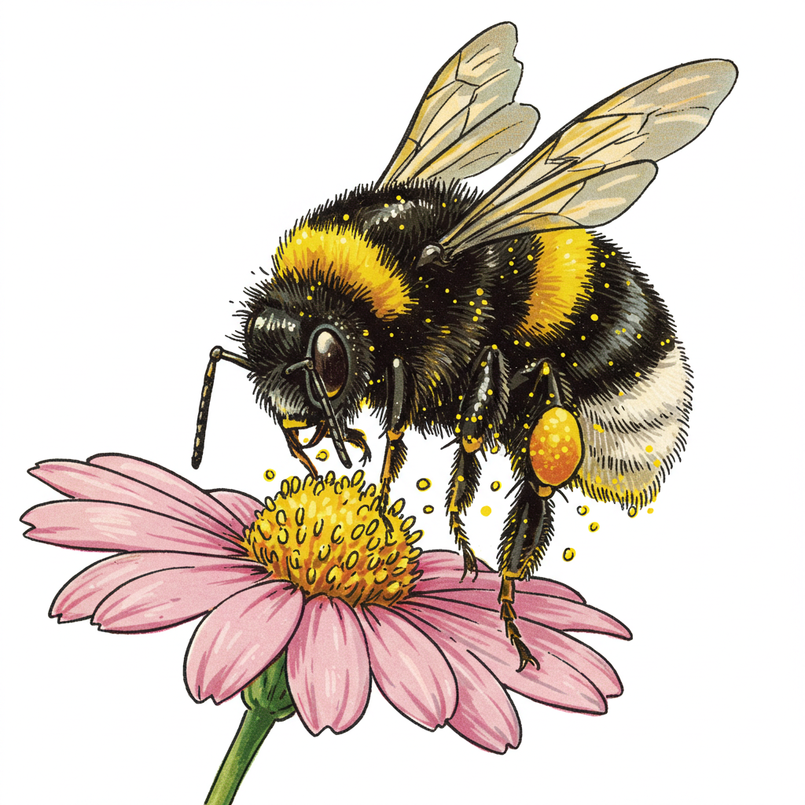
Get Wild with WDFW! Biodiversity and Pollinators

Slide 2
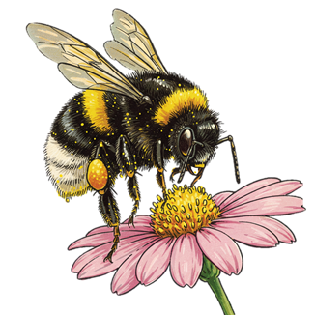
Lesson 2: Relationships in habitats How do plants help animals?

Slide 3
Notes:
Example layout for relationships in habitats model

Slide 4
Relationships in habitats

Slide 5
Relationships in habitats

Slide 6
Relationships in habitats

Slide 7
Relationships in habitats

Slide 8
Relationships in habitats

Slide 9
Relationships in habitats

Slide 11
Lesson 3: Relationships in habitats Seed dispersal

Slide 13
A fruit is a suitcase for seeds

Slide 14
Seeds move

Slide 15
Seed dispersal

Slide 16
Seed dispersal: Ants and trillium flowers

Slide 17
Seed dispersal

Slide 18
Seeds that move by attachment
Notes:
End video at 2:19

