Slide 1
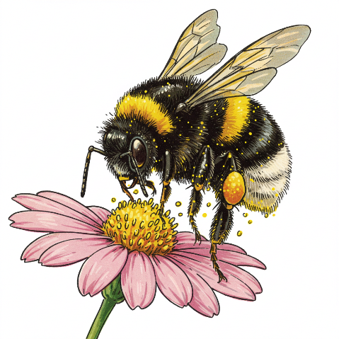
Get Wild with WDFW! Biodiversity and Pollinators

Slide 2
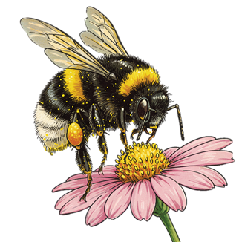
Lesson 4: Relationships in habitats Pollination!

Slide 3
Relationships in habitats

Slide 4
Relationships in habitats

Slide 5
How does a pollinator move pollen?

Slide 6
What is pollination?

Slide 7
Sip, pick, and pack: How pollinators help plants make seeds

Slide 8
Lesson 5: Pollinators and habitats

Slide 9
Pollinators: Why we love them and how you can help

Slide 10
Pollinator paradise: Prairies
Western Washington prairie
Palouse prairie

Slide 11
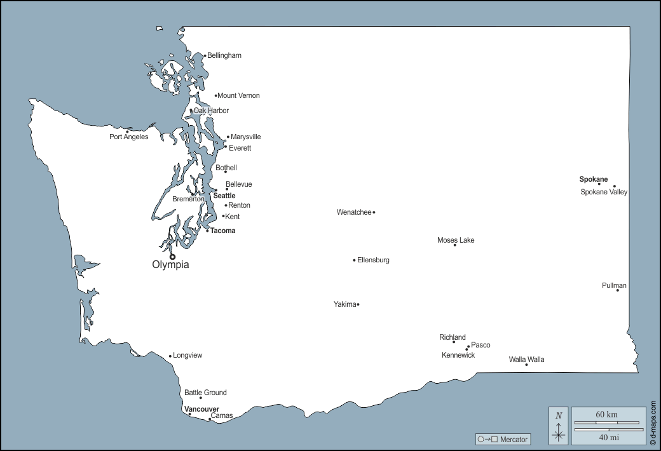
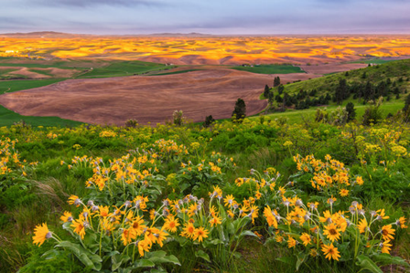
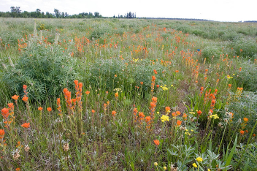
Palouse prairie
Western Washington prairie

Slide 12
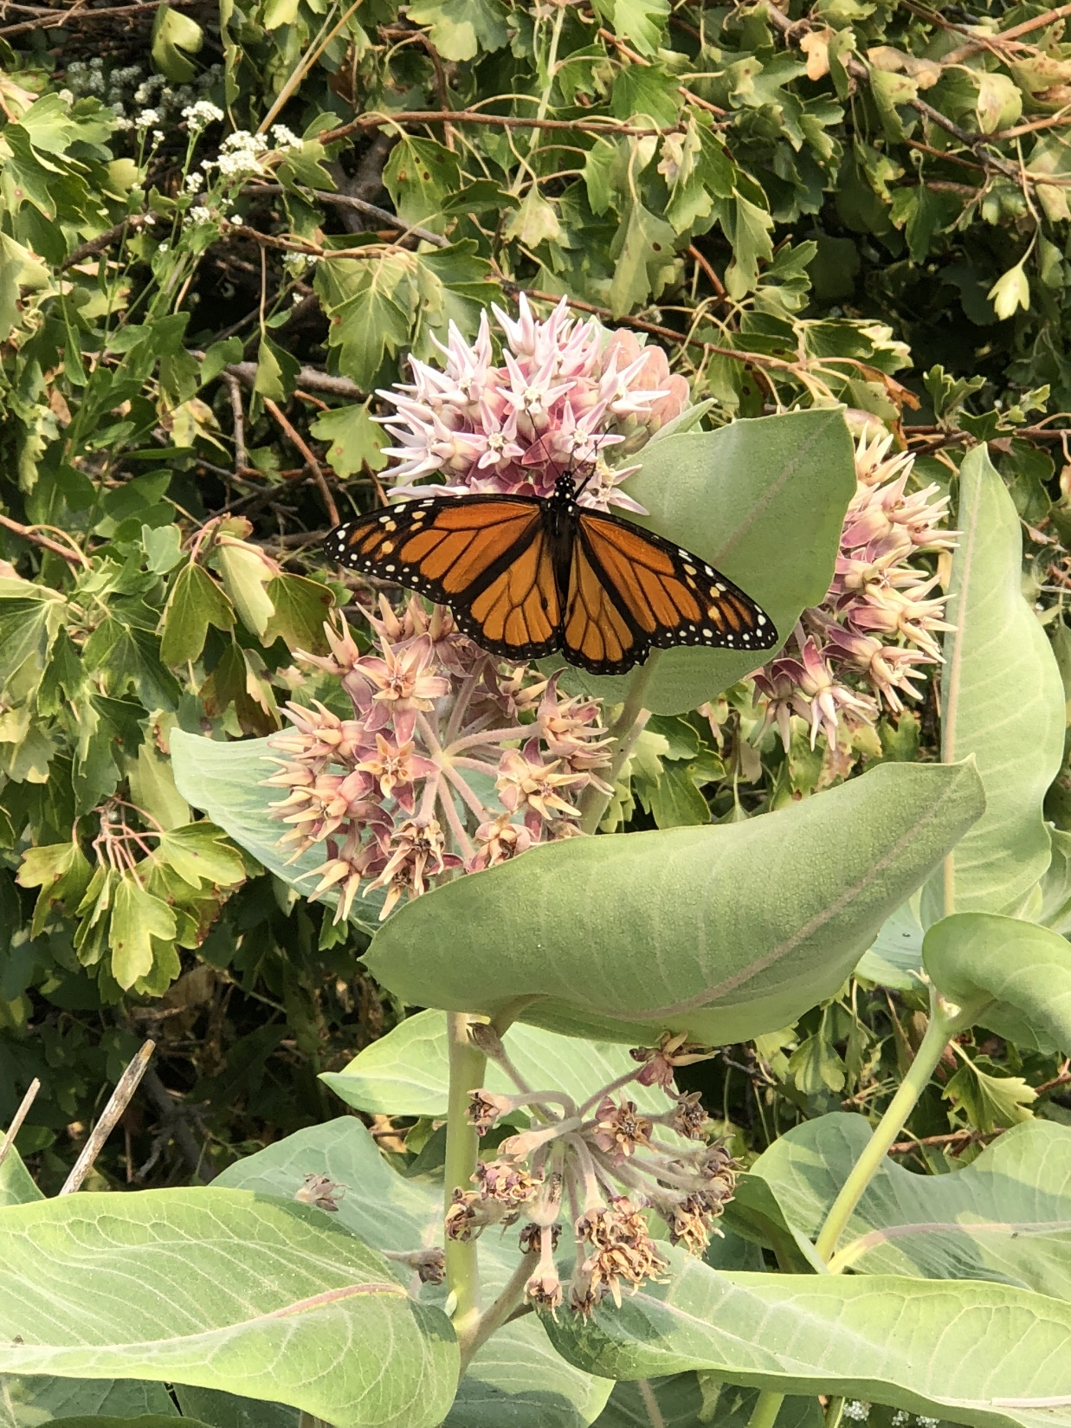
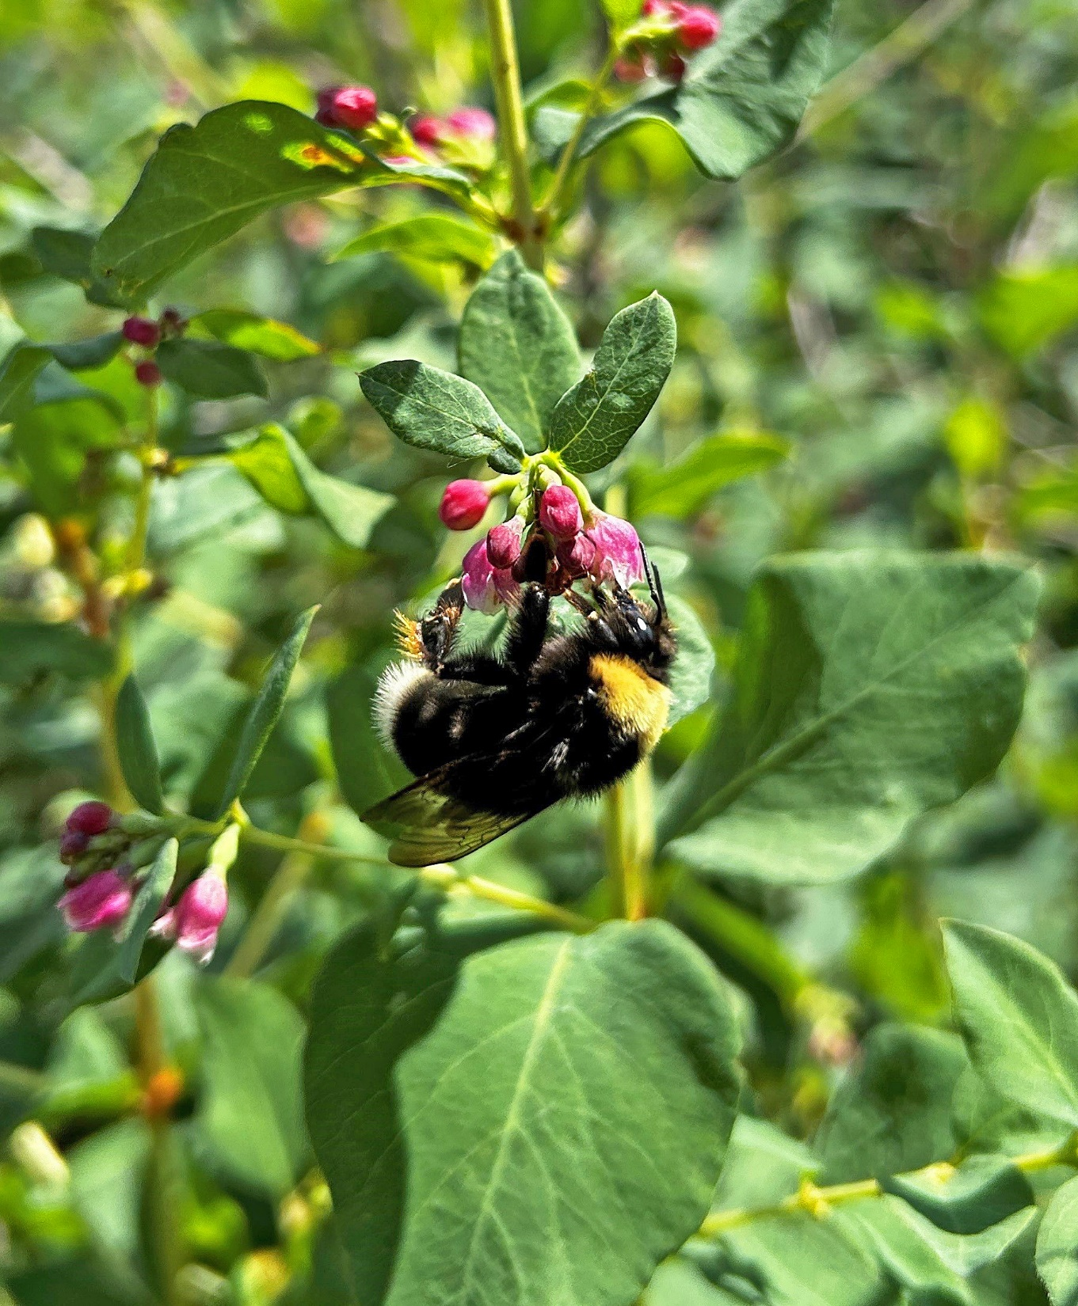
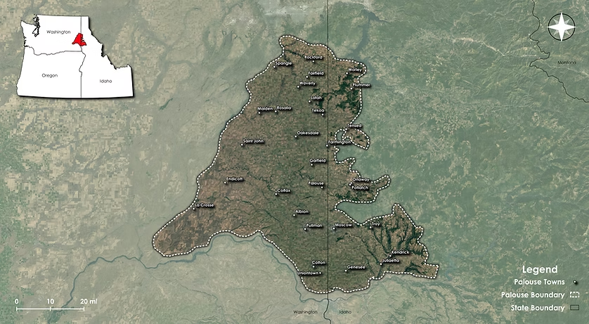
Prairie Habitats in Washington: Palouse Prairie
Notes:
Less than .1% of the historic range of the Palouse prairie habitat still exits. The prairie has many species of flowering plants, including arrow leaf balsam root. It is an important habitat for species of concern, like monarch butterflies and western bumble bees.

Slide 13
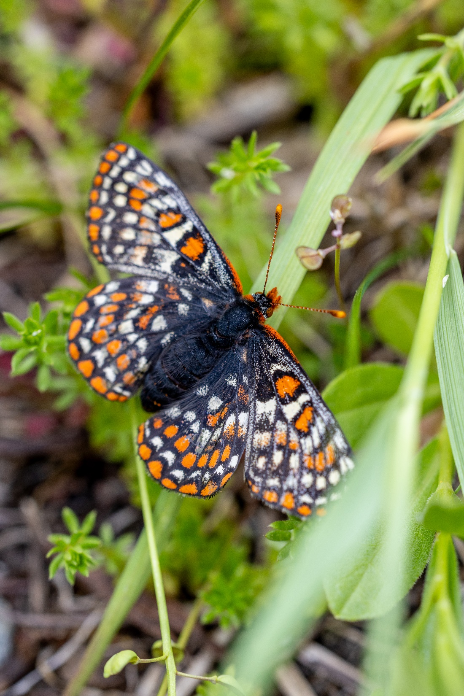
Prairie Habitats in Washington: Western Prairie
Notes:
Map credit: Photo Credit Rod Gilbert
The Washington Western Prairie is an important pollinator habitat. Much of the historic range has been lost. It is full of plants and pollinators that special relationships. Some pollinators, like the Taylor checkerspot butterfly, can only be found in this habitat.

Slide 14
Notes:
Watch video and tally the different kinds of flowers and pollinators you can find.

Slide 15
Schoolyard habitat A: Shrubsteppe habitat

Slide 16
Schoolyard habitat A: Shrubsteppe habitat
Notes:
Watch until 3:08

Slide 17
Schoolyard habitat B: Temperate forest

Slide 18
Schoolyard habitat B: Temperate forest

