Slide 1
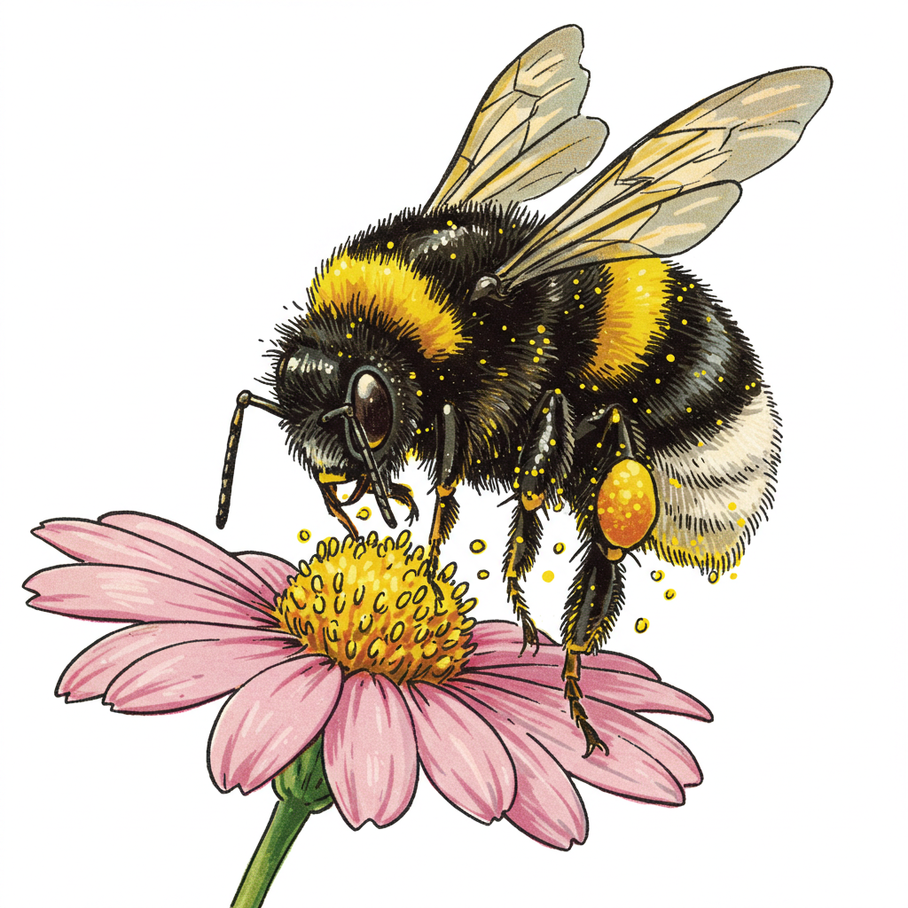
Get Wild with WDFW! Biodiversity and Pollinators

Slide 2
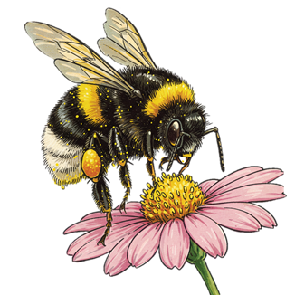
Lesson 6: Pollination and flower structures Observations with an artist’s eye

Slide 3
The reason for a flower

Slide 4
Georgia O’Keeffe
Jimson Weed, 1936
American Artist 1887-1986
“When you take a flower in your hand and really look at it, it's your world for the moment, I want to give that world to someone else."

Slide 5
Notes:
Start at 0:28 to skip teacher intro

Slide 6
Black Hollyhock Blue Larkspur, Georgia O’Keeffe 1930

Slide 7
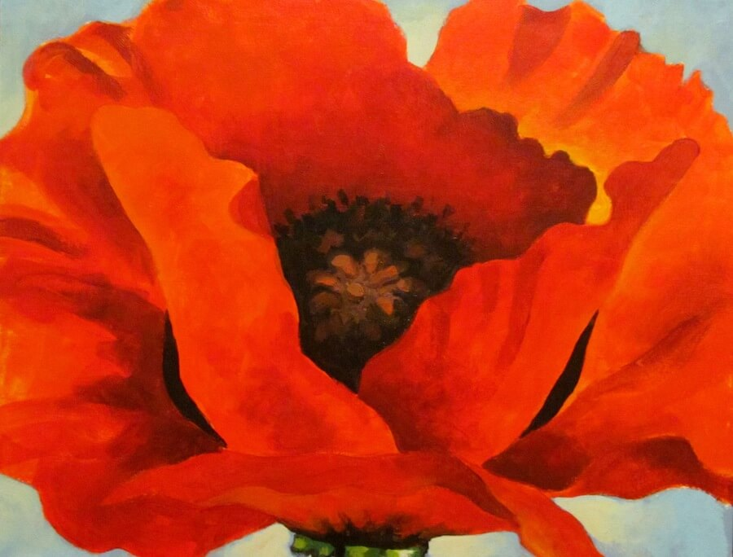
Red Poppy, 1927 by Georgia OKeeffe

Slide 8
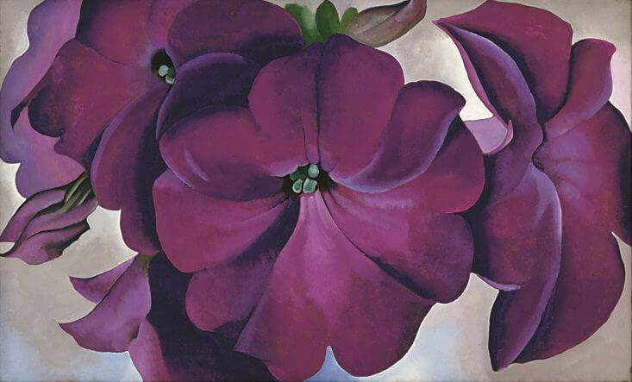
Petunias, 1924 by Georgia OKeeffe

Slide 9
Lesson 7: Pollination and animal structures Pollination investigation

Slide 10
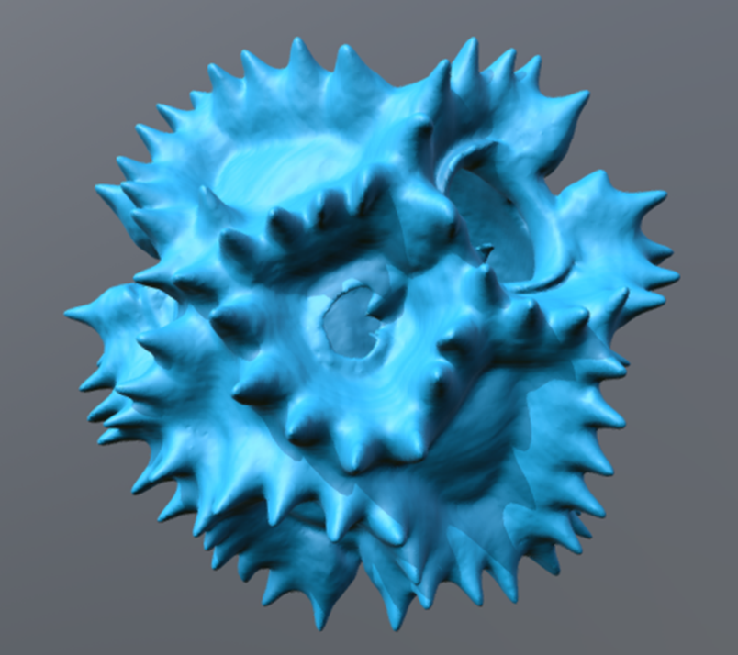
Pollen under a microscope
3D model of dandelion pollen

Slide 11
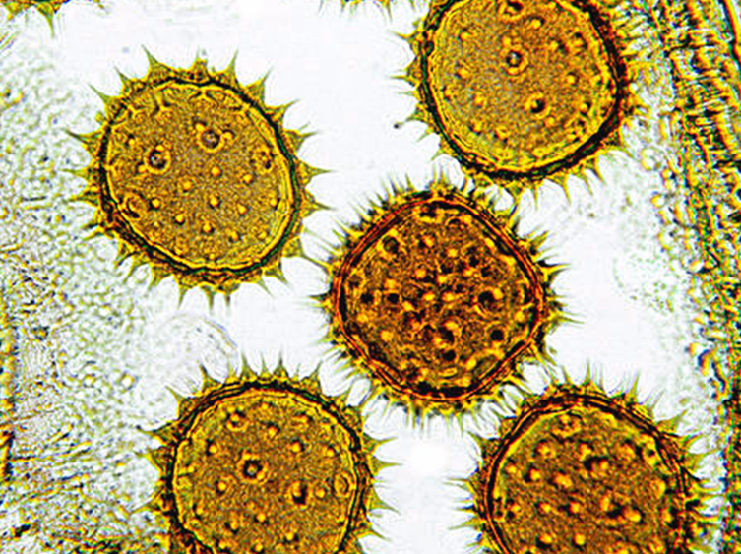
Seeds and Pollen

Slide 12
3D model of dandelion pollen
Notes:
The link will take you to the 3D Pollen Project. It is interesting to compare the structures of pollen that is moved by wind vs the structures of pollen that is moved by animals.

Slide 13
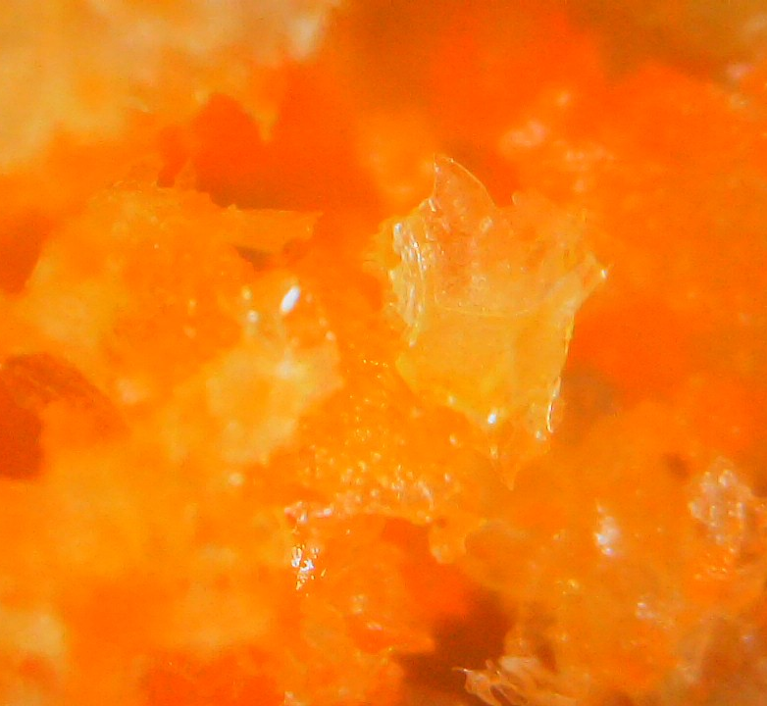
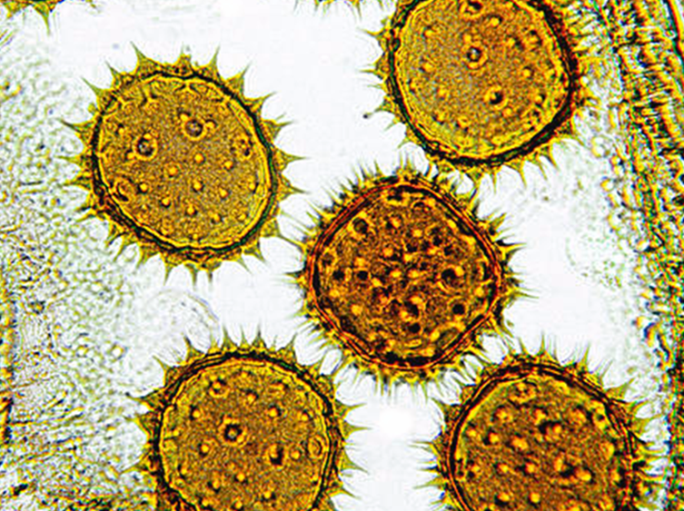
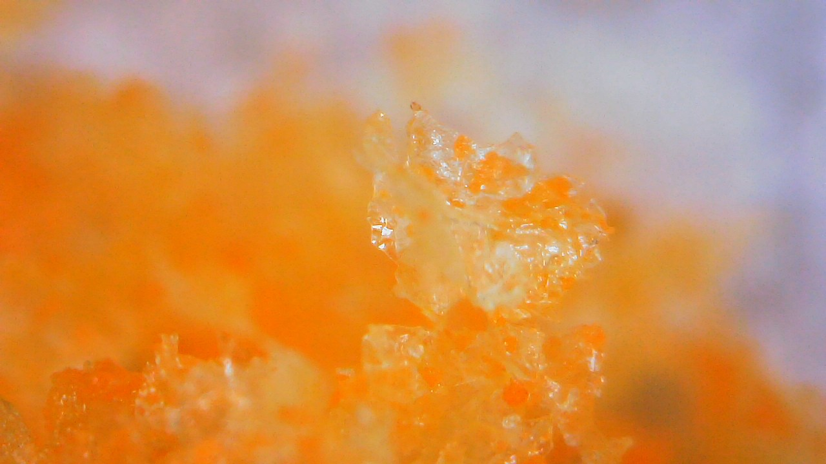
Our “pollen”
What do you think this could be?
Notes:
Compare the real pollen to our “pollen”

Slide 14
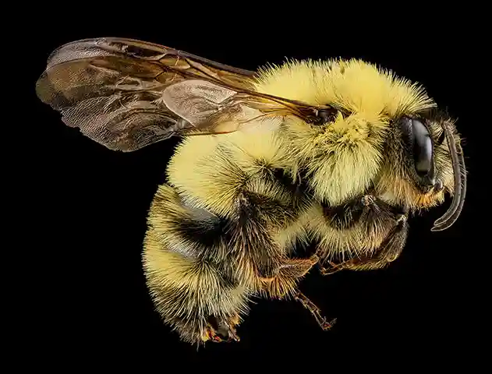
Notes:
The structures to note: Tiny hairs

Slide 15
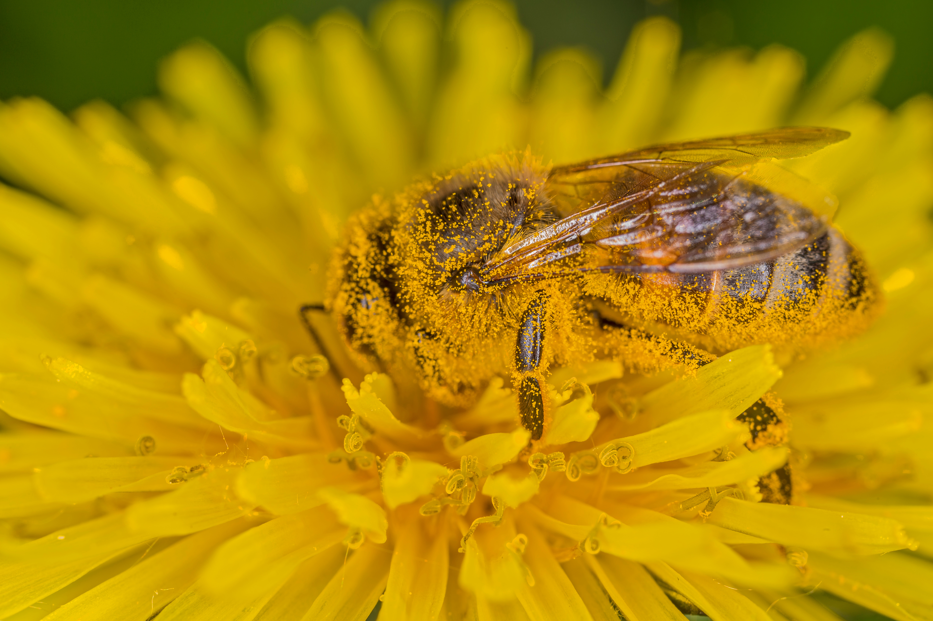
Notes:
The structures to note: tiny hairs (and electrical charge)

Slide 16
https://www.youtube.com/watch?v=kcPaiZTE9ac

Slide 17
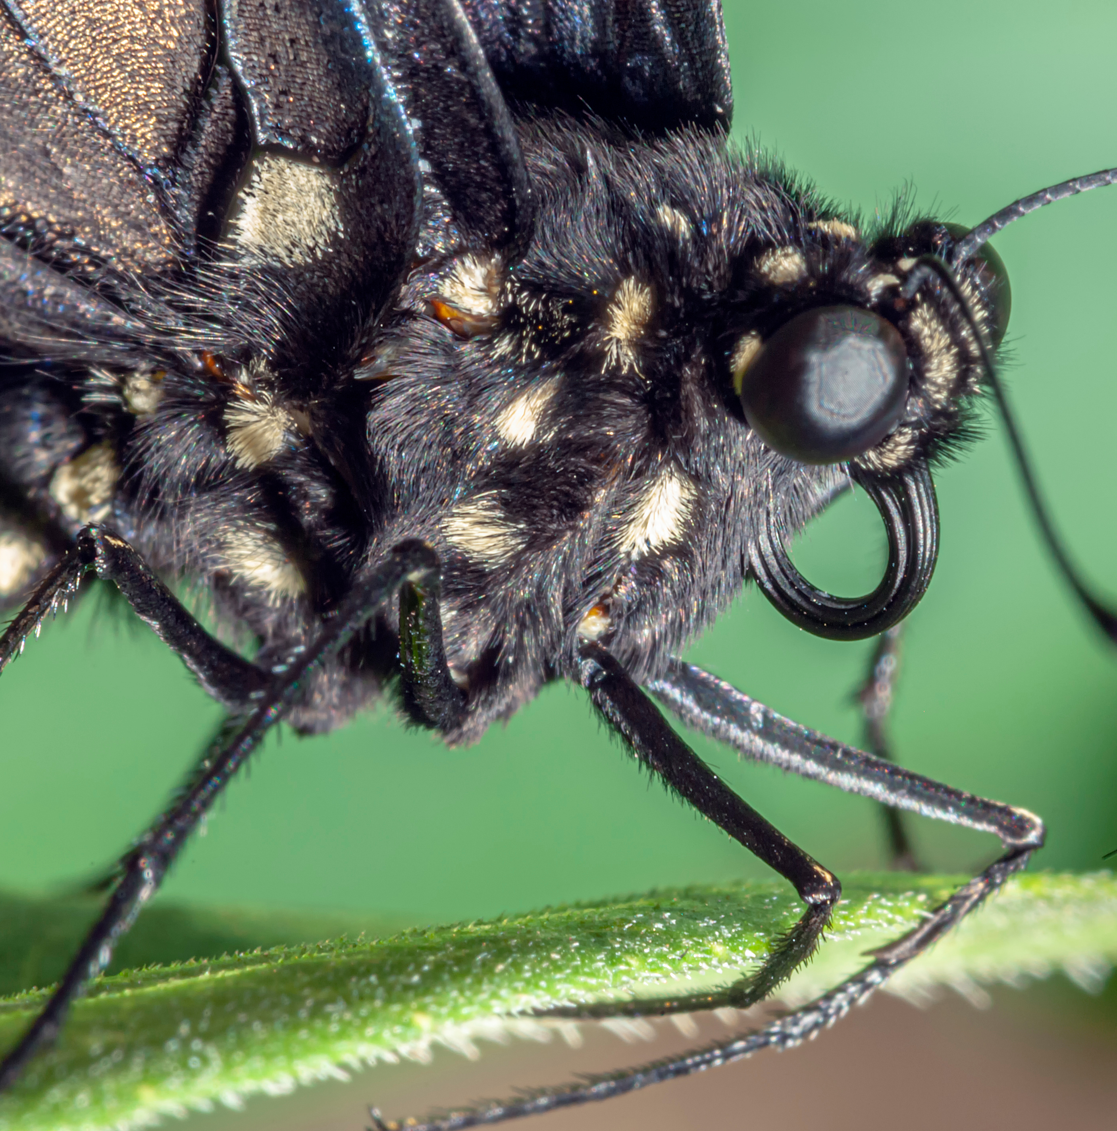
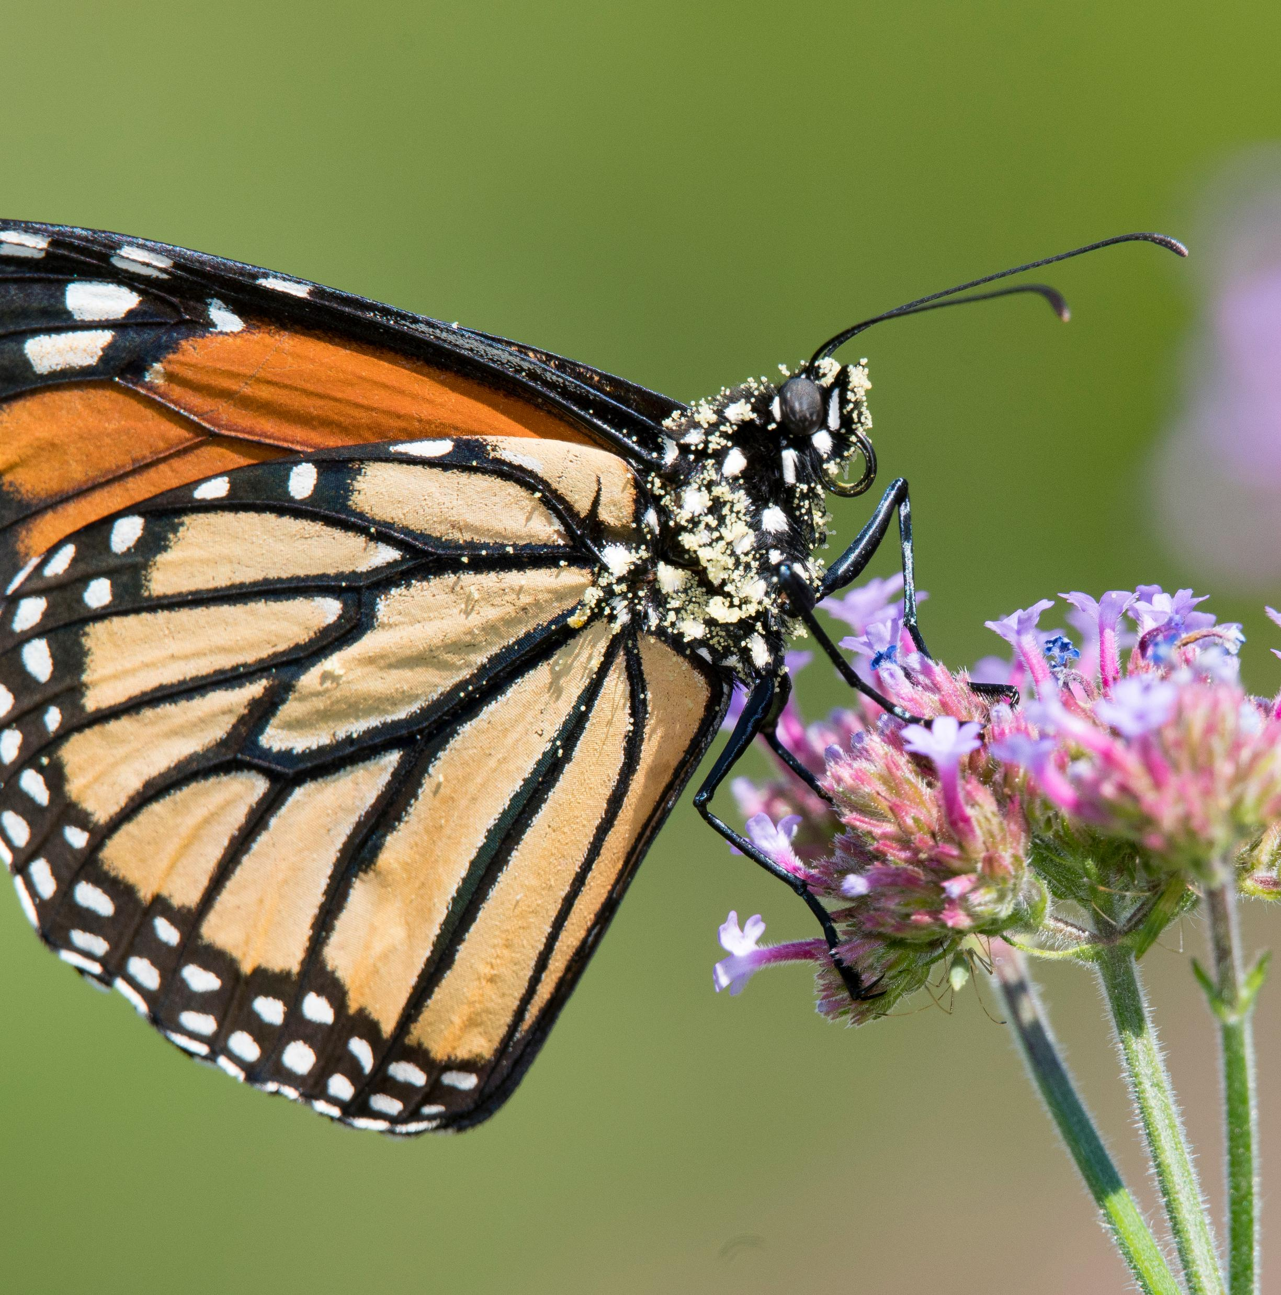
Notes:
Structures to note: scales of butterfly wings and body, proboscis curled up.

Slide 18
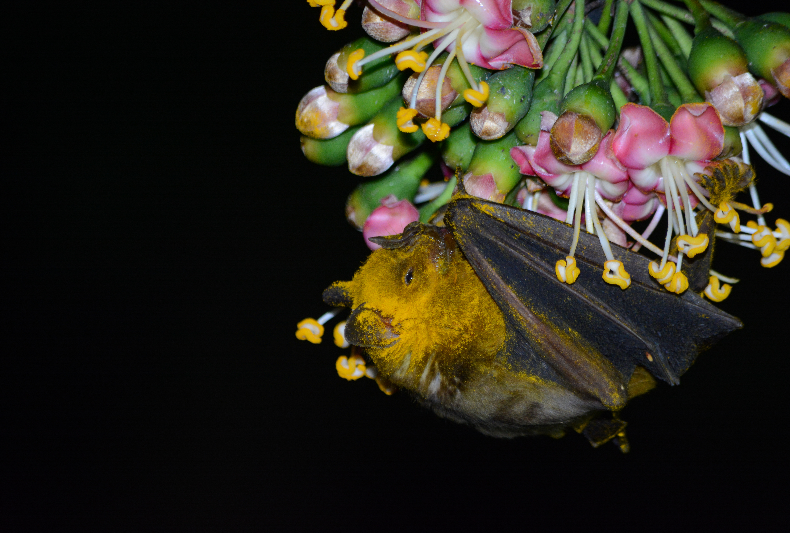
Notes:
Structures to note: fur, shape of face, tongue

Slide 19
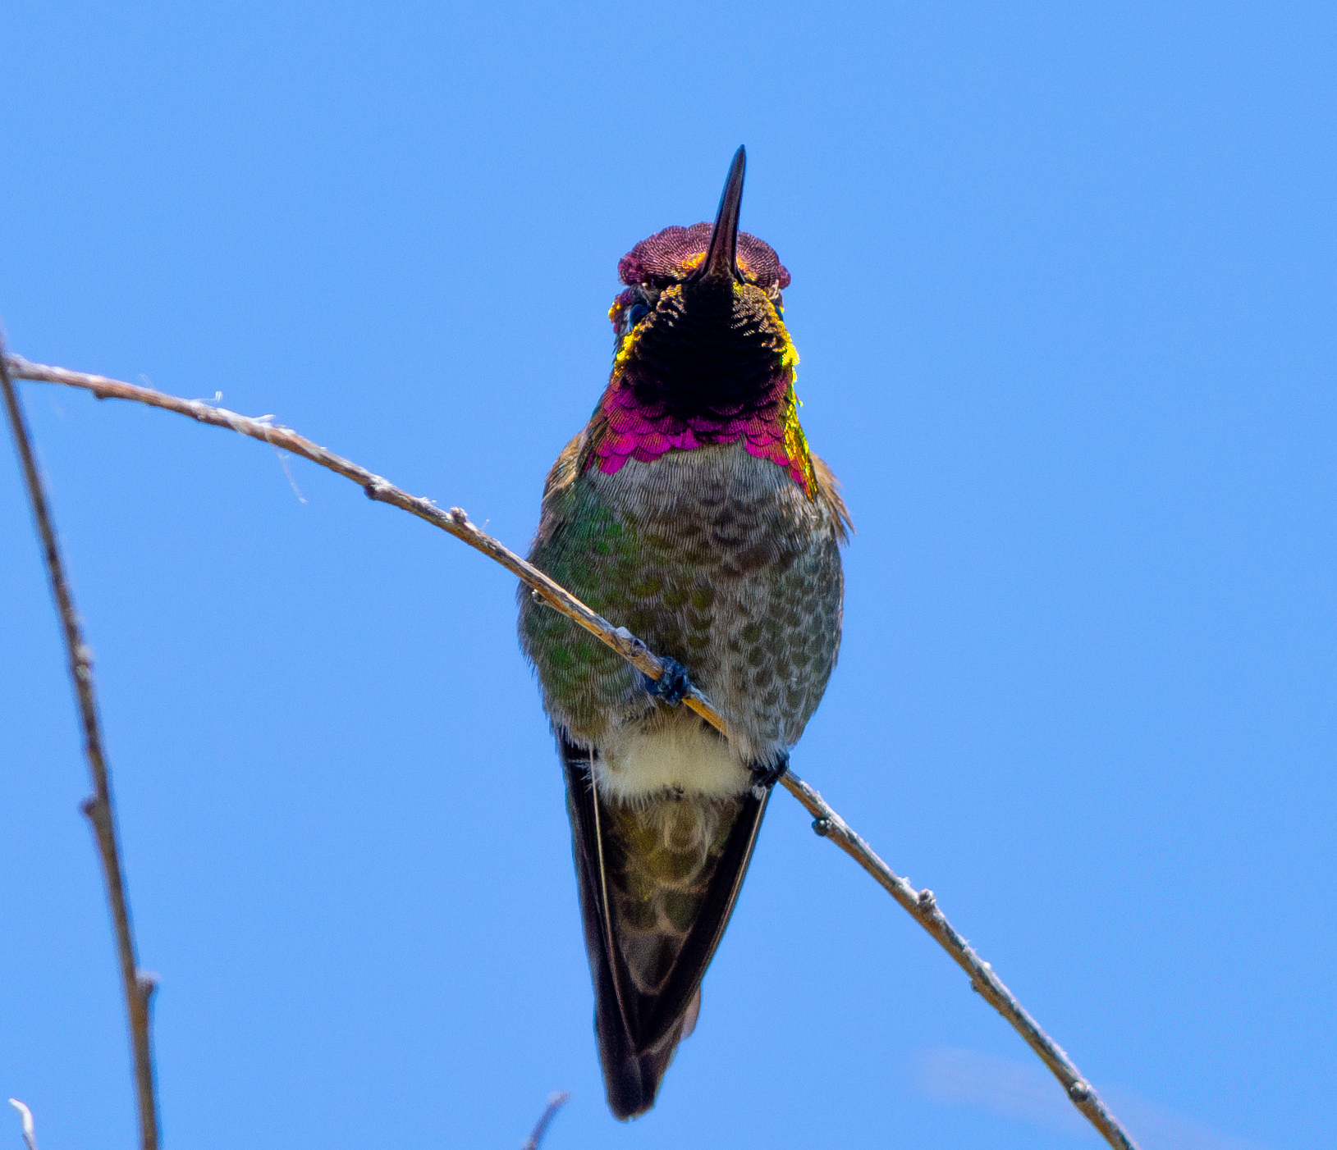
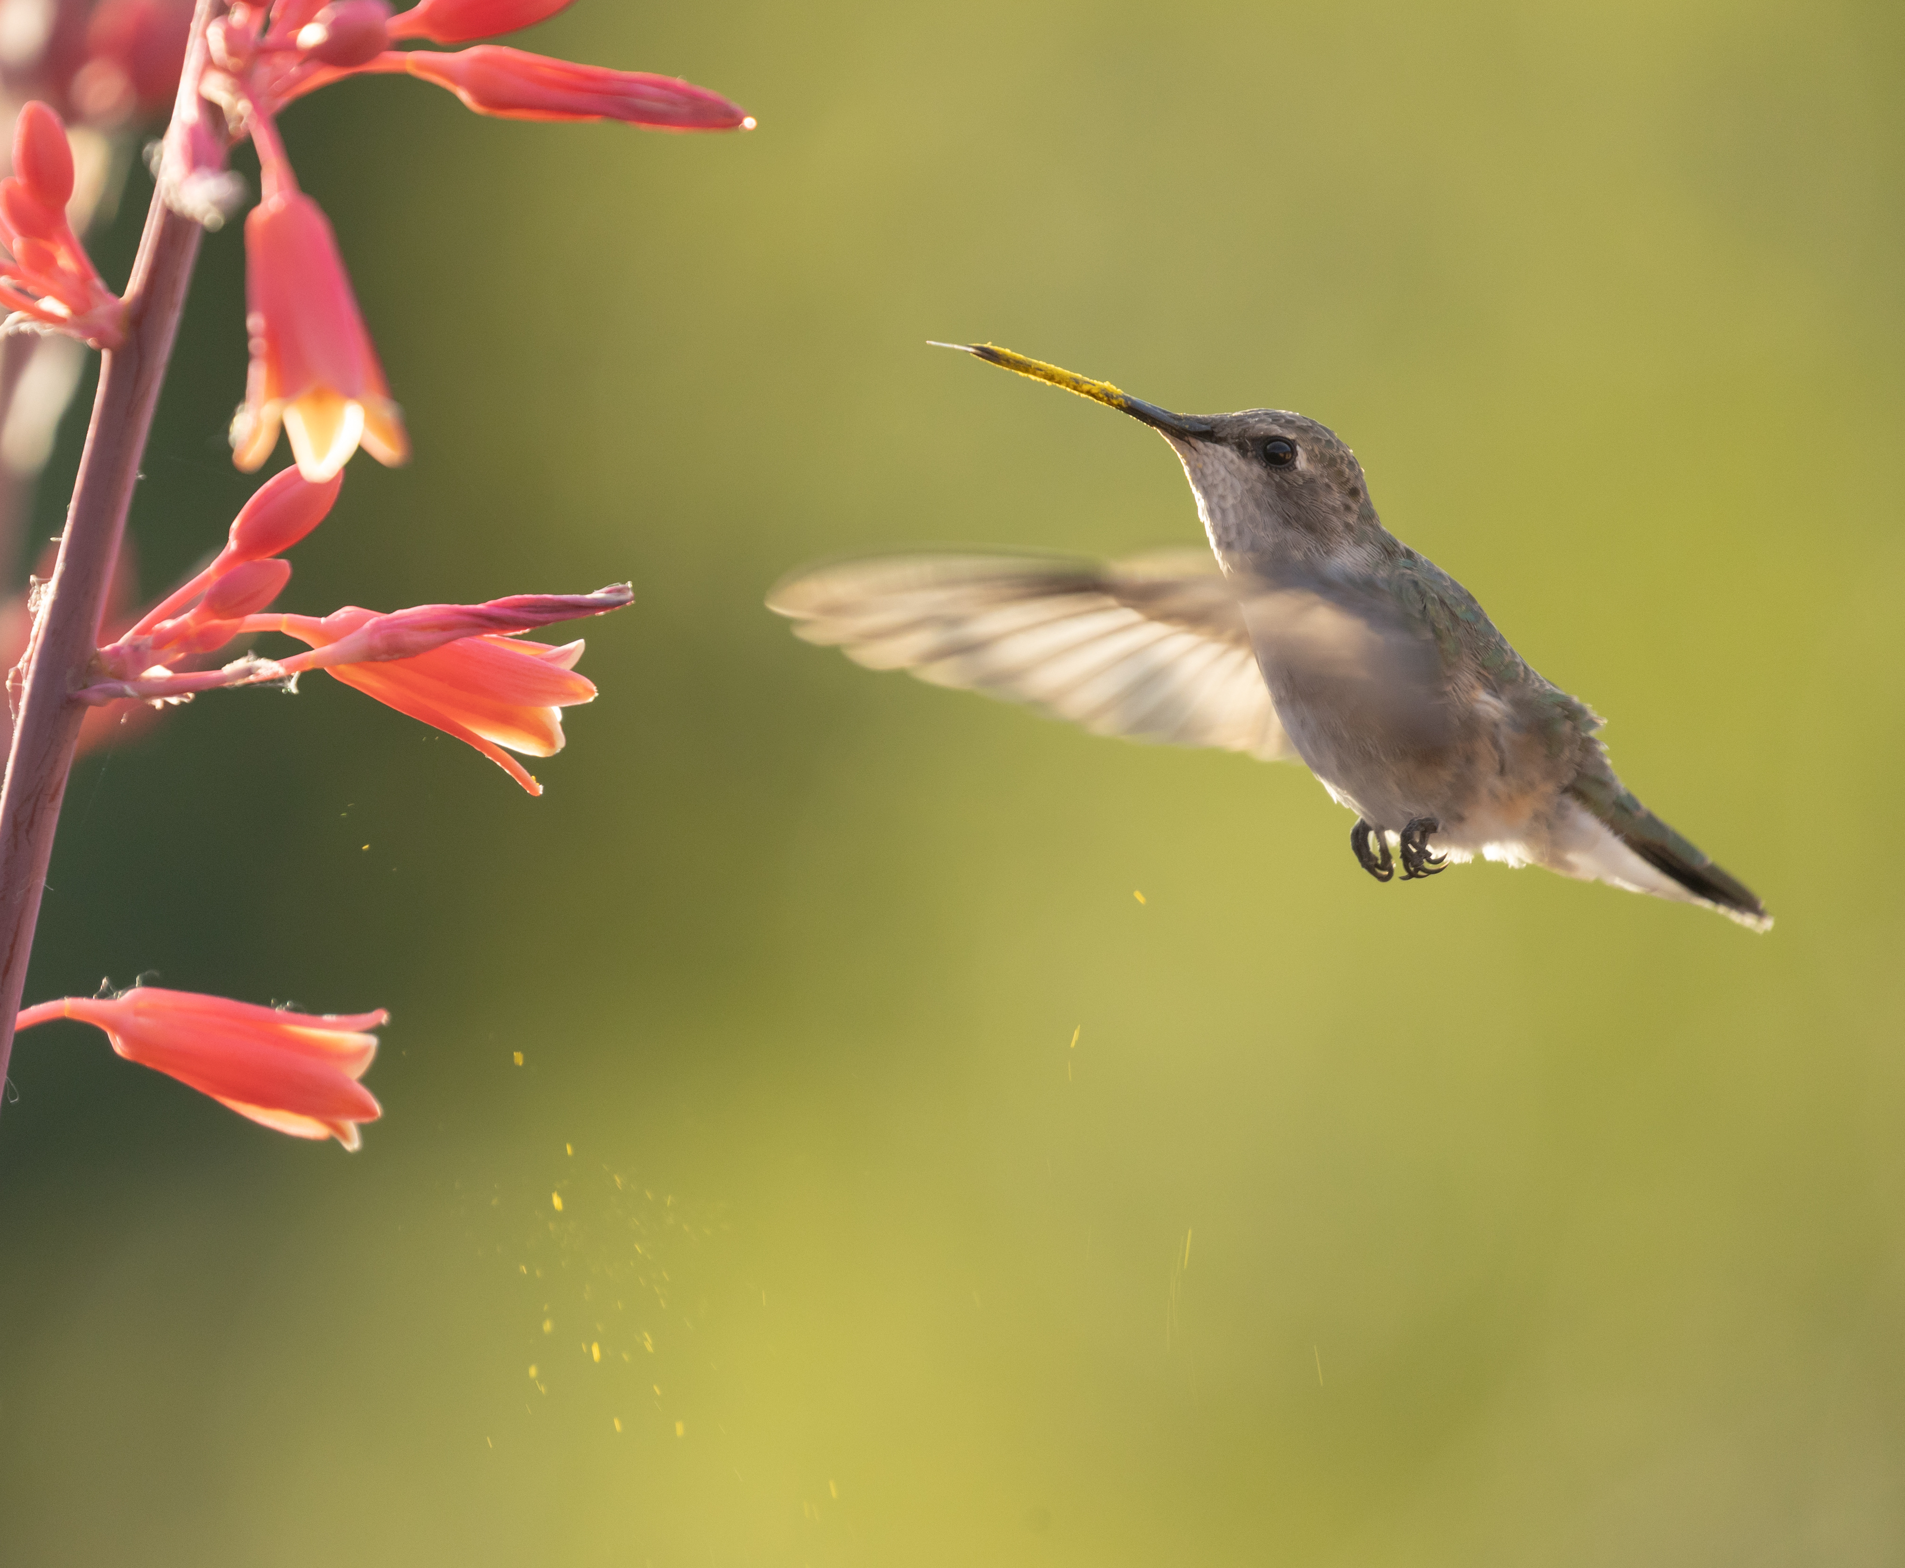
Notes:
Structures to note: beak (with pollen falling off), feathers on the bird’s face covered in pollen.

Slide 20
Set-up for investigation
Notes:
Lay out your flower art and the flight path and test flower like so. Place some “pollen” in the center of the flower art.

