Slide 1
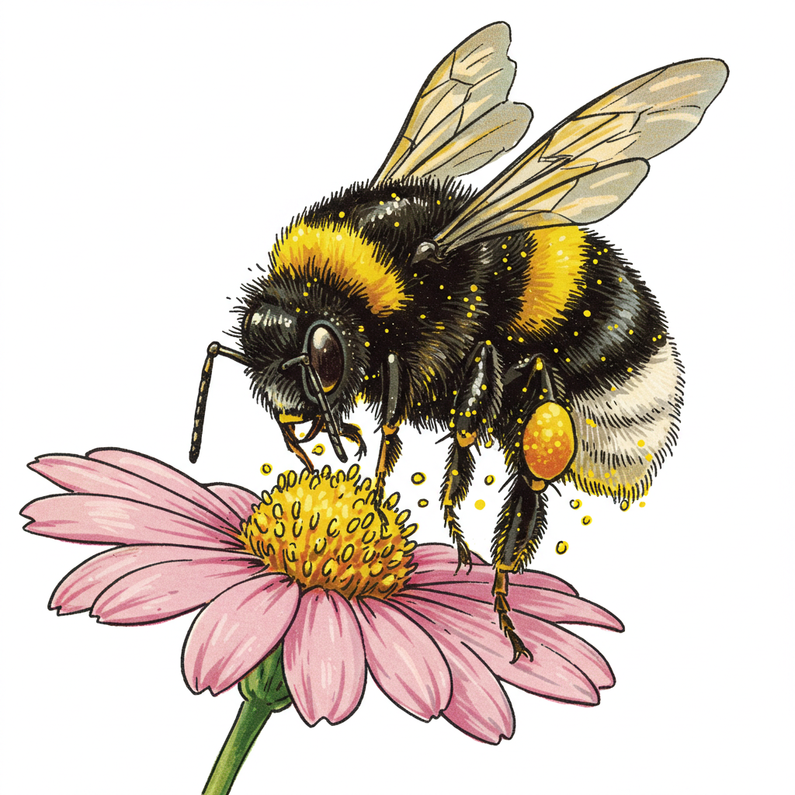
Get Wild with WDFW! Biodiversity and Pollinators

Slide 2
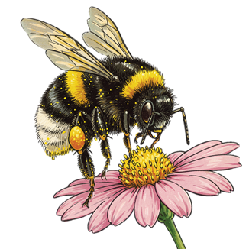
Lesson 8: Picky pollinators and their perfect plants

Slide 3
Flower talk

Slide 4
How do flowers “talk” to pollinators?
Color
Shape
Size
Scent

Slide 5
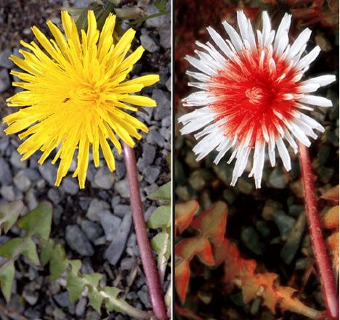
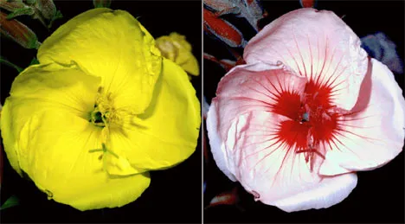
Seeing with bee eyes

Slide 6
Seeing with bee eyes
Notes:
Many insects can see both visible light and UV light

Slide 7
How do flowers “talk” to pollinators?
Food
Nectar or Pollen

Slide 8
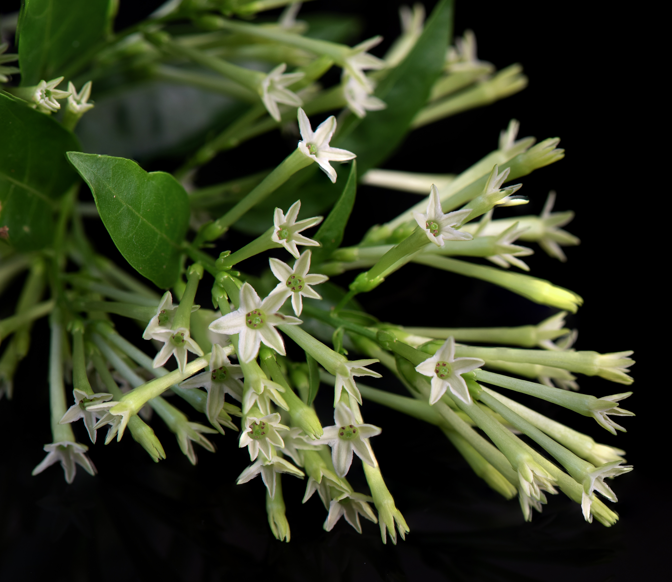
How do flowers “talk” to pollinators?
Timing
Some flowers bloom at night

Slide 9
Lesson 9: Student Assessment Research Poster and Pollination Model
Notes:
This lesson does not have any slides

Slide 10
Lesson 10: How will you help? Habitat connectivity

Slide 11
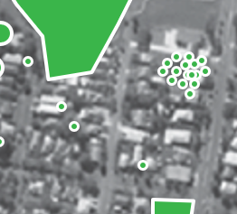
One small garden makes a difference
Community Space Habitat
Yard Habitat
Small Space Habitat
Photo by Shanahan et al., 2014; Graphics added by WDFW
Notes:
This slide has click-through animations that will allow you to point out how even small habitat additions can add to the habitat available in an urban or dense suburban space.

Slide 12
Building pollinator habitat at school

Slide 13
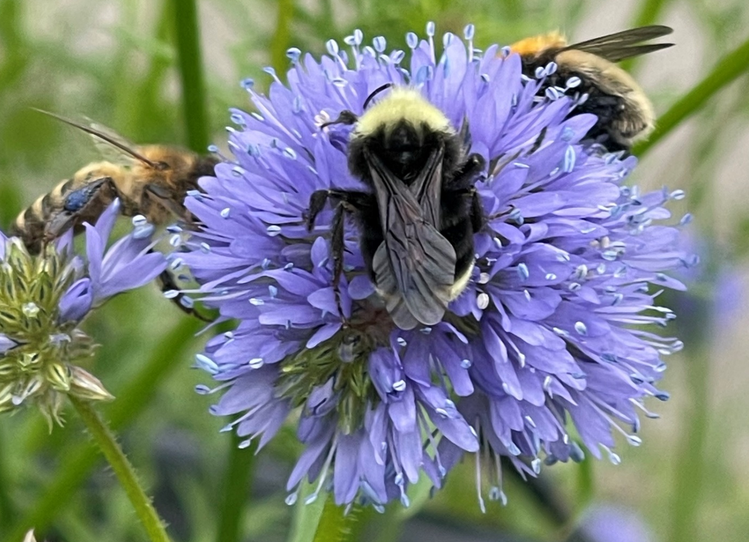
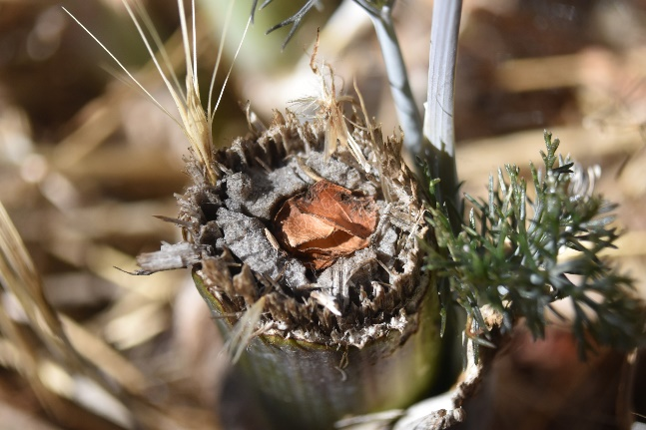
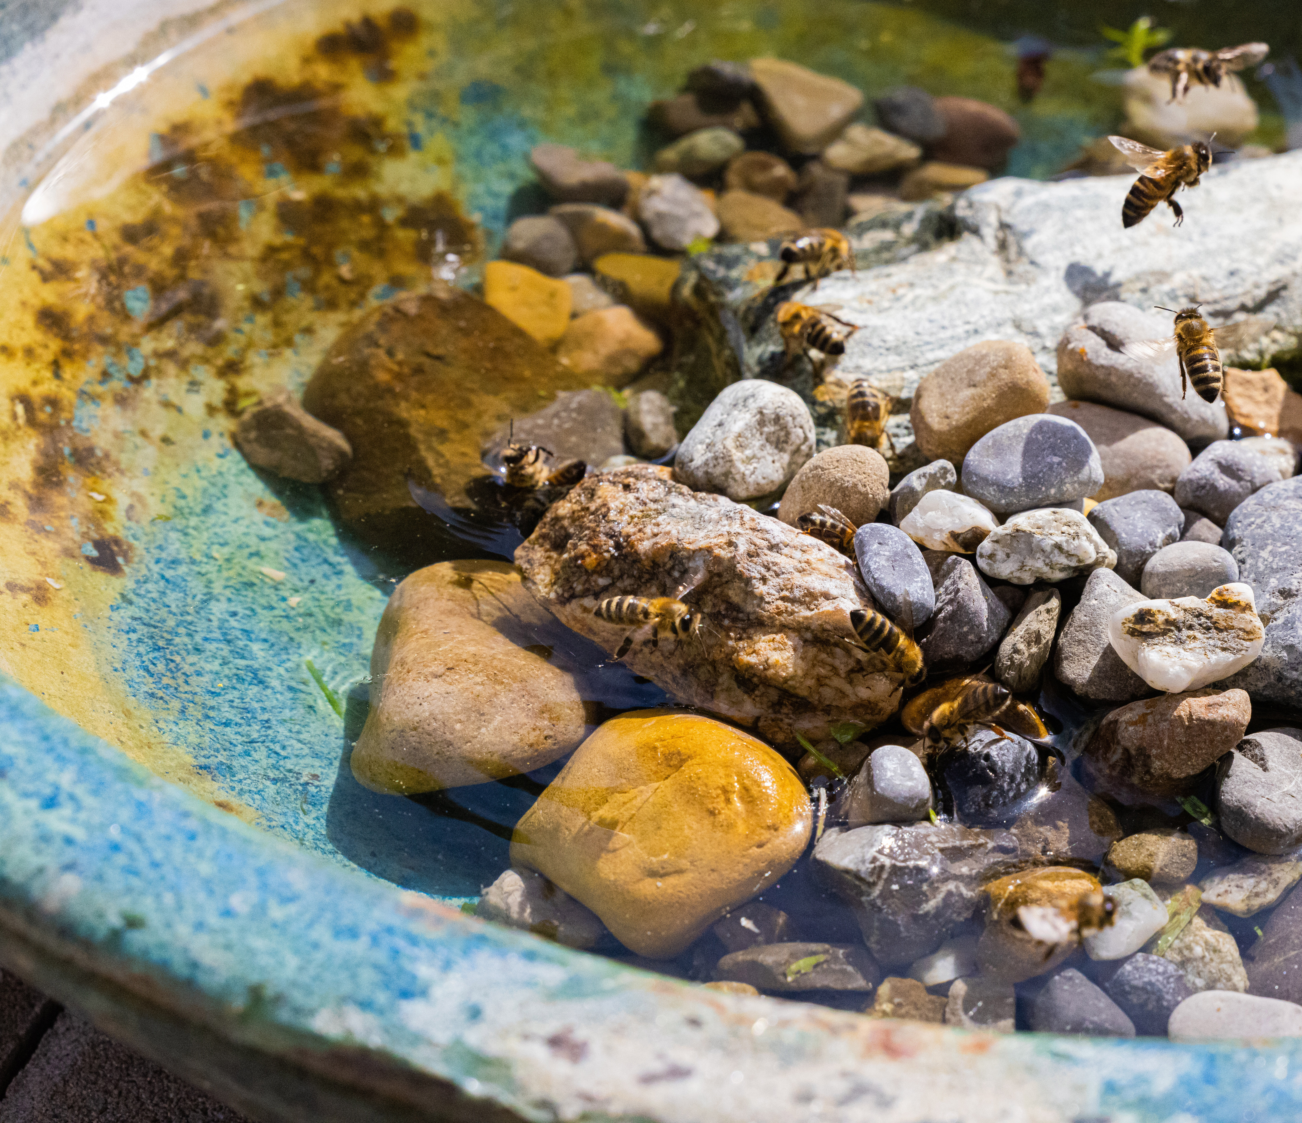
Components of habitat
1 - FOOD
3 - SHELTER
2 - WATER
4 - SPACE
Notes:
When we talk about habitat, we’re talking about the whole system that supports wildlife
There are 4 elements to habitat: Food, Water, Shelter, and Space to raise young. I’m going to go through each of these, why their important, and the many forms that they can take as you build your habitat
Space: disease transmission – less competition when there’s more space in between – similar species - can’t control what your neighbors do but you can control what you do, you’re adding to space

Slide 14
FOOD: Plants
Notes:
When we talk about habitat, we’re talking about the whole system that supports wildlife

Slide 15
WATER
Pollinator puddling dish

Slide 16
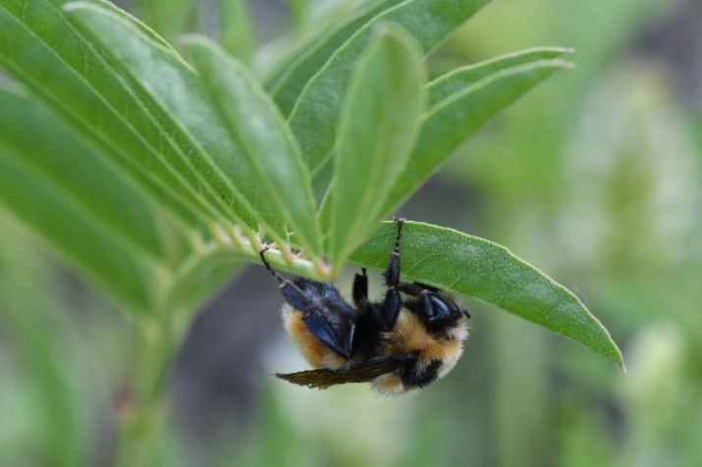
SHELTER

Slide 17
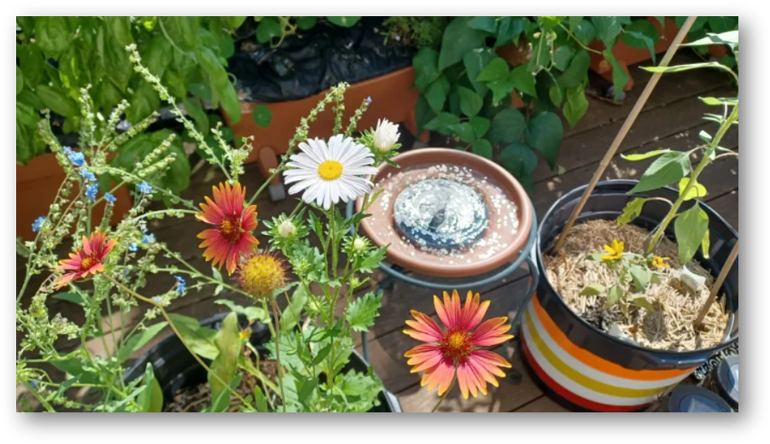
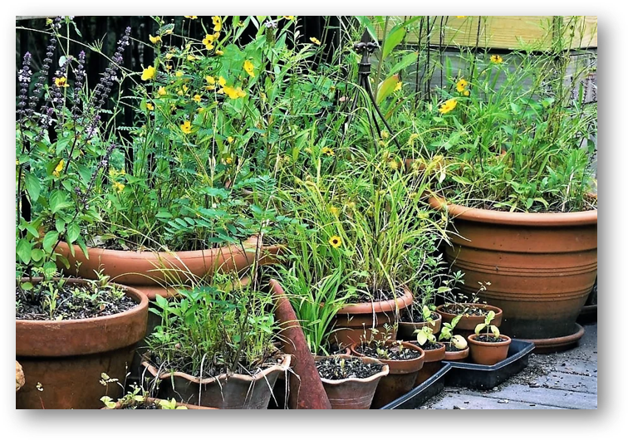
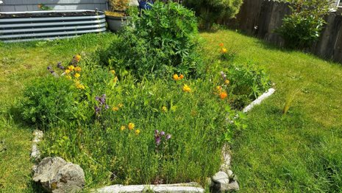
SPACE: How big will your habitat be?
Notes:
Pollinator Habitats don’t have to be big! They can be a couple of plants in a pot with a puddle

Slide 18
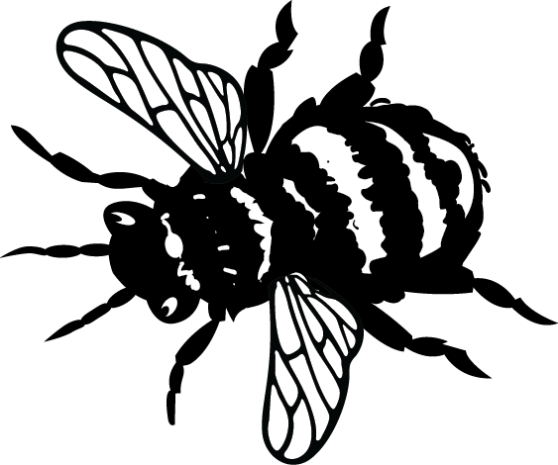
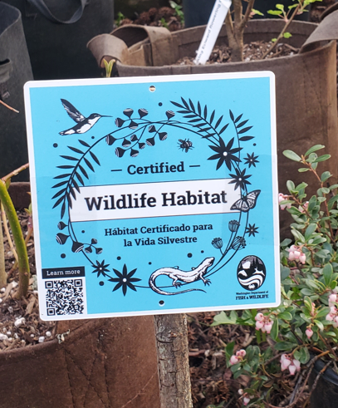
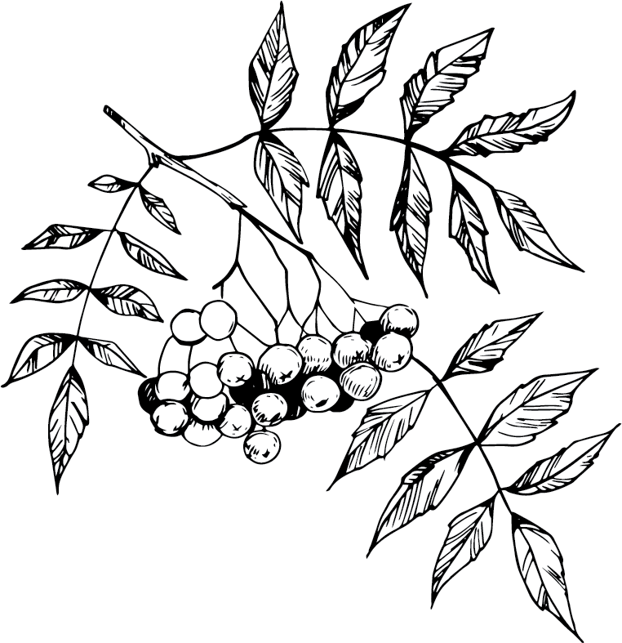
Habitat at Home
Connect with nature where you live, work, and play
Live with wildlife
Increase physical and mental wellbeing
Notes:
Habitat at Home is WDFW’s effort to help Washingtonians connect with nature wherever they live, work, and play. We want to support the whole system that makes a home for wildlife – humans included. Coexisting, living alongside wildlife, is key. This means to live alongside wildlife for co-benefit. While we can support the wellbeing of wildlife, wildlife in turn increases the physical and mental wellbeing of humans.

Slide 19
How will you help support biodiversity and pollinators where you live, learn, and play?

