Slide 1
Public Meeting Guidelines and Etiquette
Please note the following guidelines for our meeting:
Upon joining the virtual meeting, your microphone will be muted automatically.
In case of any technical issues during the meeting, notify us in the chat, and we will help you. Please note that the chat will only be monitored for technical assistance.
Public comments are welcome and will be rotated between in-person and virtual attendees.
To ask a question or make a comment, please use your device's "raise hand" feature. If on the phone, dial *9 on Zoom, and if using a computer, click the hand/reactions icon at the bottom of your screen.
During the comment period, the host will enable you to unmute yourself. You can then unmute yourself by pressing the mute button on your device or dialing *6 on your phone.
Keep discussions focused on the agenda items and questions at hand. Offensive, disrespectful, or derogatory language, including profanity, personal attacks, threats, or insults towards individuals, governments, or organizations, is strictly prohibited.
Assume positive intentions from those speaking and listen respectfully.
To ensure a balanced discussion, limit your comments to two minutes with one clarifying follow-up question.
Provide constructive feedback regarding the fisheries in which you participate. Remember that the most compelling comments are those that pertain to the topics under discussion.
WDFW staff may close public comment to stay on schedule with the agenda or to provide others who still need to comment with an opportunity to speak.
The Hybrid meetings will be recorded and posted online.
If you have further questions or comments, please submit them in written format on our public comment webpage: https://wdfw.wa.gov/fishing/management/north-falcon/public-input
Notes:
Mention key terms, Positive Intentions

Slide 2
Coastal and Strait of Juan de Fuca Recreational Discussion
April 1, 2025

Slide 3
Agenda
Introductions
Puget Sound Forecasts Review
Puget Sound Modeling Updates
Coastal Forecasts, Trends, & Opportunities
Recreational Considerations
Public Comment

Slide 4
WDFW Recreational Fisheries Team
Jake Rice, Statewide Salmon and Steelhead Manager
Christina Iverson, Puget Sound Salmon Manager
Lyle Jennings, Puget Sound Recreational Salmon Manager
Hailey Rosenthal, Puget Sound Recreational Support Biologist
Jennifer Whitney, Olympic Peninsula District Biologist
Mark Downen, Hood Canal District Biologist
Notes:
Reminder of the staff changes and modeling expectations are not the same as in years past as we spoke about in the NOF forecast kickoff.

Slide 5
What is North of Falcon?
North of Falcon is the annual, cooperative process to plan salmon seasons in Washington waters
The name refers to waters north of Oregon's Cape Falcon, which marks the southern border of Washington's management of salmon stocks
One component of a larger salmon setting process that also involves the state, tribal governments, federal regulators, other U.S. States, and Canada

Slide 6
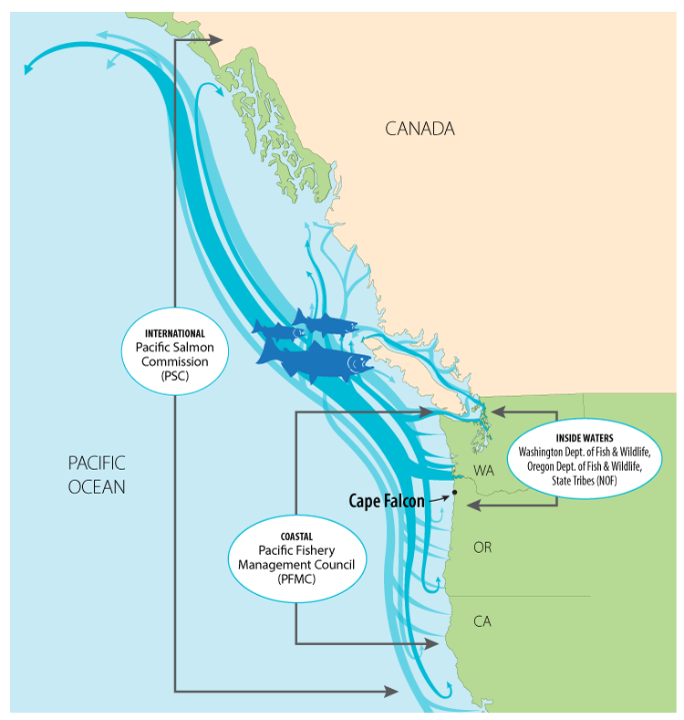
What guides North of Falcon?
Fishery managers must weigh many factors when developing salmon seasons, including:
    Endangered Species Act (ESA) constraints
    Commission policy
    Pacific Salmon Treaty obligations
    Tribal co-management: Washington’s treaty tribes manage their own fisheries, sharing data and splitting harvest with the state
    Extensive monitoring and evaluation of fisheries statewide

Slide 7
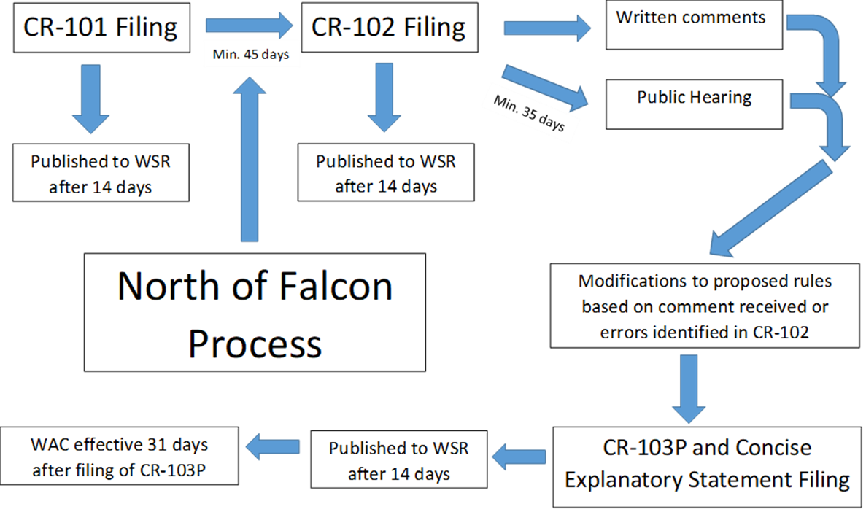
2025 Salmon Fishery Rulemaking
Administrative Procedure Act Process
Notes:
Jan 21 2025 – WSR 25-03-120
Jake pass it off to Christina

Slide 8
2025 forecast recap
Puget Sound Chinook:
  Overall, total Chinook up 32% from 10-yr avg, and up 9% from last years forecast
  Natural stocks down 37% and Hatchery stocks up 53% from recent 10-yr avg
  Coastal Chinook:
  Natural Stocks down 9% and Hatchery stocks up 11% from recent 10-yr avg
  Natural stocks 11% down and Hatchery stocks 16% up from 2024 forecasts
Columbia River Chinook:
  Forecasts for Spring Chinook are similar to 2024, and Summer Chinook are less than the 2024 actual returns
  Lower river Hatchery and Lower River Wild stocks are similar relative to last year’s forecast, Bonneville Pool Hatchery forecast is above last year’s forecast
Puget Sound Coho:
  Overall, total Coho up 1% from last years forecast
  Natural stocks up 1% and Hatchery stocks up 22% from 10-yr avg
  Coastal Coho:
  Natural Stocks down 9% and Hatchery stocks up 23% from 10-yr avg
  Natural stocks down 13% and Hatchery stocks up 8% from last year’s forecasts
Columbia River Coho:
  The Columbia River Early and Late Coho are both up relative to 2024 forecasts.
Notes:
Pass to Chrsitina

Slide 9
2025 salmon forecast recap
Puget Sound chum:
  Natural stocks up 35% and hatchery stocks down 5% from 10-year average
  PS Fall chum total ~1,297,154
  Coastal chum
  Willapa up 36% and Grays Harbor is up 141% from 10-year average

Slide 10
2025 salmon forecast recap
Puget Sound pink:
  Total pink up 70% from the 10-year cycle average
  PS pink total forecast 6.7 million
    Up 170% from 2023 (3.95 M)
  Total Fraser Pink Forecast 27.0 million

Slide 11
Proposed non-treaty ocean quotas for 2025
Alternative #1 | Alternative #1 | Alternative # 2 | Alternative # 2 | Alternative # 3 | Alternative # 3
2025 | 2024 | 2025 | 2024 | 2025 | 2024
 | Chinook | Chinook | Chinook |  | Chinook
122,500 | 85,000 | 112,500 | 78,000 | 92,500 | 72,000
 | Coho 200,000 | Coho | Coho 185,000 |  | Coho 170,000
120,000 | 105,000 | 115,000 | 95,000 | 85,000 | 80,000
Notes:
Christina, pass it off to Lyle

Slide 12
Modeling Updates
Chinook
  Treaty and Non-Treaty Puget Sound marine commercial inputs
  Treaty and Non-Treaty Puget Sound freshwater inputs
  Updated sub-legal and legal ratios
  Northern Fisheries: Individual Stock Based Management (ISBM) and Aggregate Abundance Based Management (AABM)
Coho
  Revised Treaty and Non-Treaty Puget Sound marine commercial inputs
  Revised Treaty and Non-Treaty Puget Sound freshwater inputs
  Canadian fishery updates
Notes:
Pass to Lyle

Slide 13
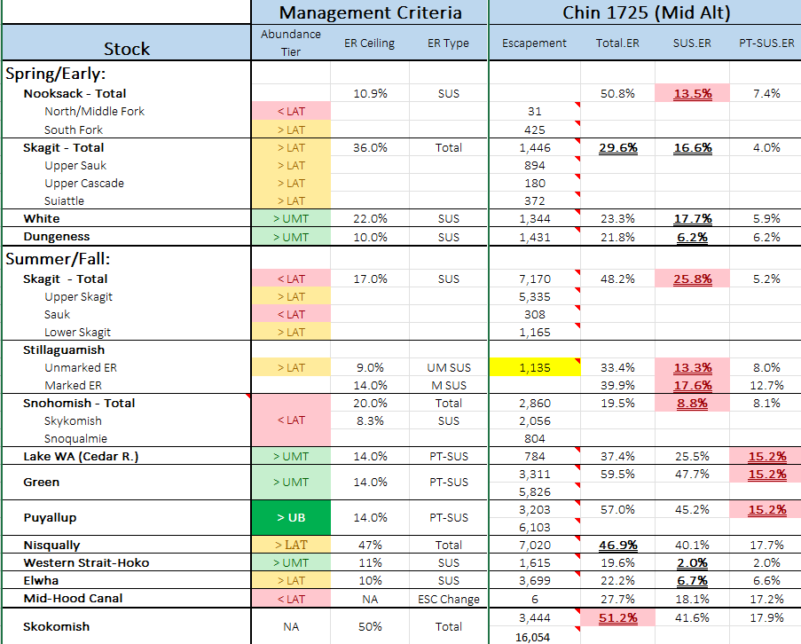
Chinook Modeling Results
(Model #1725)
Notes:
2025 Mid Ocean option
Updates – NT and T PS Marine Commercial and Freshwater inputs, updated sublegal/legal ratios, Individual Stock Based Management (ISBM) and Aggregate Abundance Based Management (AABM) updates from Northern fisheries
-

Slide 14
Current Coho Modeling - Puget Sound
Management Unit | ER CEILING | Mid (2517)
Skagit | 60% | 48.2%
Stilly | 50% | 26.9%
Snohomish | 40% | 28.6%
Hood Canal | 45%* | 45.1%
Strait of Juan de Fuca tributaries | 40% | 9.1%
Interior Fraser (Thompson) | 10% SUS | 11.3%
Notes:
Per the Comp Coho Agreement, ?????

Slide 15
Chinook – Current Proposed Season in modeling
MA 5/6 – July 1 - Aug 15
MA 7 – Thursday, Friday, Saturday openers July 17 – 19
MA 9 – Thursday, Friday, Saturday openers July 17 – 19
MA 10 – Thursday, Friday, Saturday openers July 17 – 19
MA 11 – Wednesday through Saturday in June. Thursday, Friday, Saturday openers starting July 17 – 19. Open 7 days a week August 1 – September 30.
MA 12 – July 1 SOA
MA 13 – No changes
Additional opportunity in MAs 7, 9, 10, and 11 will be provided as quota allows. As in recent seasons.
Winter seasons same as 2024-25.

Slide 16
Coho - Current Season in Modeling
MA 5/6: MSF 7/1-9/26, NS 9/27- 10/15
MA 7: MSF during Chinook openers in July, 8/1-8/30, NS 9/1-9/30
MA 8-1: NS 8/1-10/13
MA 8-2: NS 8/1-9/24
MA 9: MSF during Chinook openers in July, 8/1-9/23, NS 9/24-9/30
MA 10: NS 6/1 -11/15
MA 11: NS during Chinook openers in June and July and 8/1-11/15
MA12: SOA - July 1
MA 13: MSF 7/1/25 - 6/30/26
Notes:
MA-9 – MSF 7/11 – 7/30, 3-day (Thurs- Sat), MSF 7/31 – 9/23, NS (1 Coho limit) 9/24-10/08

Slide 17
Marine Area Pink Fisheries
Adding 2 additional pinks to the daily limit in all inside Marine Areas except MA 8-2.
Strong returns expected to the Fraser at 27 million.
Strong returns expected to Hood Canal and South Sound.
  2.5 million to Hood Canal.
  4 million to Central and South Sound.
Conservation concerns for Stillaguamish pinks being forecast below escapement.
  Preseason forecast is 25% below the 5 pink cycle average (2015-23).

Slide 18
Hood Canal Coho: Update
The Comprehensive Coho Management Plan and Pacific Salmon Treaty limit exploitation rates to 45% for mid-range forecast abundances and to 20% for critically low forecast abundances.
State and Tribal co-managers recognized the 2025 forecast abundance is just above the Critical Abundance threshold. Co-managers are planning to implement more conservative fisheries to reduce our combined exploitation rate below the allowable ceiling of 45%.
The current state proposal for sport fisheries reductions are:
  Convert MA 9 non-selective coho fishery to mark-selective at the end of September.
  Convert MA 12 coho fisheries to mark selective.
  Close MA 12 to recreational salmon fishing October 1 – 15. Reopen October 16
Notes:
Lyle, pass it off to Mark D

Slide 19
Olympic Peninsula Freshwater Fisheries
Notes:
Pass to Jenni

Slide 20
Hood Canal Freshwater Proposed Seasons
Notes:
Mark, pass it off to Jenni

Slide 21
Dungeness River
Proposed for 2025
In recent years, low flows have delayed the traditional October 16 hatchery coho opening on the Dungeness. Open fishery 1 week later in the permanent rules and open earlier (October 16) via E-Reg if flows allow.
Proposed rules are October 23 to November 30. Salmon daily limit 4, release all salmon other than hatchery coho.

Slide 22
Other Strait of Juan de Fuca tributaries
Concern: anglers targeting salmon during gamefish seasons. To protect salmon during gamefish seasons the following gear rules are proposed.
Lyre River, mouth to falls; add selective gear rules when salmon are present. Currently there are no gear restrictions. This proposal would add selective gear rules September 1 through January 31.
Clallam River; add selective gear rules when salmon are present. Currently selective gear rules are in effect the Saturday before Memorial Day through October 31. This proposal would extend selective gear rules through January 31.
Hoko River, mouth to Upper Hoko Bridge; extend fly fishing only rules for 2 additional weeks to protect Chinook. Currently flyfishing only rules are in effect on the lower Hoko September 1 through October 31. This proposal would extend flyfishing only rules through November 15.

Slide 23
2025 Considerations for North Coast rivers
Hoh River
Wild Spring/Summer Chinook:
  Forecast = 1,233 (2024 forecast: 1,146)
  Escapement goal = 900 or 69% of the run.
  Above escapement goal but not by much.
Wild Fall Chinook:
  Forecast = 2,491 (2024: 3,460)
  Escapement goal = 1,200 or 60% of run size (60% = 1,495).
  Harvestable = 996 (498 share)
Wild Fall Coho:
  Escapement goal = 2,000-5,000.
  OA3 forecast = 5,371 (less to terminal run) (2024: 4,870)
  Harvestable = up to ~2,600 (~1,300 share)

Slide 24
2025 Considerations for North Coast rivers
Quillayute System
Wild fall Chinook:
Forecast = 6,393 (2024: 8,552)
  Escapement Goal = 3,000 or 60% of run (3,836).
  Harvestable = 2,557 (1,279 share)
Wild summer Chinook:
  Forecast =1,744 (2024: 1,560)
  Escapement guideline = 1,200
Hatchery spring Chinook:
  Forecast = 2,447 (2024: 2,489)
  Broodstock needs = ~900
  Harvestable = 1,547 (773 share)
Wild fall coho:
  Forecast (OA3) = 10,879 (2024: 10,244)
  Escapement goal = 6,300-15,800
  Harvestable = ~3,000 (~1,500 share) above lower end of escapement goal
Hatchery fall coho:
Forecast (OA3) = 13,546 (2024: 10,298)
  Broodstock needs = ~600
  Harvestable = ~11,000 (~5,500 share)
Wild summer coho:
  Forecast (OA3) = 347 (2024: 393)
  Escapement Goal = Not established, 900-1,200 fish guideline
Hatchery summer coho:
  Forecast (OA3) = 2,975 (2024: 2,315)
  Broodstock needs = ~100
  Harvestable =~2,500 (~1,250 shares)

Slide 25
Suggestions for North Coast freshwater regulations received from the public
Allow retention of one wild fish (coho or Chinook) during fall fisheries on the Quillayute system.
Provide as much advance notice as possible if in-season fisheries modifications (E-Regs) are necessary.
Eliminate bait if E-Regs are necessary.
Consider one and done if E-Regs are necessary.
Establish rules to protect wild summer coho, concerns with no escapement goal, low flow, low forecast.
Prioritize a full season over a larger bag limit.
Establish a flow dependent bag limit (Quillayute).
Allow one barbless treble hook (instead of one single point barbless hook).
Allow bait and barbed hooks in fall fisheries.

Slide 26
Hoh River
Proposed for 2025
Higher daily limit than last year due to higher coho forecast.
Mouth to Oxbow, Sept 16 – Nov. 30, daily limit 3, only 2 adults may be retained, only 1 may be a Chinook. December 1-15 daily limit 1 coho only.
Oxbow to Morgans Crossing, Oct 16 – Nov. 30, daily limit 3, only 2 adults may be retained, only 1 may be a Chinook. December 1-15 daily limit 1 coho only.
Only one single point barbless hook. Bait allowed.

Slide 27
Quillayute River
Proposed for 2025
Spring Fisheries, same as 2024
  Quillayute & Sol Duc, May 1-Aug. 31, 4 salmon, only 2 adults, release wild Chinook, wild coho & sockeye. Bait allowed except July 16-Aug 31 on Sol Duc.
  Bogachiel, Calawah, & Dickey, July 1-Aug. 31, 4 salmon only 2 adults, release wild Chinook, wild coho & sockeye. Bait prohibited.
  Concern for wild summer coho forecast at less than 400.
Fall Fisheries, higher bag limit than 2024 on Bogachiel, Calawah, Dickey. 1 wild fish retention (coho or Chinook).
  Quillayute & Sol Duc, Sept 1-Dec 15, 6 salmon, only 3 adults, only 1 wild. Bait allowed
  Bogachiel, Calawah, & Dickey, Sept 1-Dec 15, 3 salmon, only 2 adults, only 1 wild. Bait allowed.

Slide 28
Potential for In-Season Action on North Coast
Concern: In recent years, low flows, high temperatures, and run coming in below preseason forecast have led to in-season management actions through E-Reg.
Possible in-season actions through E-Reg
    Lower bag limit
    Release stock of concern
    Gear restrictions.
    Closure of some areas
    Closed to fishing
Notes:
Jenni, pass it off to Jake

Slide 29
2025 NOF meeting schedule
Date | Meeting
March 19 | North of Falcon #1 – Statewide proposals
March 24 | PFMC public hearing – Westport, WA
March 25 | North of Falcon #2 – statewide proposals
April 1 | Coastal and Strait of Juan de Fuca recreational fisheries
April 2 | Willapa Bay and Grays Harbor fisheries
April 3 | Columbia River Fisheries – Buoy 10 to Hwy 395 Bridge at Pasco, WA
April 3 | Puget Sound freshwater and marine recreational fisheries
April 9-15 | Pacific Fishery Management Council meeting – San Jose, CA
Registrations links and meeting materials are available on the WDFW website.
Notes:
Pass to Jake

Slide 30
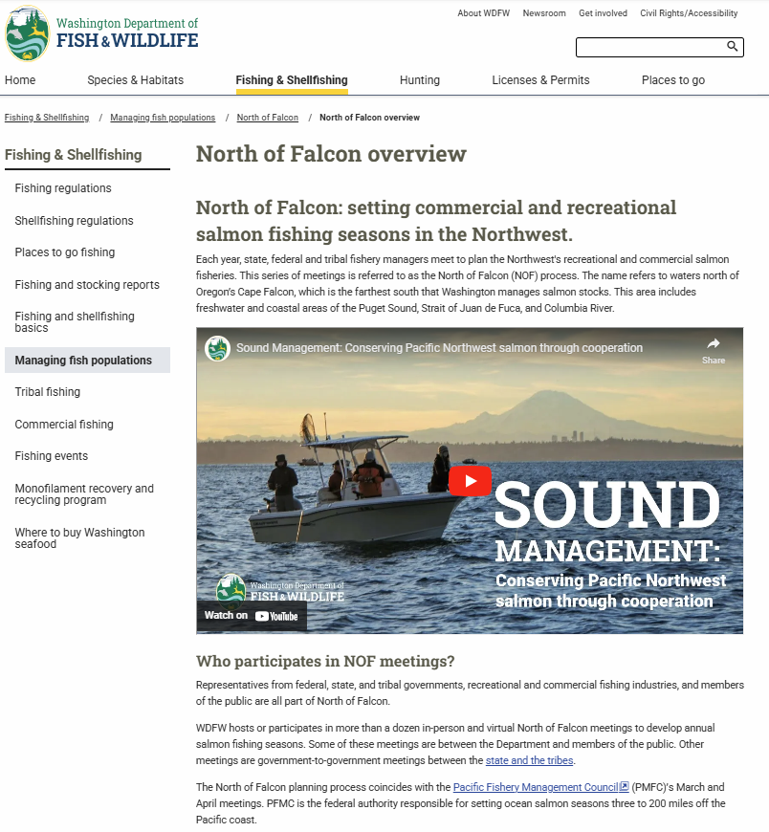
Learn more at WDFW.wa.gov/NOF
Find up-to-date information about:
Upcoming meetings
Proposed seasons
Updated forecasts and model runs
Public input opportunities
Salmon Fishing Current blog

Slide 31
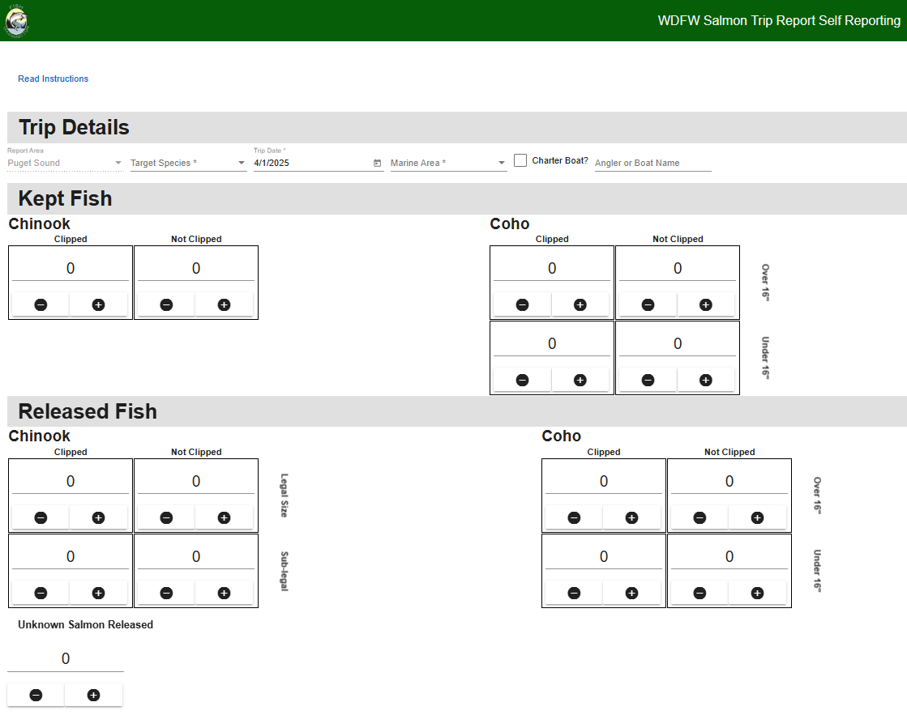
Salmon Trip Report
Anglers are encouraged to fill out Salmon Trip Reports (STR)
Link to online reporting: https://str.wdfw-fish.us/home
Link to the website: https://wdfw.wa.gov/licenses/fishing/trip-reporting
Notes:
Anglers are encouraged to fill out salmon trip reports. These are an important evaluation tool in our monitoring efforts.

Slide 32
Questions?
Request this information in an alternative format or language at wdfw.wa.gov/accessibility/requests-accommodation, 833-885-1012, TTY (711), or CivilRightsTeam@dfw.wa.gov.

