Slide 1
Public Meeting Guidelines and Etiquette
Please note the following guidelines for our meeting:
Upon joining the virtual meeting, your microphone will be muted automatically.
In case of any technical issues during the meeting, notify us in the chat, and we will help you. Please note that the chat will only be monitored for technical assistance.
Public comments are welcome and will be rotated between in-person and virtual attendees.
To ask a question or make a comment, please use your device's "raise hand" feature. If on the phone, dial *9 on Zoom, and if using a computer, click the hand/reactions icon at the bottom of your screen.
During the comment period, the host will enable you to unmute yourself. You can then unmute yourself by pressing the mute button on your device or dialing *6 on your phone.
Keep discussions focused on the agenda items and questions at hand. Offensive, disrespectful, or derogatory language, including profanity, personal attacks, threats, or insults towards individuals, governments, or organizations, is strictly prohibited.
Assume positive intentions from those speaking and listen respectfully.
To ensure a balanced discussion, limit your comments to two minutes with one clarifying follow-up question.
Provide constructive feedback regarding the fisheries in which you participate. Remember that the most compelling comments are those that pertain to the topics under discussion.
WDFW staff may close public comment to stay on schedule with the agenda or to provide others who still need to comment with an opportunity to speak.
The Hybrid meetings will be recorded and posted online.
If you have further questions or comments, please submit them in written format on our public comment webpage: https://wdfw.wa.gov/fishing/management/north-falcon/public-input
Notes:
Mention key terms, Positive Intentions

Slide 2
Puget Sound Marine and Freshwater Recreational Discussion
April 3, 2025

Slide 3
Agenda
Introductions
Puget Sound Forecasts Review
Puget Sound Modeling Updates
Freshwater Forecasts, Trends, & Opportunities
Recreational Considerations
Public Comment

Slide 4
WDFW Recreational Fisheries Team
Jake Rice, Statewide Salmon and Steelhead Manager
Christina Iverson, Puget Sound Salmon Manager
Lyle Jennings, Puget Sound Recreational Salmon Manager
Hailey Rosenthal, Puget Sound Recreational Support Biologist
Edward Eleazer, Region 4 Fish Program Manager
Julie Klacan, Nooksack and Samish District Biologist
Andrew Fowler, Skagit/Sauk District Biologist
Pete Verhey, Stillaguamish/Snohomish District Biologist
Aaron Bosworth, Cedar/Green District Biologist
Gabe Madel, Puyallup/Nisqually District Biologist
Notes:
Reminder of the staff changes and modeling expectations are not the same as in years past as we spoke about in the NOF forecast kickoff.

Slide 5
What is North of Falcon?
North of Falcon is the annual, cooperative process to plan salmon seasons in Washington waters
The name refers to waters north of Oregon's Cape Falcon, which marks the southern border of Washington's management of salmon stocks
One component of a larger salmon setting process that also involves the state, tribal governments, federal regulators, other U.S. States, and Canada

Slide 6
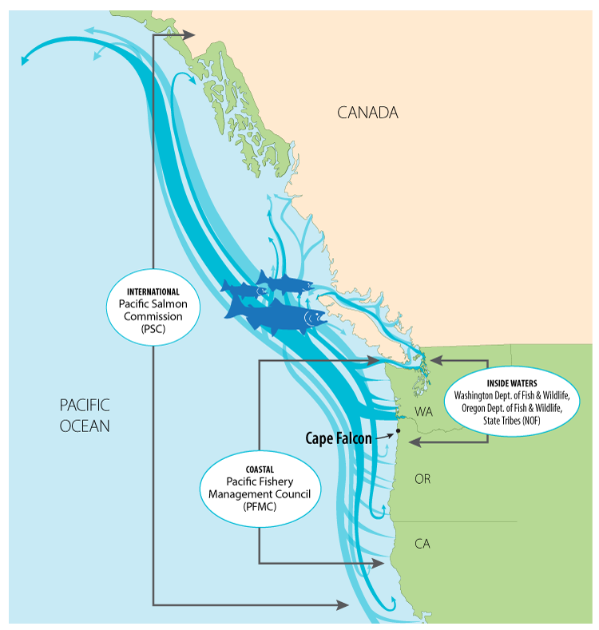
What guides North of Falcon?
Fishery managers must weigh many factors when developing salmon seasons, including:
Endangered Species Act (ESA) constraints
Commission policy
Pacific Salmon Treaty obligations
Tribal co-management: Washington’s treaty tribes manage their own fisheries, sharing data and splitting harvest with the state
Extensive monitoring and evaluation of fisheries statewide

Slide 7
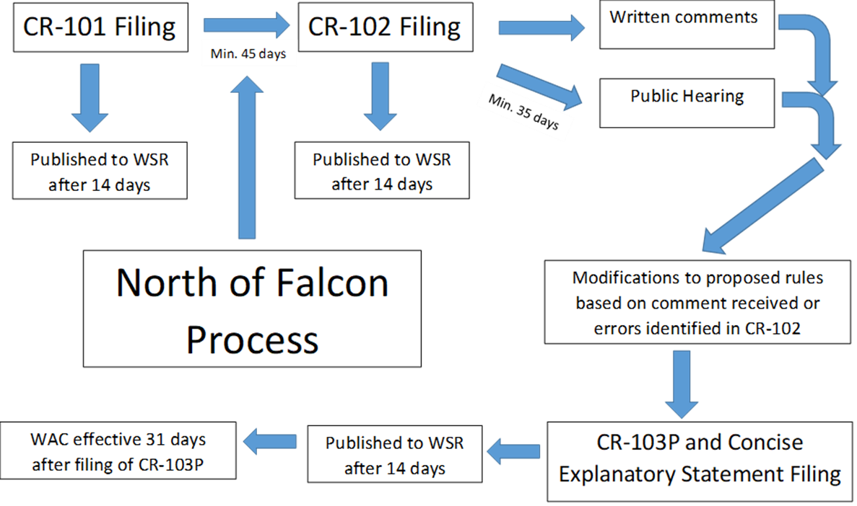
2025 Salmon Fishery Rulemaking
Administrative Procedure Act Process
Notes:
Jan 21 2025 – WSR 25-03-120
Jake pass it off to Christina

Slide 8
Proposed non-treaty ocean quotas for 2025
Alternative #1 | Alternative #1 | Alternative # 2 | Alternative # 2 | Alternative # 3 | Alternative # 3
2025 | 2024 | 2025 | 2024 | 2025 | 2024
 | Chinook | Chinook | Chinook |  | Chinook
122,500 | 85,000 | 112,500 | 78,000 | 92,500 | 72,000
 | Coho 200,000 | Coho | Coho 185,000 |  | Coho 170,000
120,000 | 105,000 | 115,000 | 95,000 | 85,000 | 80,000

Slide 9
2025 forecast recap
Puget Sound Chinook:
Overall, total Chinook up 32% from 10-yr avg, and up 9% from last years forecast
Natural stocks down 37% and Hatchery stocks up 53% from recent 10-yr avg
Coastal Chinook:
Natural Stocks down 9% and Hatchery stocks up 11% from recent 10-yr avg
Natural stocks 11% down and Hatchery stocks 16% up from 2024 forecasts
Columbia River Chinook:
Forecasts for Spring Chinook are similar to 2024, and Summer Chinook are less than the 2024 actual returns
Lower river Hatchery and Lower River Wild stocks are similar relative to last year’s forecast, Bonneville Pool Hatchery forecast is above last year’s forecast
Puget Sound Coho:
Overall, total Coho up 1% from last years forecast
Natural stocks up 1% and Hatchery stocks up 22% from 10-yr avg
Coastal Coho:
Natural Stocks down 9% and Hatchery stocks up 23% from 10-yr avg
Natural stocks down 13% and Hatchery stocks up 8% from last year’s forecasts
Columbia River Coho:
The Columbia River Early and Late Coho are both up relative to 2024 forecasts.
Notes:
Pass to Chrsitina

Slide 10
2025 salmon forecast recap
Puget Sound chum:
Natural stocks up 35% and hatchery stocks down 5% from 10-year average
PS Fall chum total ~1,297,154
Coastal chum
Willapa up 36% and Grays Harbor is up 141% from 10-year average

Slide 11
2025 salmon forecast recap
Puget Sound pink:
Total pink up 70% from the 10-year cycle average
PS pink total forecast 7.76 million
Up 7% from 2023 return (7.72 M)
Total Fraser Pink Forecast 27.0 million

Slide 12
2025 forecast recap
Baker Lake sockeye:
Forecast is up 57% from 10-year average
~60,000
Lake Washington sockeye
Forecast is down 17% from 10-year average
~35,000
Notes:
Christina, pass it off to Lyle

Slide 13
Modeling Updates
Chinook
Treaty and Non-Treaty Puget Sound marine commercial inputs
Treaty and Non-Treaty Puget Sound freshwater inputs
Updated sub-legal and legal ratios
Northern Canada Fisheries: Individual Stock Based Management (ISBM) and Aggregate Abundance Based Management (AABM)
Coho
Revised Treaty and Non-Treaty Puget Sound marine commercial inputs
Revised Treaty and Non-Treaty Puget Sound freshwater inputs
Canadian fishery updates

Slide 14
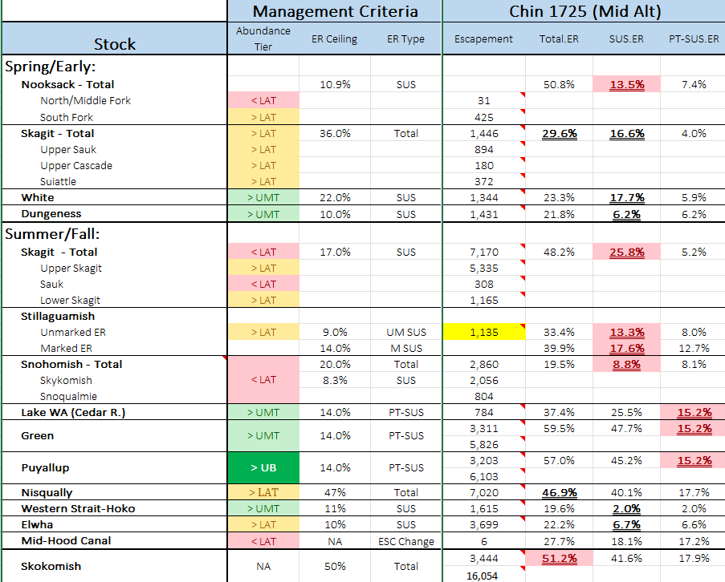
Chinook Modeling Results (Model #1725)
Notes:
2025 Mid Ocean option
Updates – NT and T PS Marine Commercial and Freshwater inputs, updated sublegal/legal ratios, Individual Stock Based Management (ISBM) and Aggregate Abundance Based Management (AABM) updates from Northern fisheries
-

Slide 15
Current Coho Modeling - Puget Sound
Management Unit | ER CEILING | Mid (2517)
Skagit | 60% | 48.2%
Stilly | 50% | 26.9%
Snohomish | 40% | 28.6%
Hood Canal | 45%* | 45.1%
Strait of Juan de Fuca tributaries | 40% | 9.1%
Interior Fraser (Thompson) | 10% SUS | 11.3%

Slide 16
Chinook – Current Proposed Season in modeling
MA 5/6 – July 1 - Aug 15
MA 7 – Thursday, Friday, Saturday openers July 17 – 19
MA 9 – Thursday, Friday, Saturday openers July 17 – 19
MA 10 – Thursday, Friday, Saturday openers July 17 – 19
MA 11 – Wednesdays through Saturdays in June. Thursday, Friday, Saturday openers in July starting July 17 – 19. Open 7 days a week August 1 – September 30.
MA 12 – July 1 SOA
MA 13 – No changes
Additional opportunity in MAs 7, 9, 10, and 11 will be provided as quota allows. As in recent seasons.
Winter seasons same as 2024-25.
Notes:
Pass to Lyle

Slide 17
Coho - Current Season in Modeling
MA 5/6: MSF 7/1-9/26, NS 9/27- 10/15
MA 7: MSF during Chinook openers in July, 8/1-8/30, NS 9/1-9/30
MA 8-1: NS 8/1-10/13
MA 8-2: NS 8/1-9/24
MA 9: MSF during Chinook openers in July, 8/1-9/23, NS 9/24-9/30
MA 10: NS 6/1 -11/15
MA 11: NS during Chinook openers in June and July and 8/1-11/15
MA12: SOA - July 1
MA 13: MSF 7/1/25 - 6/30/26
Notes:
*****Talk through changes from Tuesday night**
MA-9 – MSF 7/11 – 7/30, 3-day (Thurs- Sat), MSF 7/31 – 9/23, NS (1 Coho limit) 9/24-10/08

Slide 18
Marine Area Pink Fisheries
Adding 2 additional pinks to the daily limit in all inside Marine Areas except MA 8-2.
Strong returns expected to Hood Canal and South Sound.
2.5 million to Hood Canal.
4 million to Central and South Sound.
Conservation concerns for Stillaguamish pinks being forecast below escapement.
Preseason forecast is 25% below the 5 pink cycle average (2015-23).

Slide 19
Hood Canal Coho: Update
The Comprehensive Coho Management Plan and Pacific Salmon Treaty limit exploitation rates to 45% for mid-range forecast abundances and to 20% for critically low forecast abundances.
State and Tribal co-managers recognized the 2025 forecast abundance is just above the Critical Abundance threshold. Co-managers are planning to implement more conservative fisheries to reduce our combined exploitation rate below the allowable ceiling of 45%.
The current state proposal for sport fisheries reductions are:
Convert MA 9 non-selective coho fishery to mark-selective at the end of September.
Convert MA 12 coho fisheries to mark-selective.
Close MA 12 to recreational salmon fishing October 1 – 15. Reopen October 16
Notes:
Lyle, pass it off to Mark D

Slide 20
MA 7 Winter Chinook Proposal
Proposal: Remove fish from the MA 7 Summer Chinook quota to create a small MA 7 opening during the winter.
Short duration increases uncertainty of the estimates
Compounds with a small quota and high interest from anglers.
Increases likelihood of exceeding impacts.
Monitoring staff and expenses, are not easily transferrable to other fisheries.
Budget uncertainties in the next biennium limit the agency’s ability to commit to additional sampling efforts.

Slide 21
Lake Washington Chinook Proposal
Proposal: 3-Day Chinook opener in the North end of Lake Washington over Labor Day weekend.
Potential marine area reductions could be needed to account for impacts in a lake fishery.
Fishery would require additional monitoring resources.
Budget uncertainties in the next biennium limit the agency’s ability to commit to additional sampling efforts.
WDFW will continue to explore pathways to a future Lake Washington Chinook opportunity.

Slide 22
Freshwater Fisheries
Notes:
Pass to Julie

Slide 23
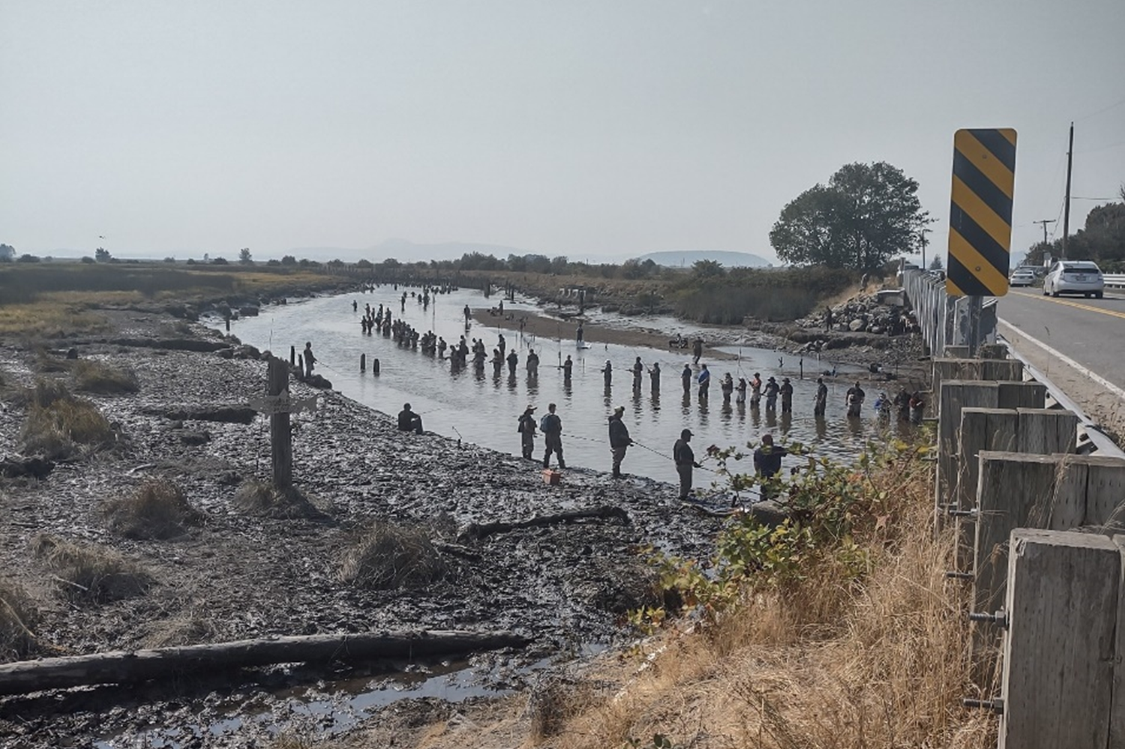
Freshwater Proposed Seasons – North Sound
Nooksack
After September 30, closed to sport fishing downstream of I-5 to avoid gear conflicts with comanagers.
Coho, Chum, Pinks – Mainstem Nooksack. Daily limit 6 which may include up to 4 pinks, up to 2 chum, and no more than 2 wild coho.
No sport hatchery Spring Chinook fishery due to low forecast
Samish
Regular issues and
complaints from anglers and neighbors:
Safety (anglers hit by gear)
Snagging
Crowding
Trespassing
Samish 2022 season. Some anglers described 2023 as even more crowded than 2022.
Photo credit: anonymous angler sent this to WDFW

Slide 24
Freshwater Proposed Seasons – North Sound
Samish Proposals
Mouth to Thomas Road
Stationary Gear rule
Stationary gear restriction means the line and weight and lure or bait must be moving while in the water. The line and weight and lure or bait may not be stationary.
Hook size restriction. Maximum hook gap of 1/2” from point to shank.
Extend fishing season through September 30, 2025.
Proposing an eggs-only and unweighted tackle only section from the Bayview-Edison Rd bridge upstream to wing wall (approx. 1000 ft). See next slide.
Proposing a Veterans/active military day and a youth fishing day in the eggs-only section. Dates TBD
All area from mouth to hatchery rack, when not open for Chinook, closed waters through 10/31.
Documented enforcement issues with regular trespassing complaints, and snagging Chinook.
Agricultural concerns about tainting organic fresh-to-market crops
Requested by enforcement and some neighbors.

Slide 25
Proposed Samish River Eggs-Only Unweighted Tackle Only Section

Slide 26
Freshwater Proposed Seasons – North Sound
Skagit
Hatchery spring Chinook – Similar lower and upper area fisheries as 2024.
Sockeye – river and lake opportunity.
Mount Vernon to Dalles Bridge: 4 fish limit, proposing 2 pole ok for 2025.
Baker Lake 6 fish limit in lake. Proposed open: Jul-12 (Even with zero hauled. Monitor trap count to make sure a trip is right for you.) https://wdfw.wa.gov/fishing/reports/counts/baker-river
Pink and Coho, 2 each per day (hatchery or wild for coho)
In General: Pink open Aug-16. Coho open 9/1 mouth to Gilligan.
Likely gamefish restrictions upstream of Dalles to protect Chinook.
Sauk summer Chinook struggling
Notes:
Pass to Andrew

Slide 27
Freshwater Proposed Seasons – Central Sound
Stillaguamish River
Coho, mainstem (Marine Dr. Br to confluence NF and SF), Sept. 13 – Nov. 30. No bait.
Fly-only trout, North Fork, mouth to Cicero bridge, Aug. 30 – Nov. 30.
Snohomish River
Pink and Coho, Mouth to Confluence of Skykomish and Snoqualmie, Aug. 23 - Nov. 30. No bait.
Skykomish River
Chinook MSF, mouth to Wallace R., (currently modeled for June 21 – July 13, 23 days). Bait allowed.
Summer steelhead opening around Reiter (from RR trestle at High-Bridge to confluence of NF and SF Skykomish, June 21 – July 13). No bait.
Coho and Pink, Oct. 11 – Nov. 30. No Bait.
Wallace River
Coho, Oct. 11 – Nov. 30. No bait.
Snoqualmie River
Coho, Nov. 1 – 30.
Notes:
Pass to Pete

Slide 28
Freshwater Proposed Seasons – Central Sound
Lake Washington: Sept 16 - Oct 31: Coho only (Daily limit 4).
Dependent on In-Season Update (ISU) at Ballard Locks.
Lake Sammamish: Oct 1 - Nov 30: Coho only (Daily limit 4).
Also dependent on ISU at Ballard Locks.
Green/Duwamish:
Harbor Island to Tukwilla Intl. Blvd.
Aug 20-Dec 31: Daily limit 6, up to 3 adult coho/chum, release Chinook.
Tukwilla Intl. Blvd. to South 212th St. Bridge.
Aug 20-Dec 31: Daily limit 6, up to 3 adult coho/chum, up to 2 Chinook.
Chinook retention dependent on ISU (Tribal Test Fishery in Elliot Bay).
South 212th St. Bridge to the Hwy. 18 Eastbound Bridge.
Sept 16-Dec 31: Daily limit 6, up to 3 adult coho/chum, release Chinook.
Auburn-Black Diamond Road Bridge to the Tacoma Municipal boundary.
Nov 1-Dec 31: Daily limit 6, up to 3 adult coho/chum, release Chinook.
Notes:
Pass to Aaron.

Slide 29
Freshwater Proposed Seasons – South Sound
Minter Creek - Proposed Chinook closure (Sep. 1-Oct. 15) from Creviston Drive to boundary markers below hatchery rack due to ongoing angler behavior issues. The lower fishery regulations will remain unchanged from the 2024 season.
Puyallup & Carbon– Similar seasons relative to 2023, Daily limit 6, Up to 4 adults with no more than 2 Chinook or coho or 1 of each.
Nisqually – Similar Seasons to 2024, July 1-Nov. 15, Daily limit 6 with no more than 2 adults.
Notes:
Pass to Gabe. Only difference with last year’s fisheries is that the Puyallup is allowing 4 adults, only 2 adults are allowed to be Chinook or coho.

Slide 30
2025 NOF meeting schedule
Date | Meeting
March 19 | North of Falcon #1 – Statewide proposals
March 24 | PFMC public hearing – Westport, WA
March 25 | North of Falcon #2 – statewide proposals
April 1 | Coastal freshwater and Puget Sound recreational fisheries
April 2 | Willapa Bay and Grays Harbor fisheries
April 3 | Columbia River Fisheries – Buoy 10 to Hwy 395 Bridge at Pasco, WA
April 3 | Puget Sound freshwater and Puget Sound recreational fisheries
April 9-15 | Pacific Fishery Management Council meeting – San Jose, CA
Registrations links and meeting materials are available on the WDFW website.
Notes:
Pass to Jake

Slide 31
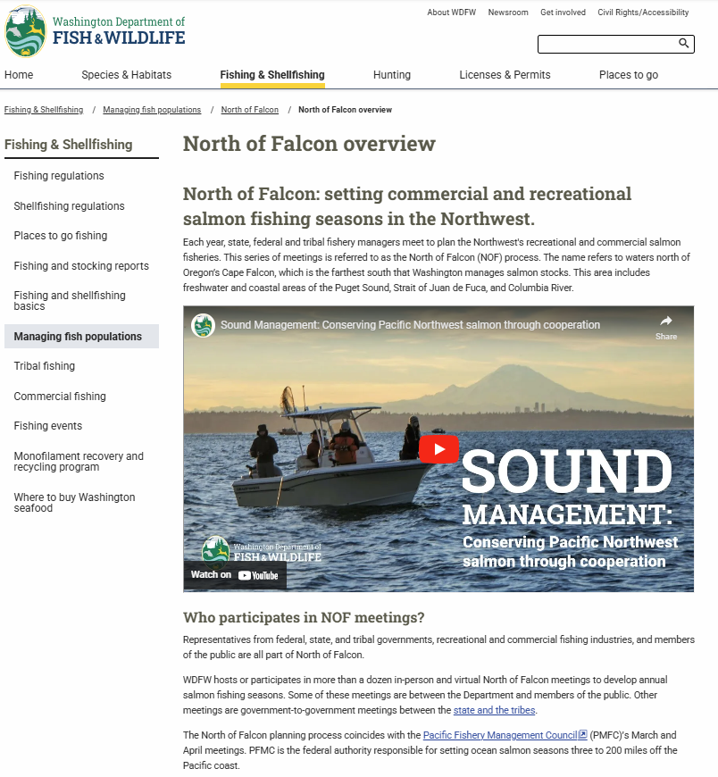
Learn more at WDFW.wa.gov/NOF
Find up-to-date information about:
Upcoming meetings
Proposed seasons
Updated forecasts and model runs
Public input opportunities
Salmon Fishing Current blog

Slide 32
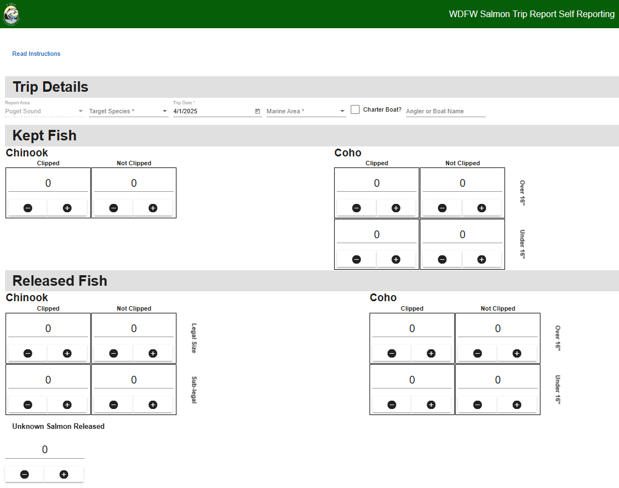
Salmon Trip Report
Anglers are encouraged to fill out Salmon Trip Reports (STR)
Link to online reporting: https://str.wdfw-fish.us/home
Link to the website: https://wdfw.wa.gov/licenses/fishing/trip-reporting
Notes:
Anglers are encouraged to fill out salmon trip reports. These are an important evaluation tool in our monitoring efforts.

Slide 33
Questions?
Request this information in an alternative format or language at wdfw.wa.gov/accessibility/requests-accommodation, 833-885-1012, TTY (711), or CivilRightsTeam@dfw.wa.gov.

